Slide 1
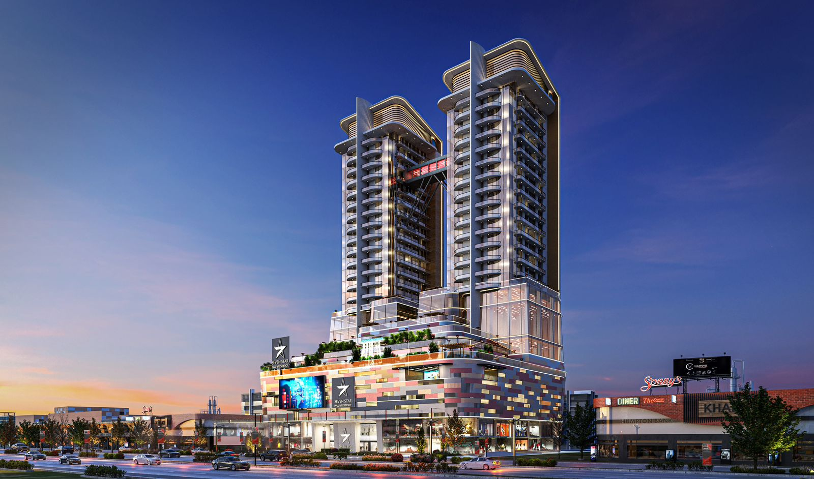
Seven Star Mall & Residency

Slide 2
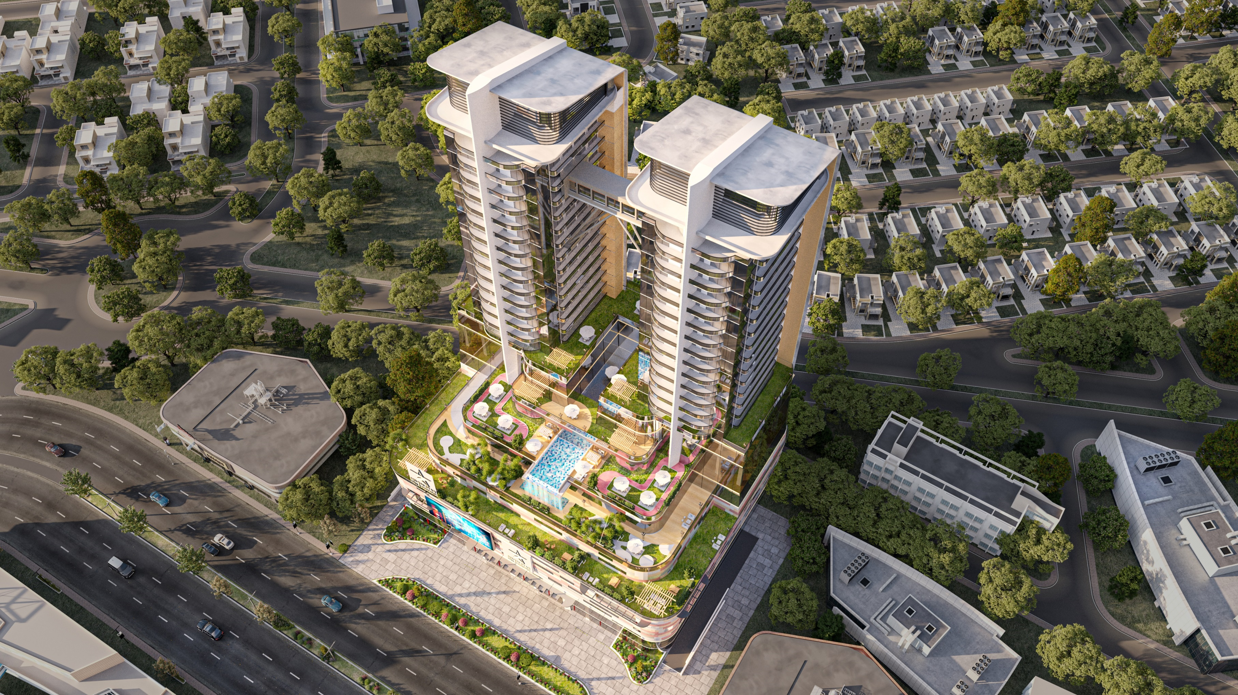

Slide 3
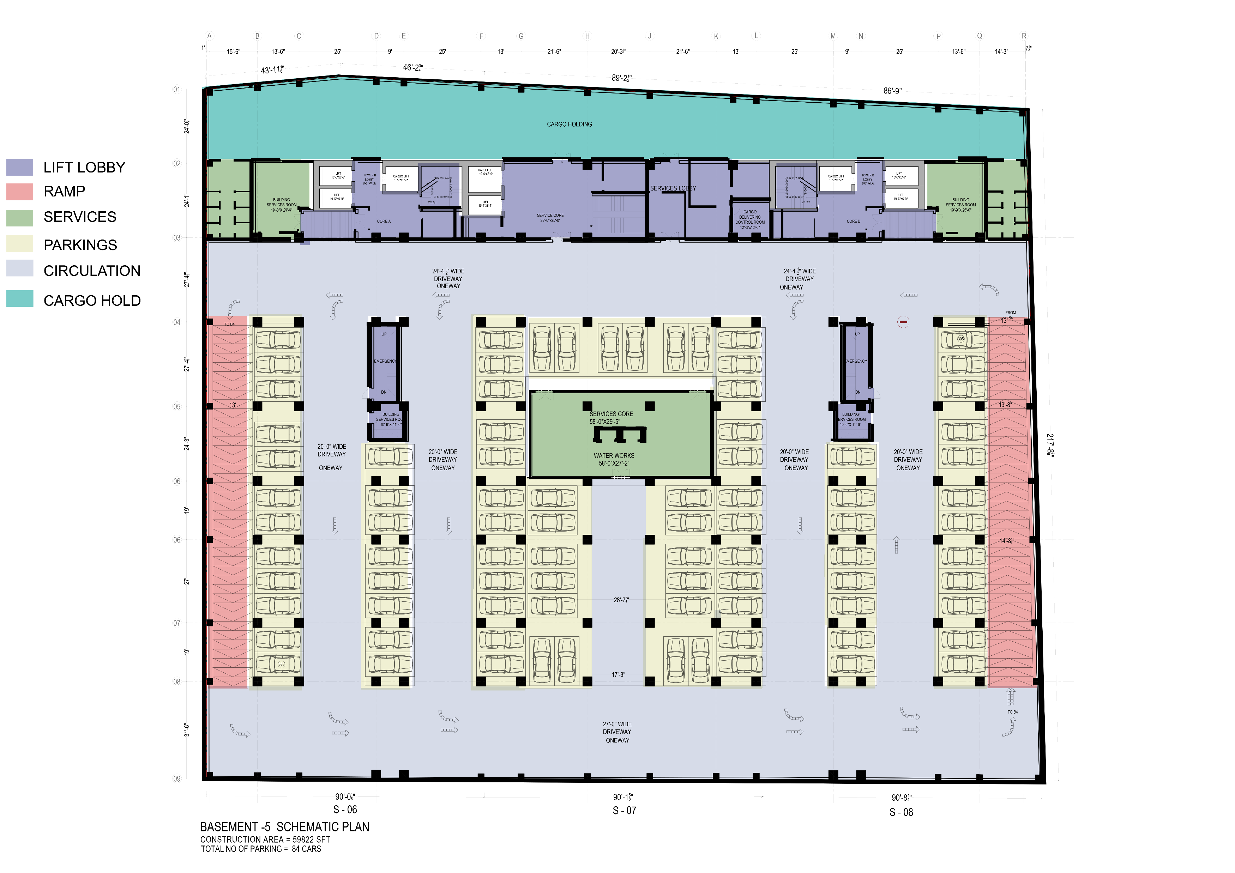

Slide 4
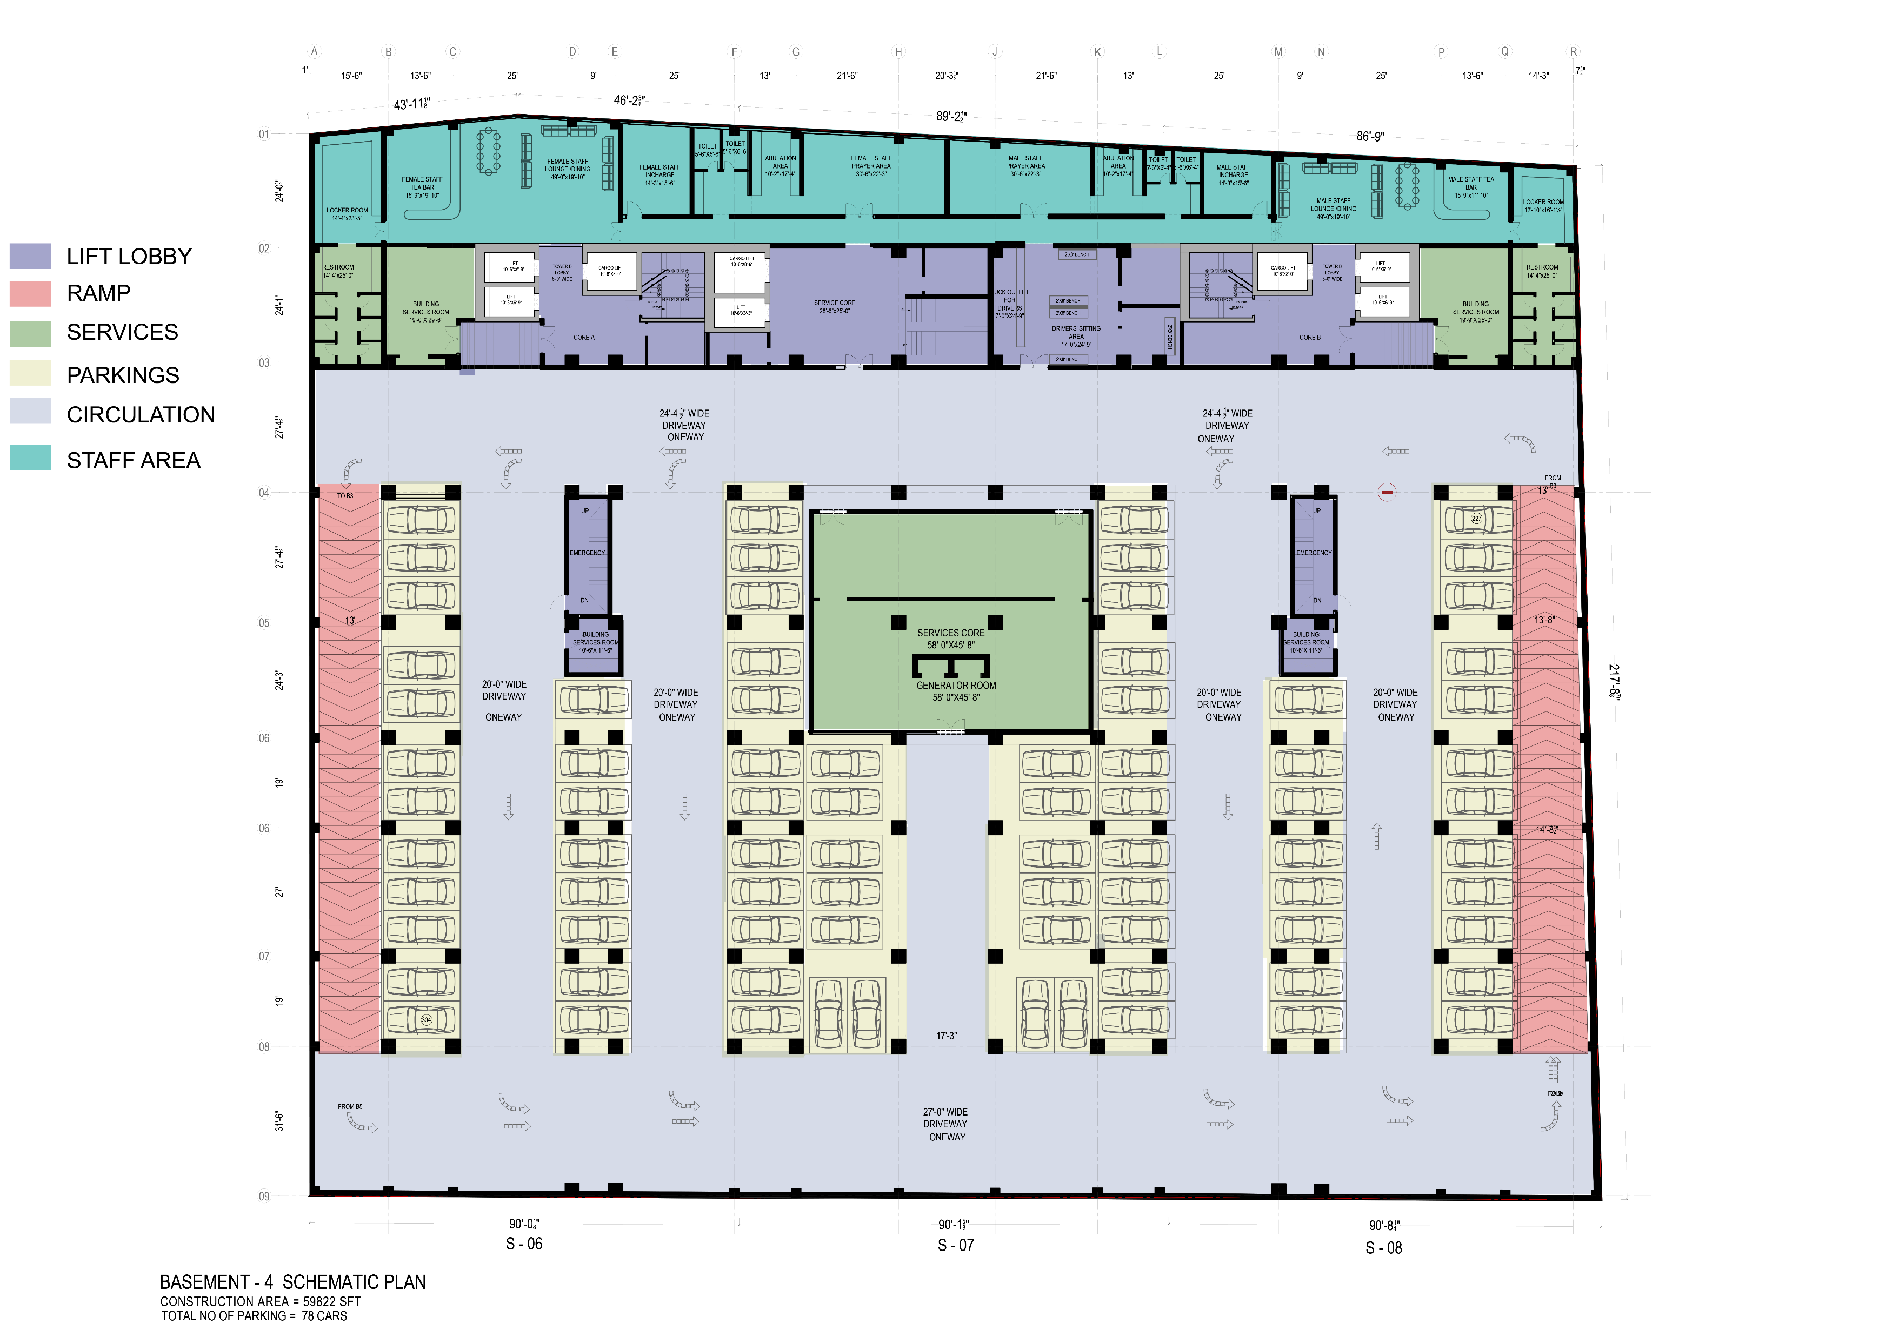

Slide 5
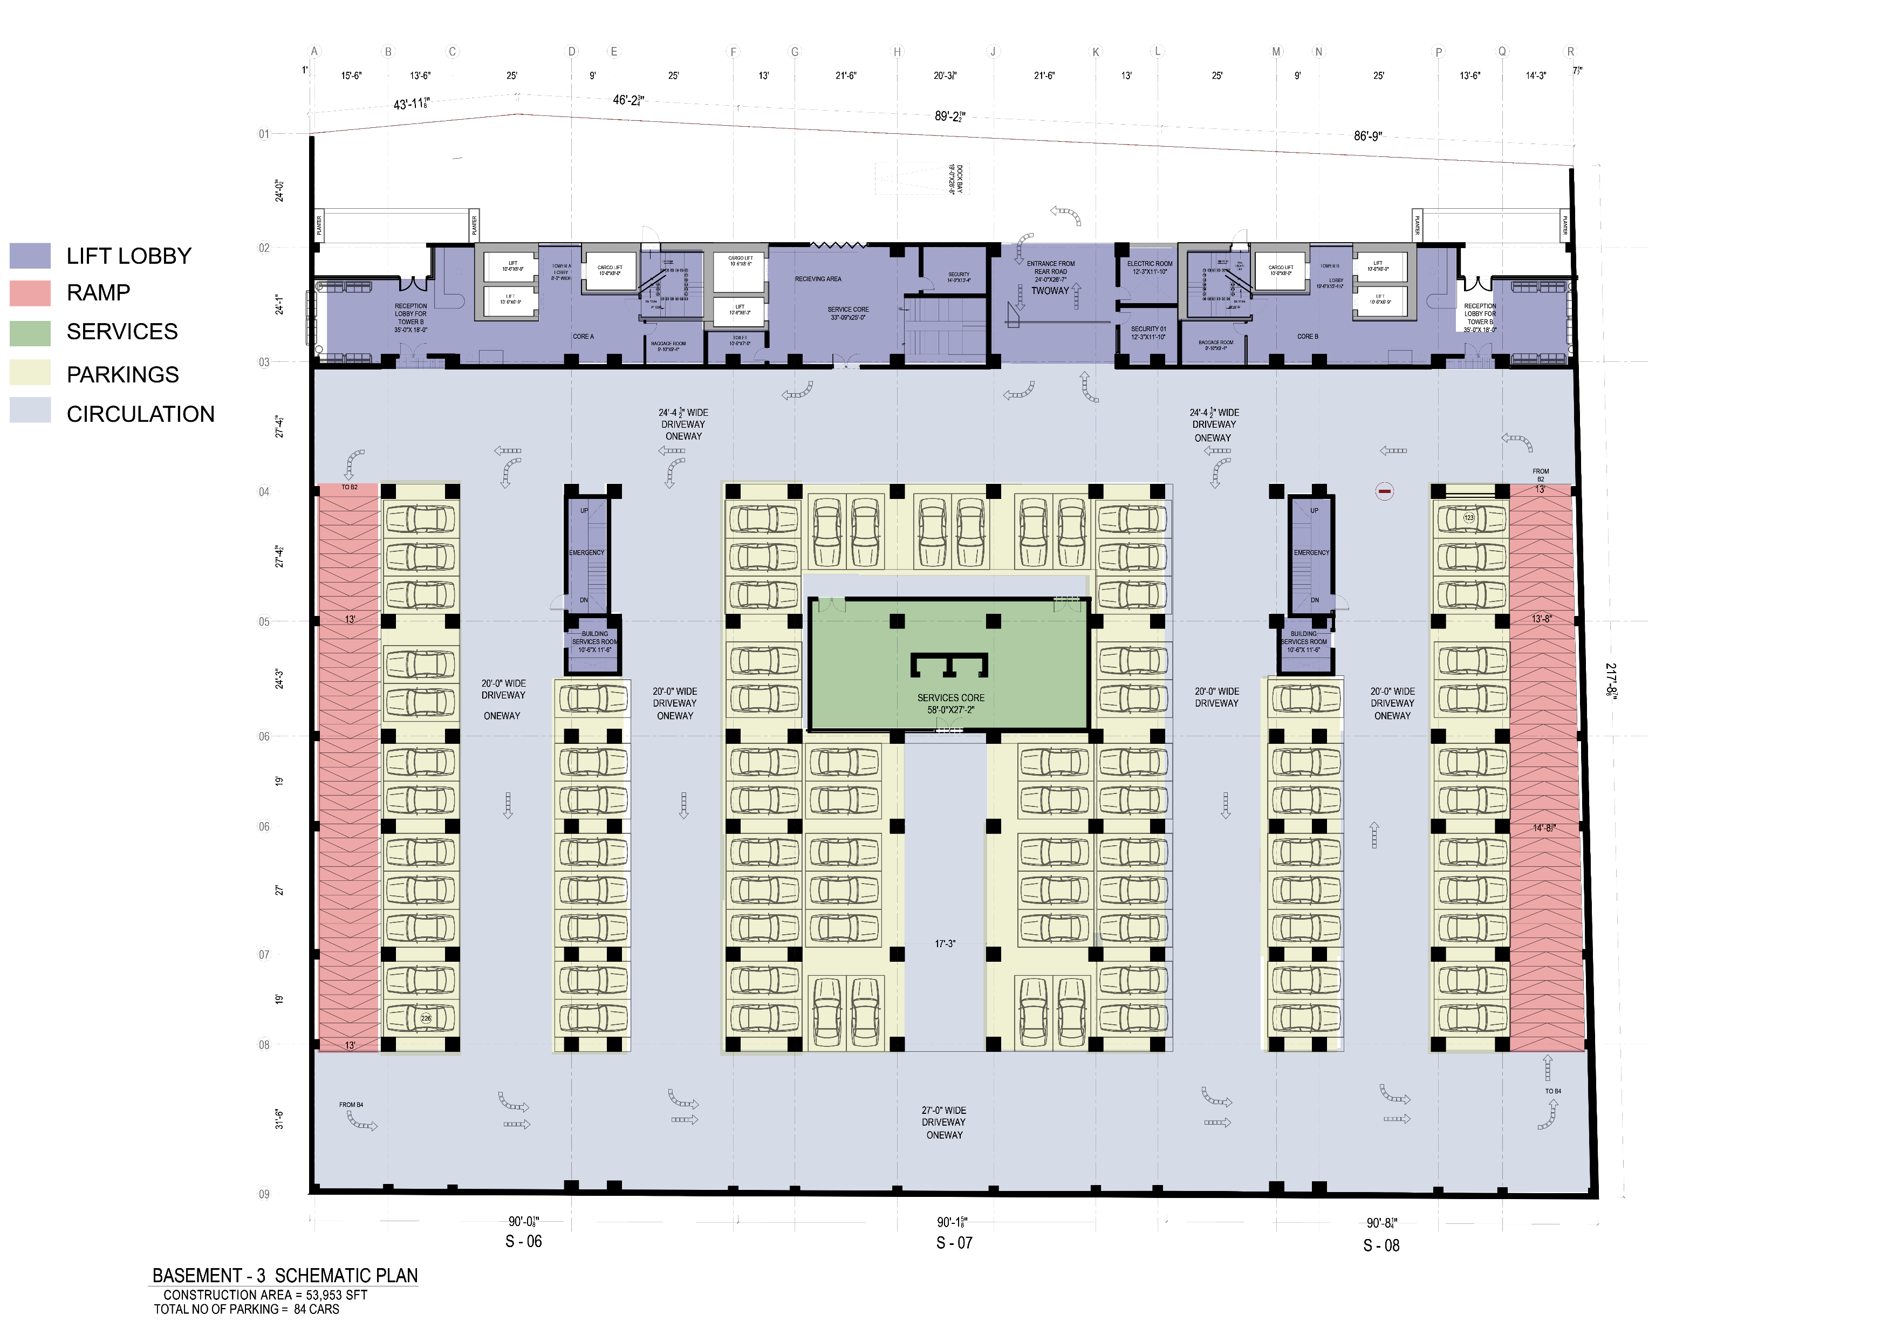

Slide 6
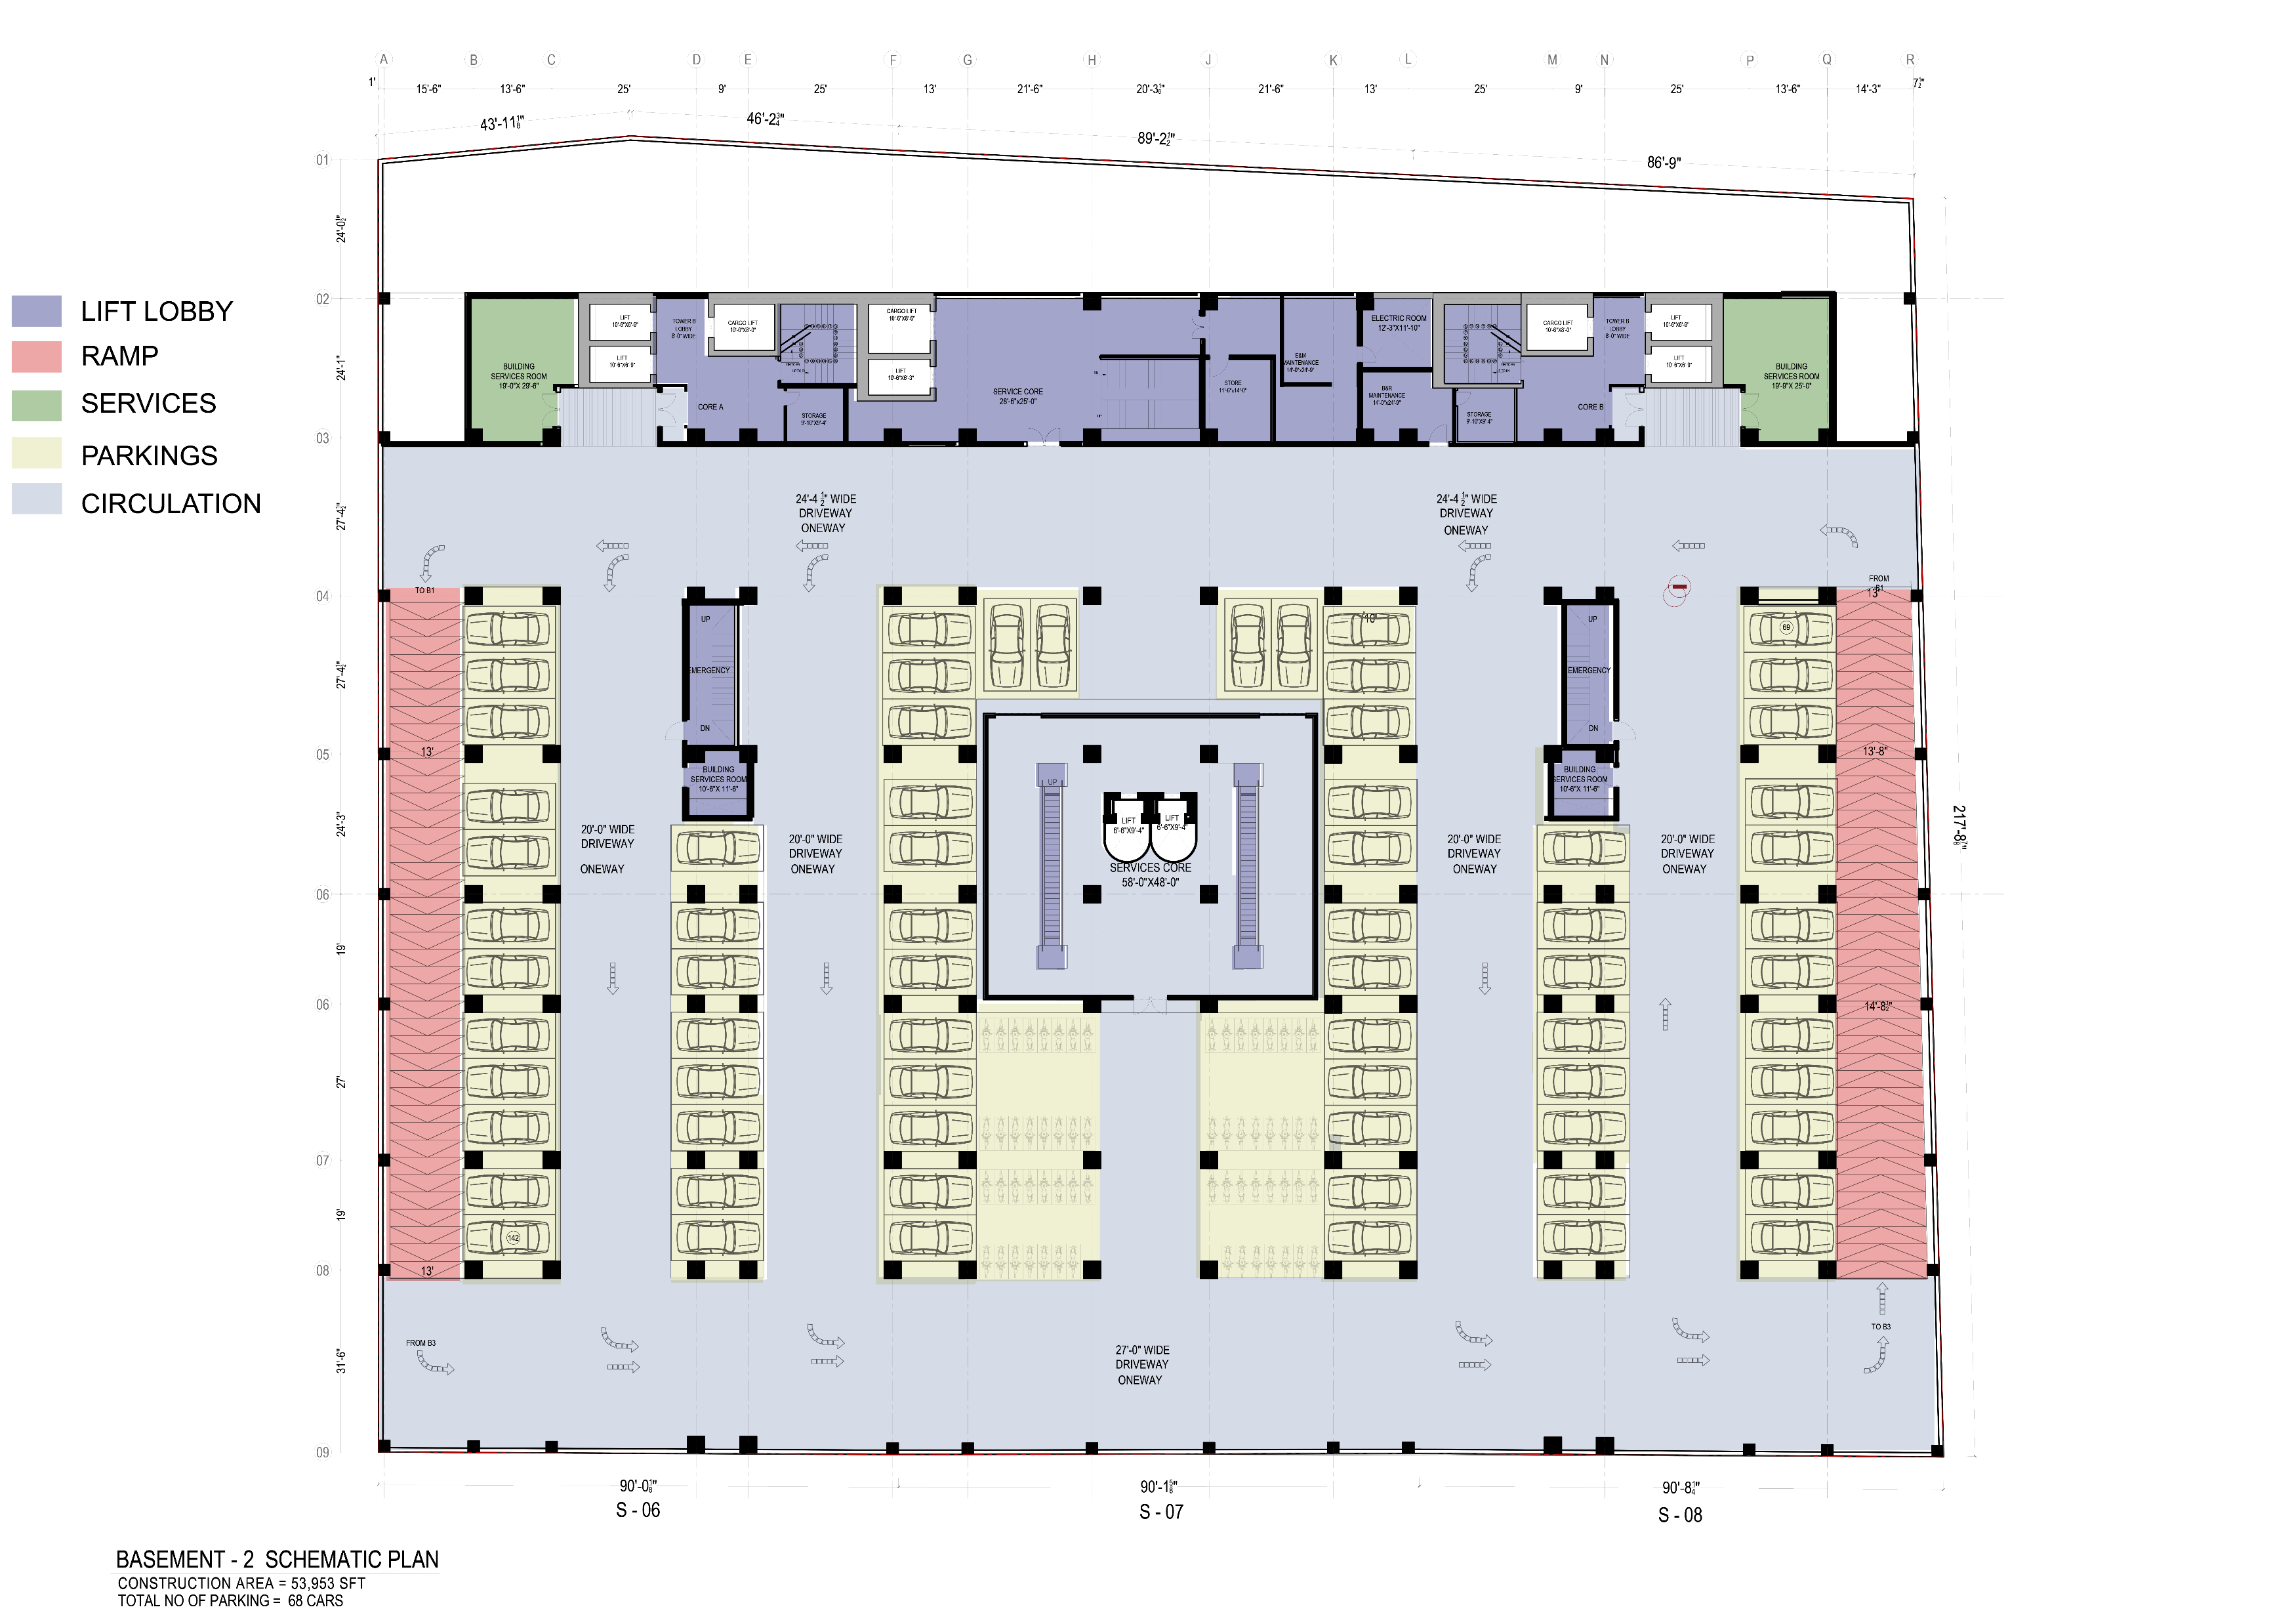

Slide 7
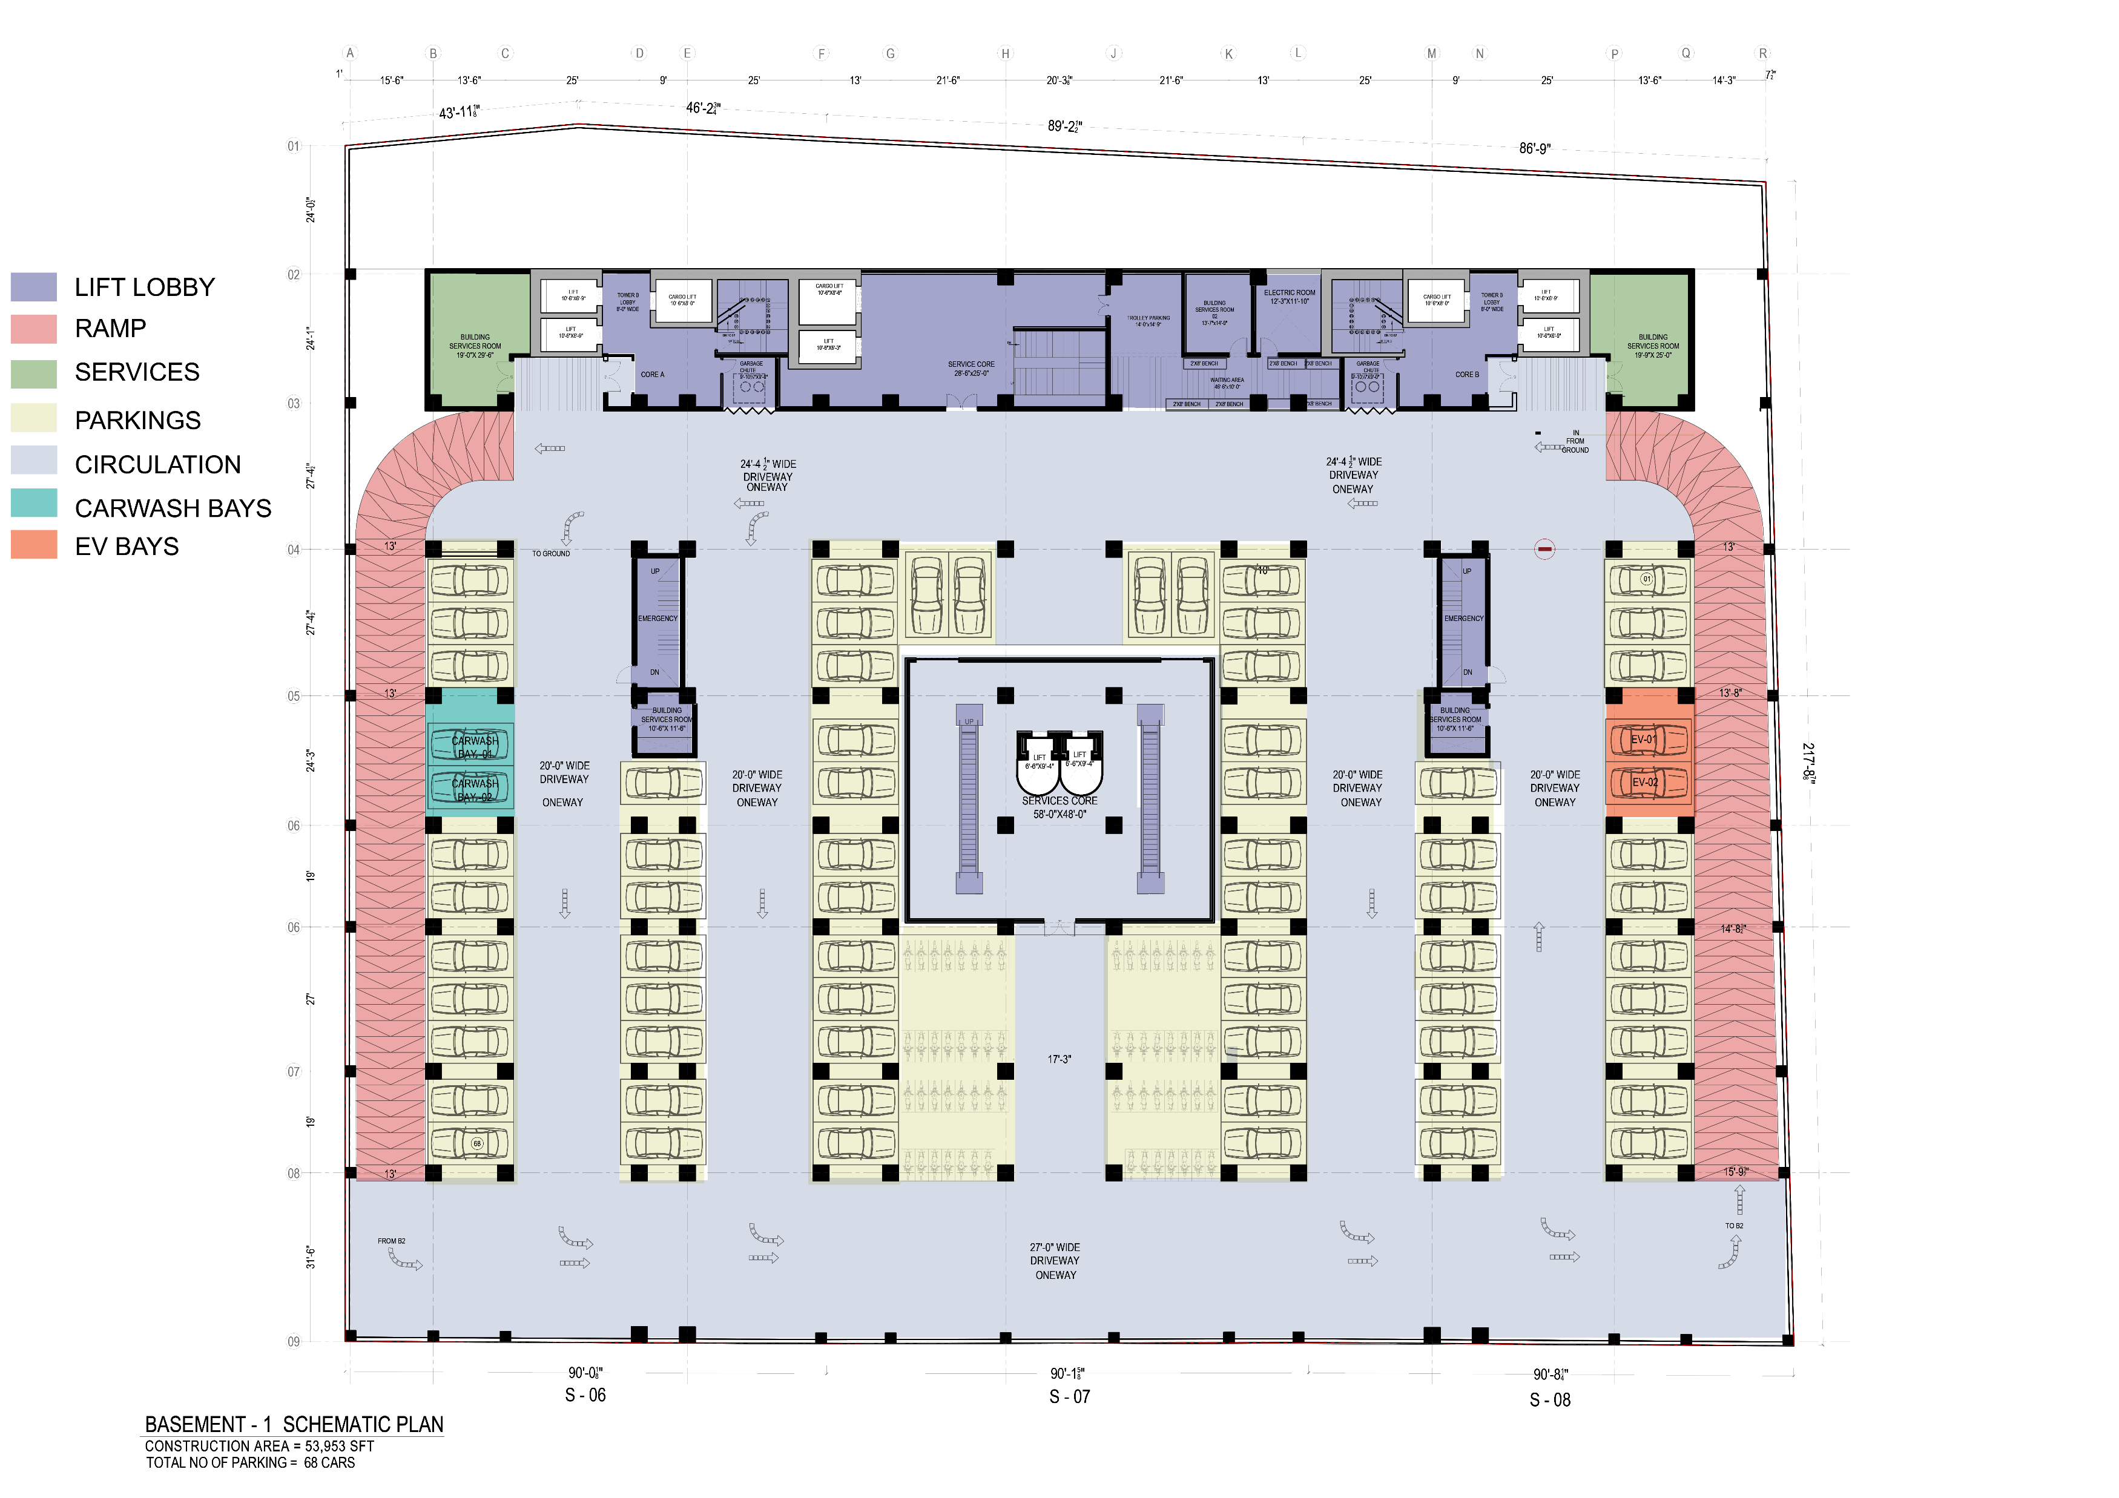

Slide 8
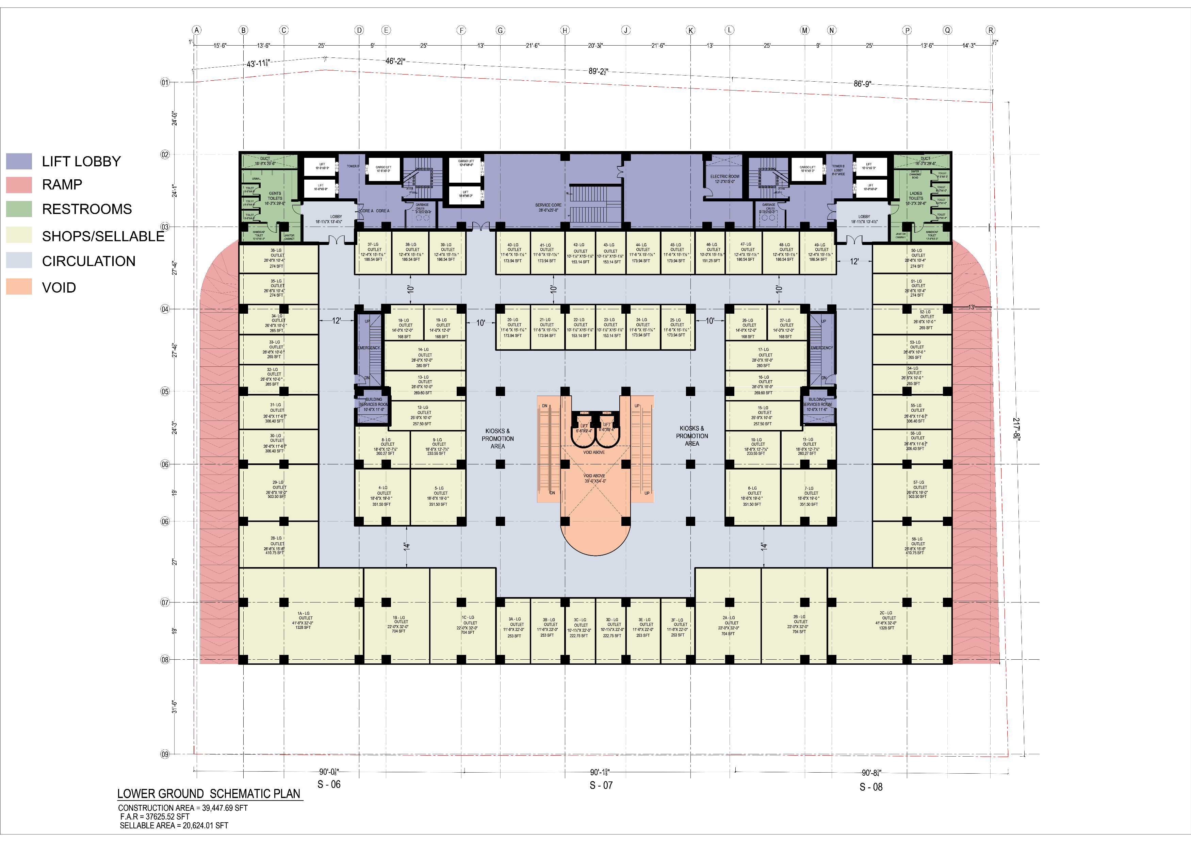

Slide 9
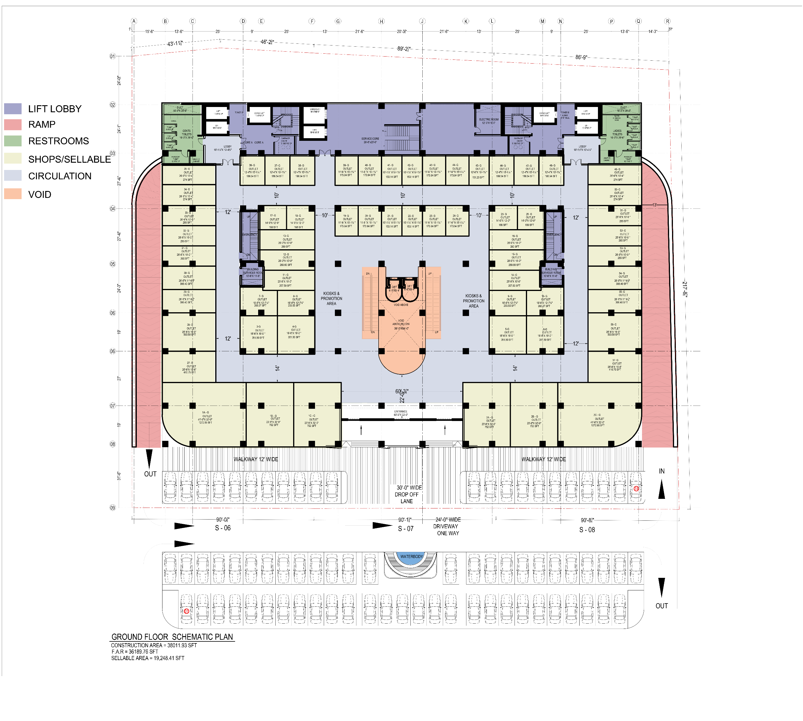

Slide 10
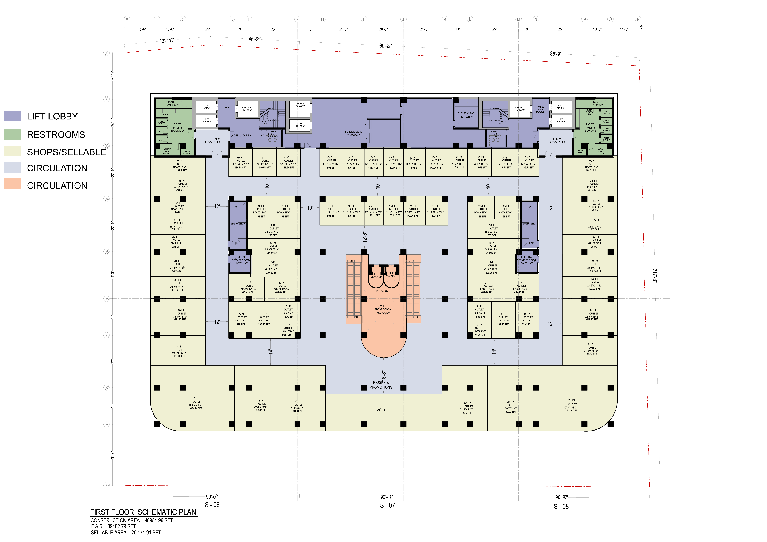

Slide 11
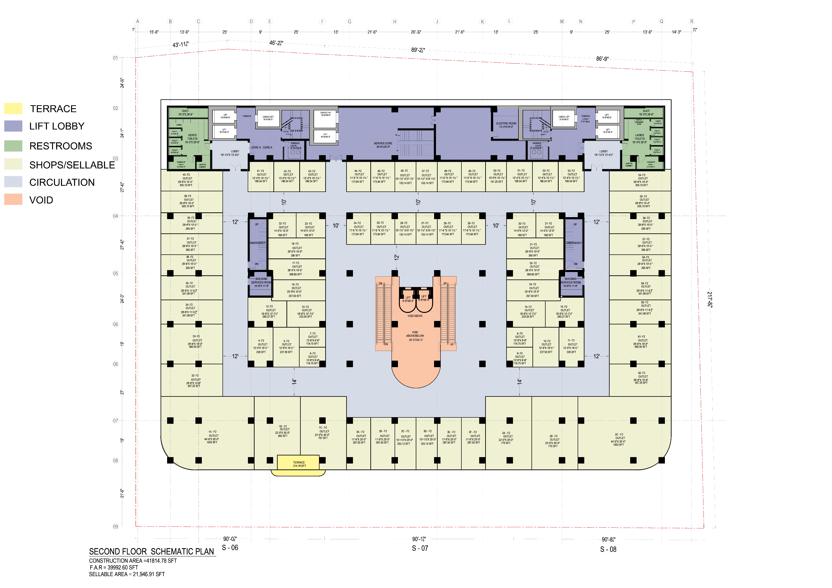

Slide 12
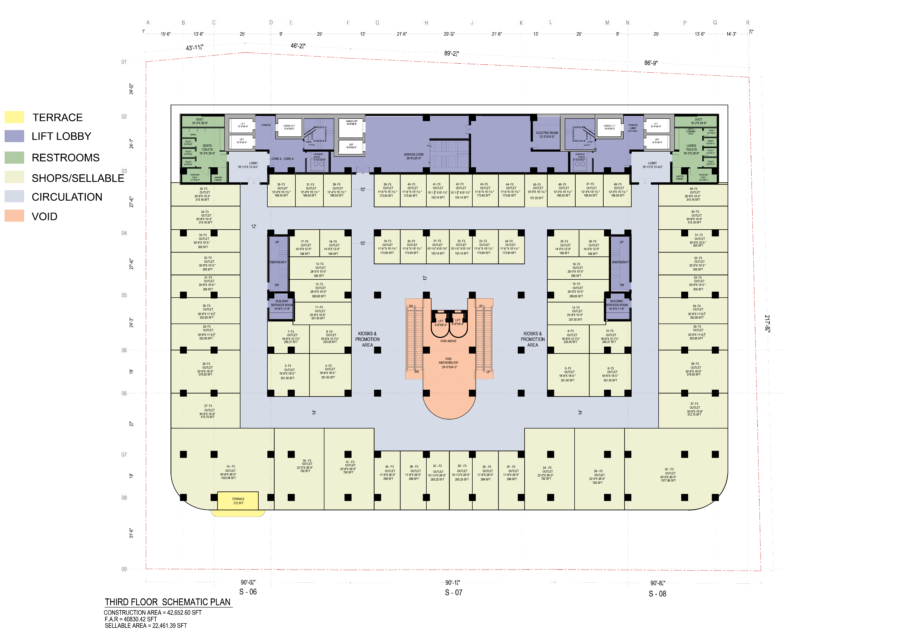

Slide 13
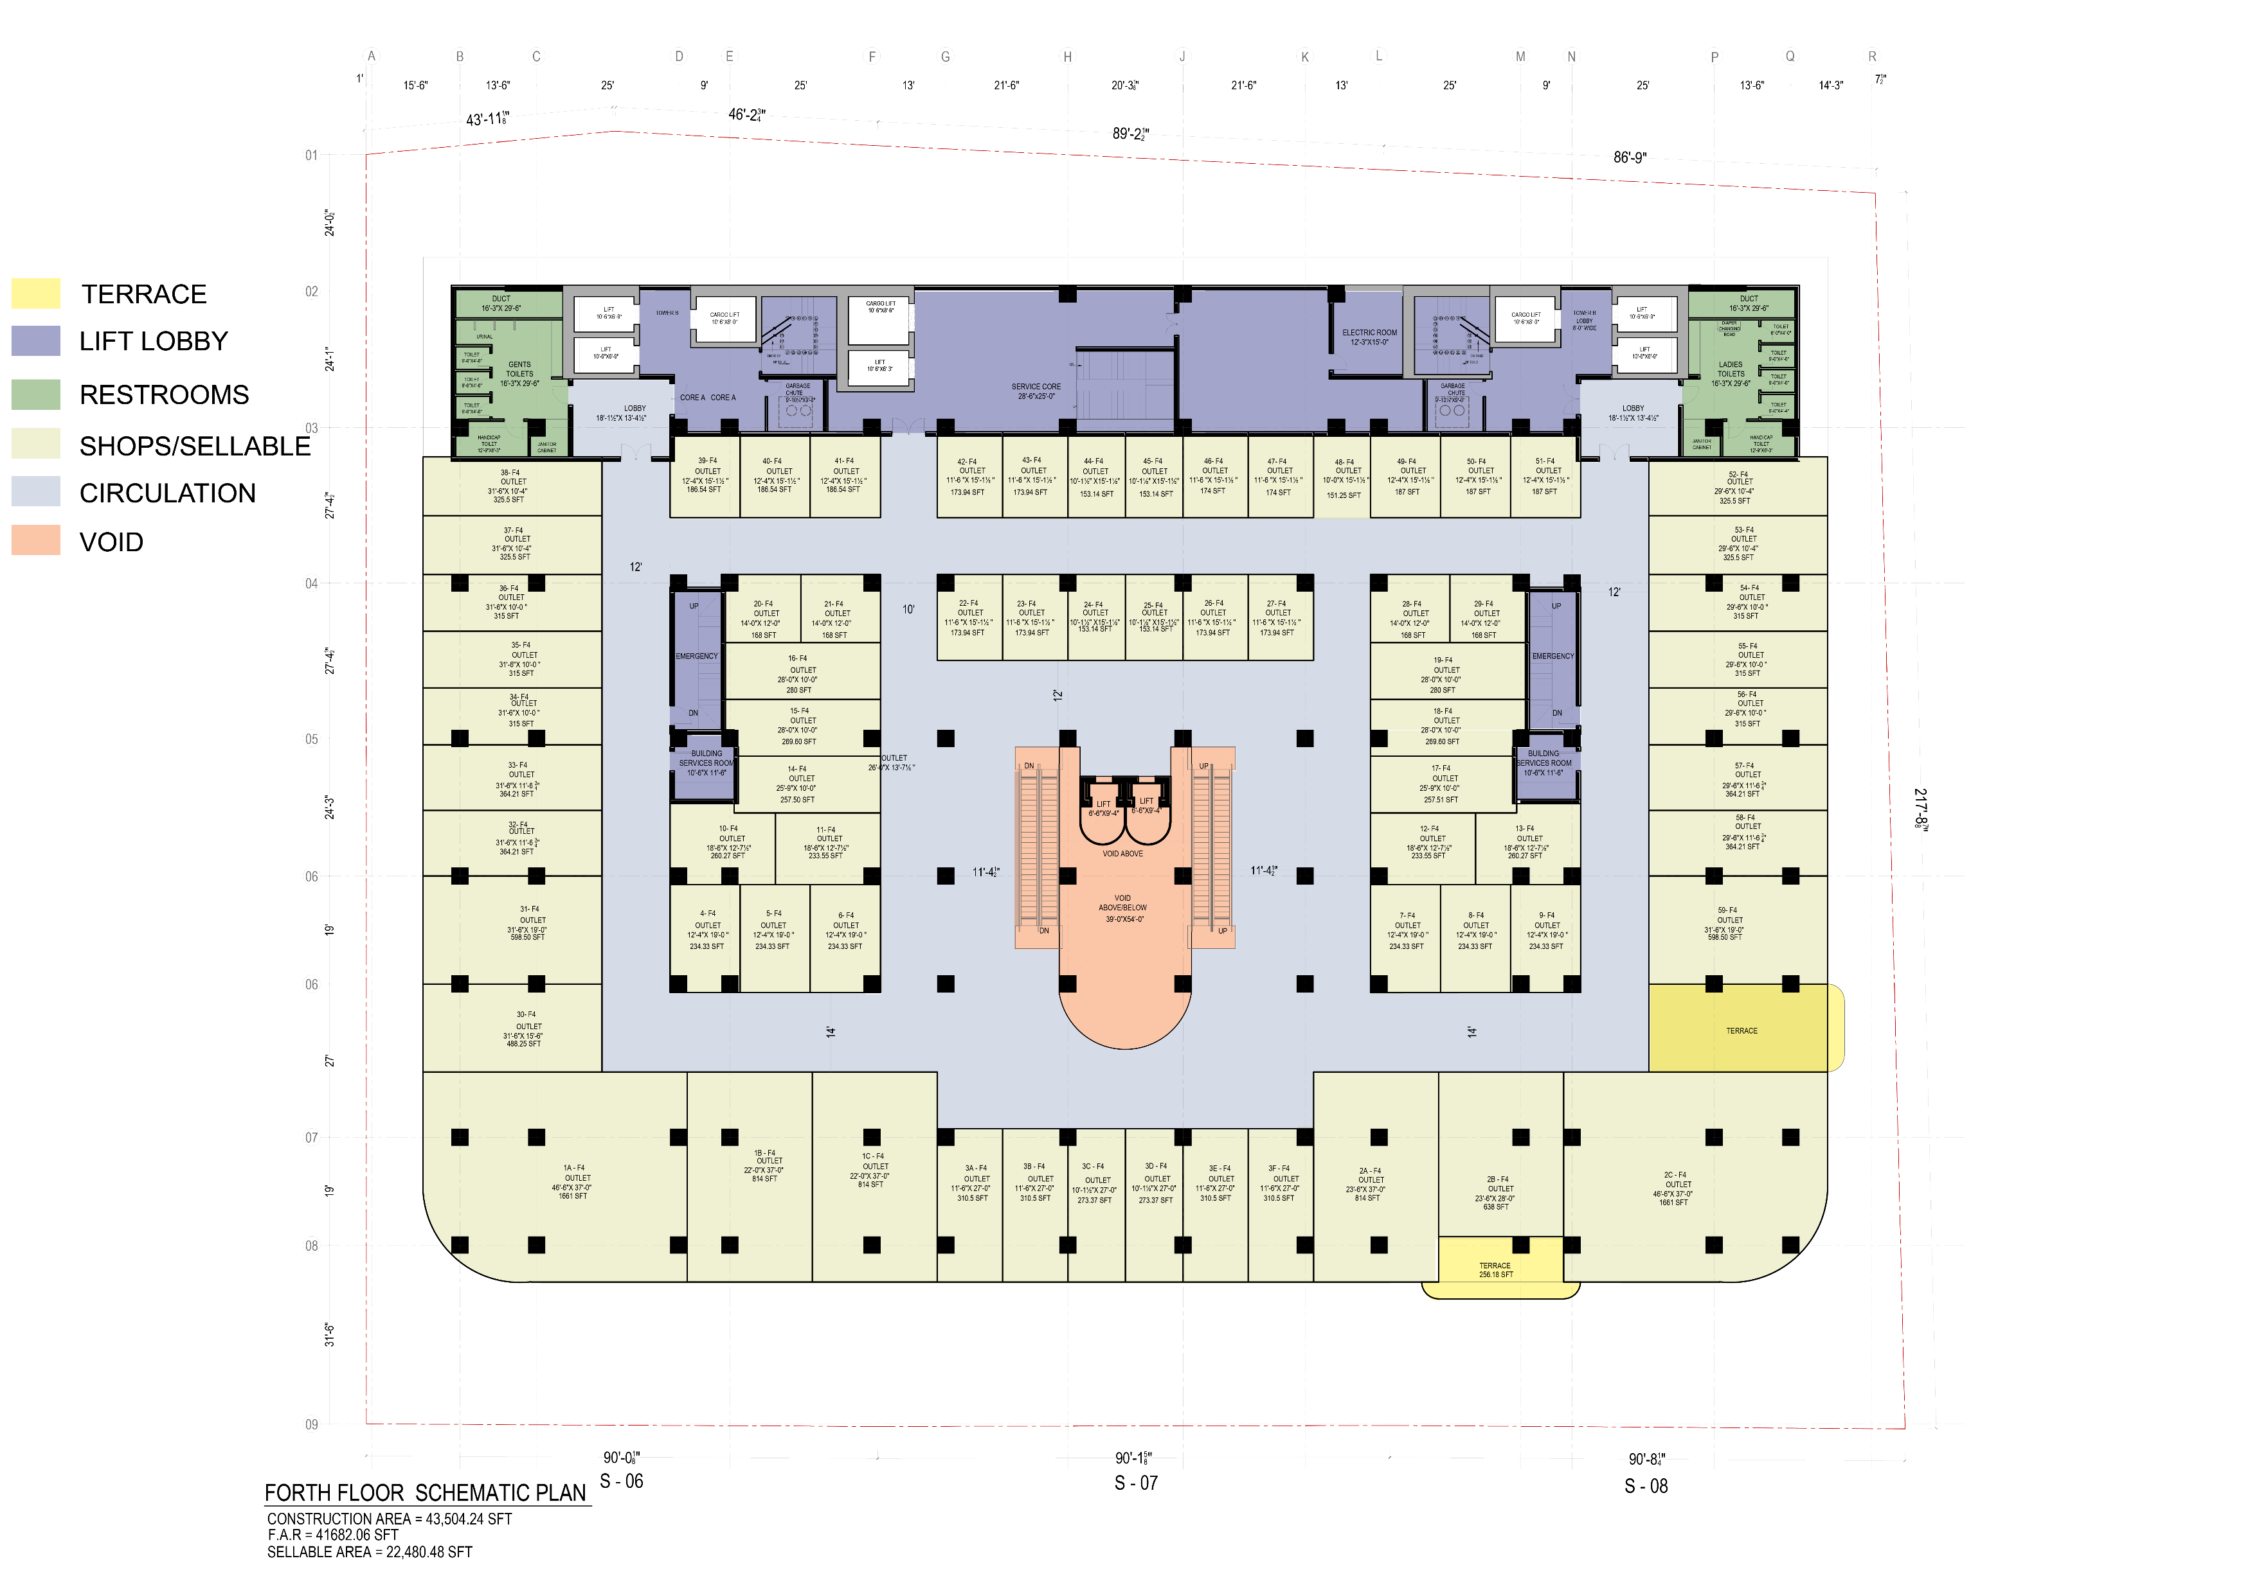

Slide 14
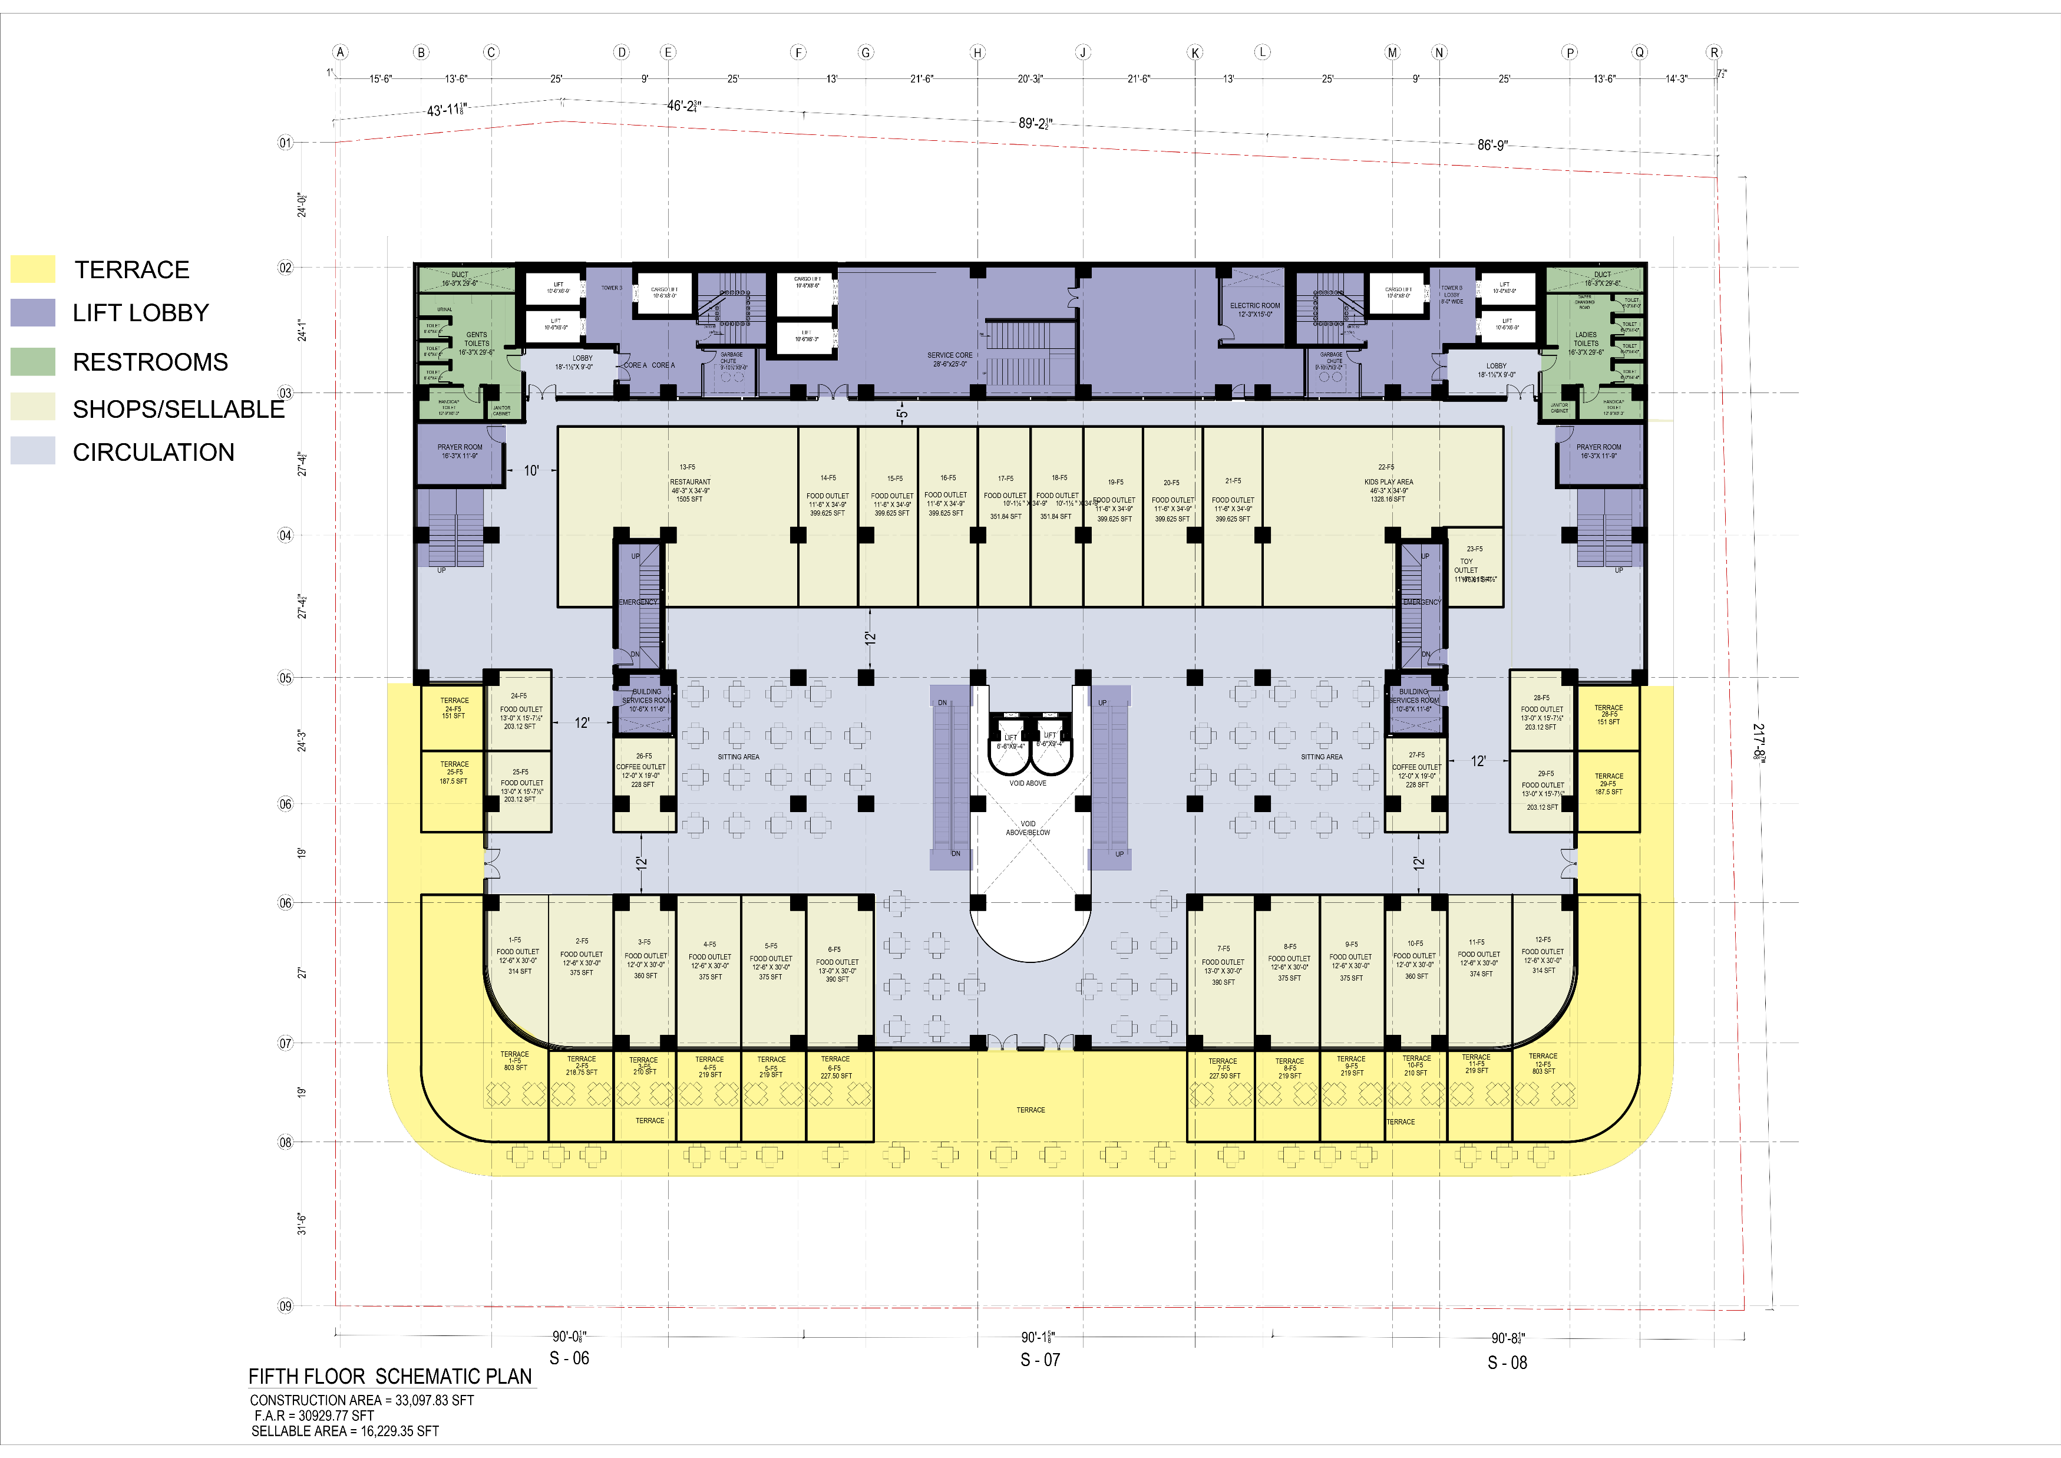

Slide 15
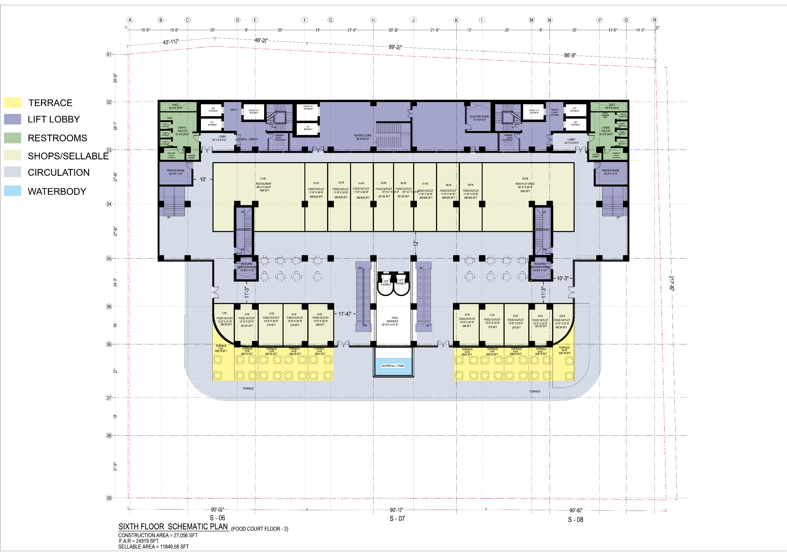

Slide 16
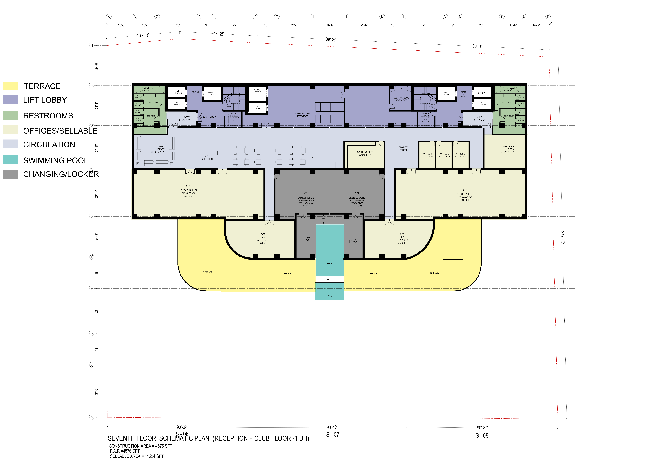

Slide 17
TOWER A & B | FLOOR PLANS

Slide 18
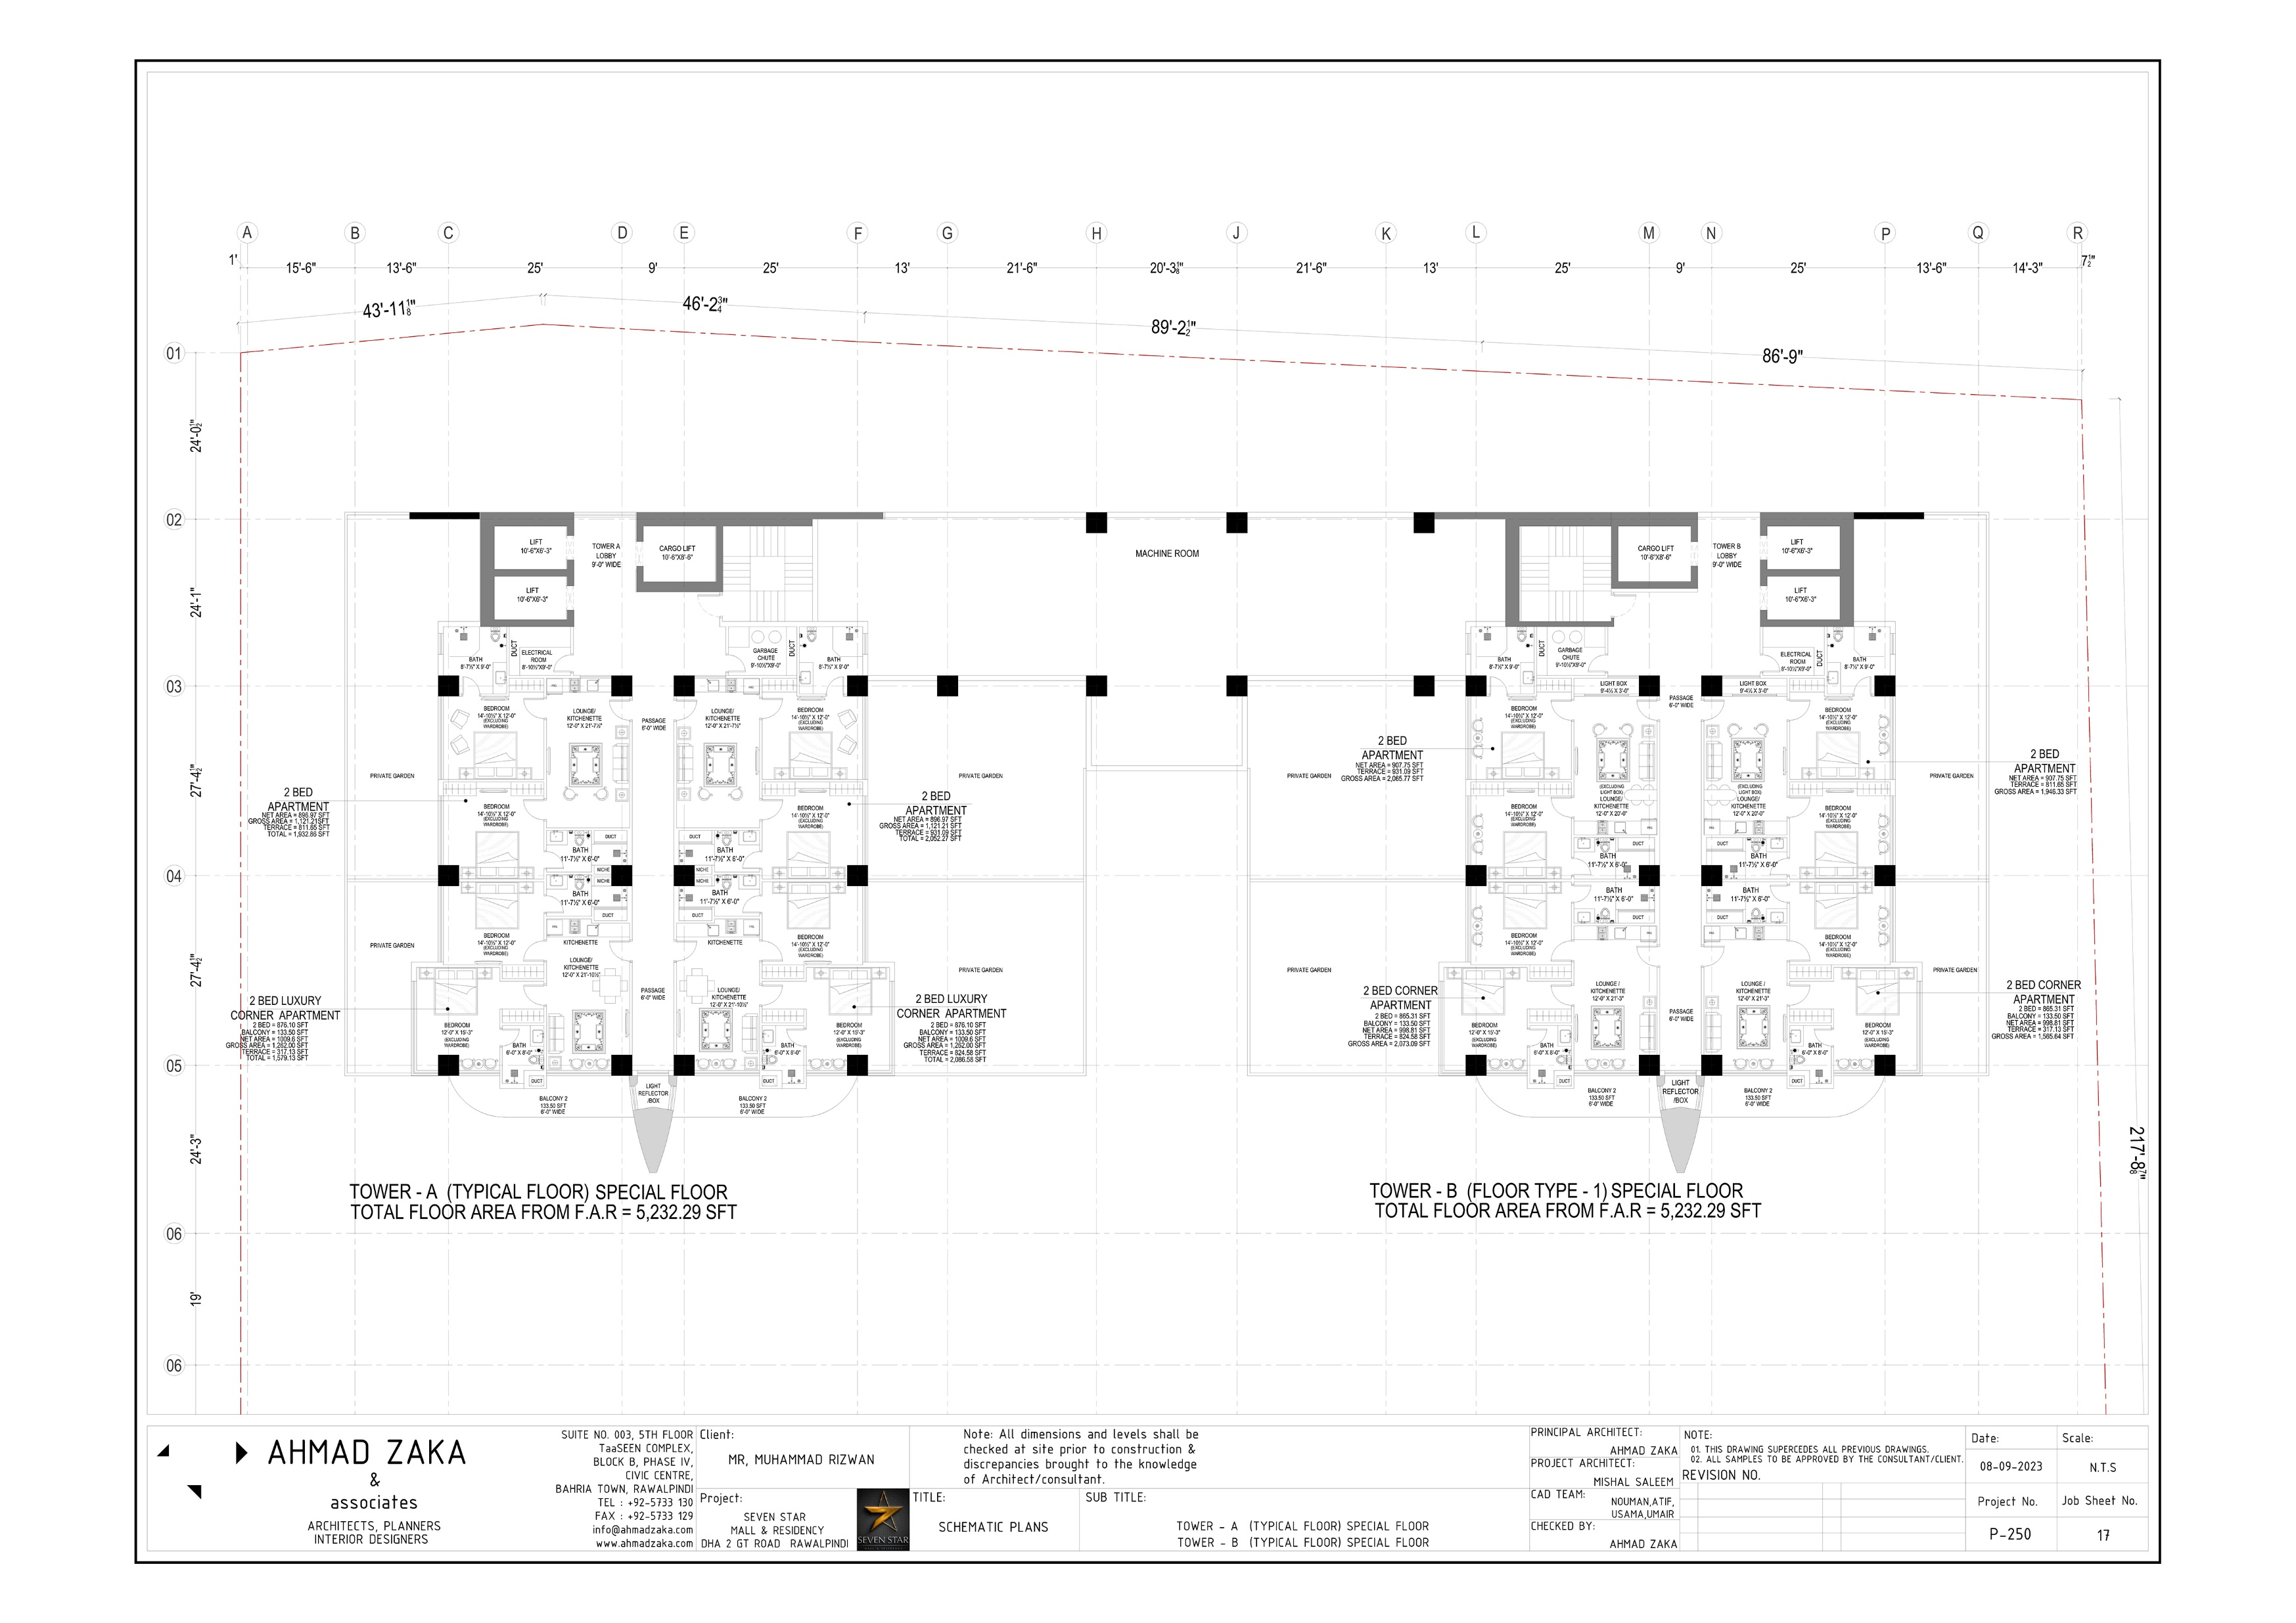
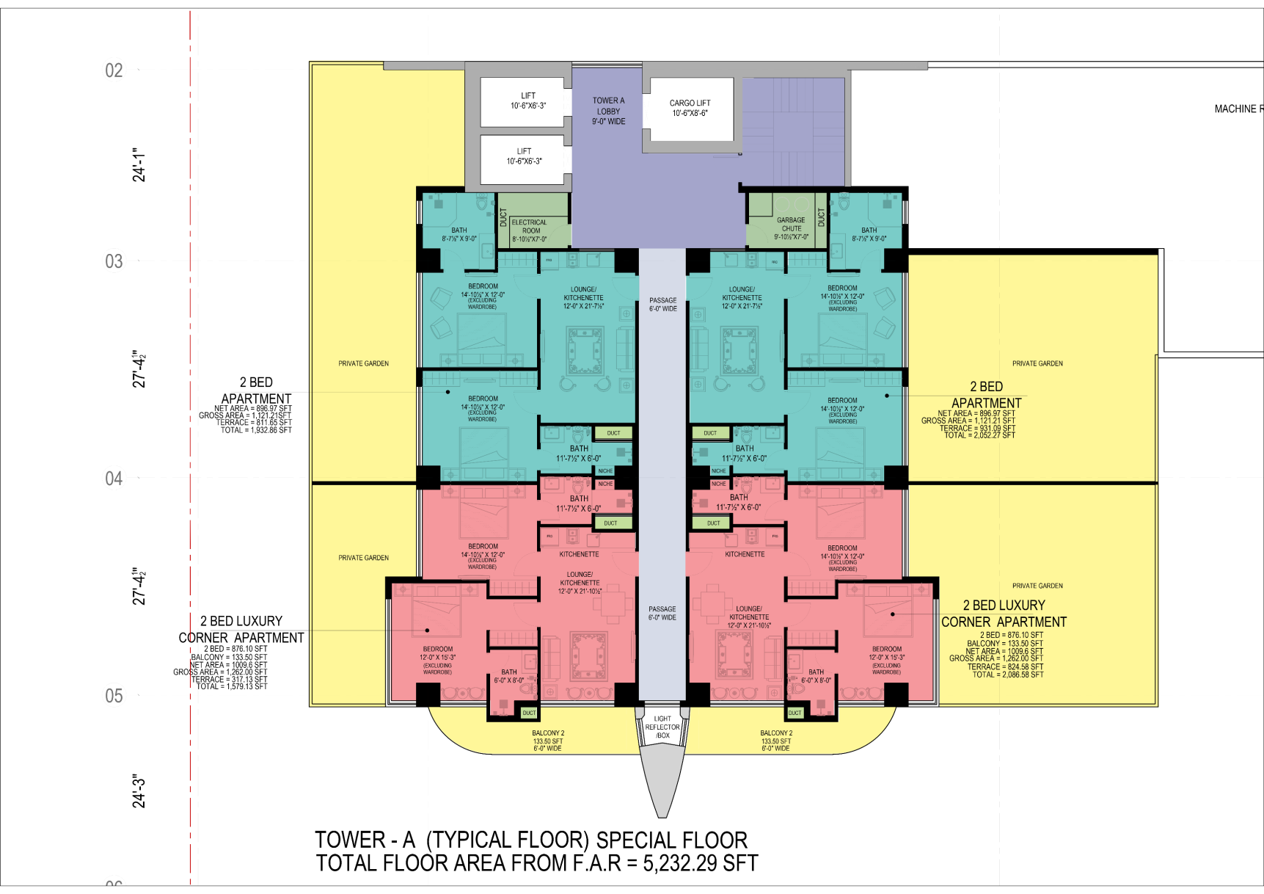
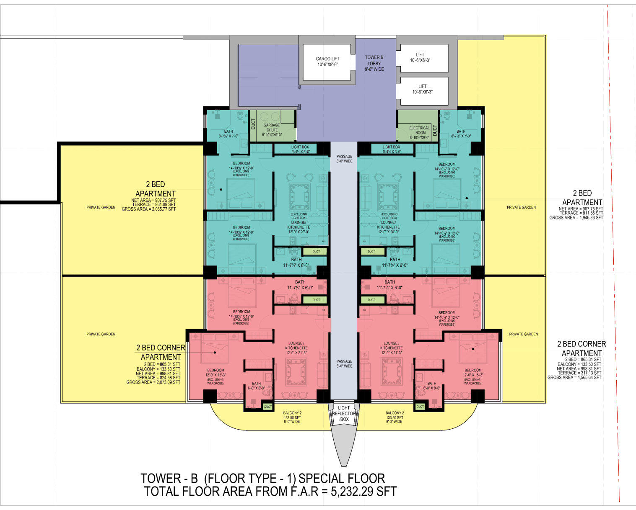
TOWER-A
TOWER-B
LIFT LOBBY
LIFT LOBBY
SERVICES
SERVICES
TWO BED TYPICAL
TWO BED TYPICAL
TWO BED CORNER
TWO BED CORNER
PRIVATE GARDEN/
TERRACES
PRIVATE GARDEN/
TERRACES

Slide 19
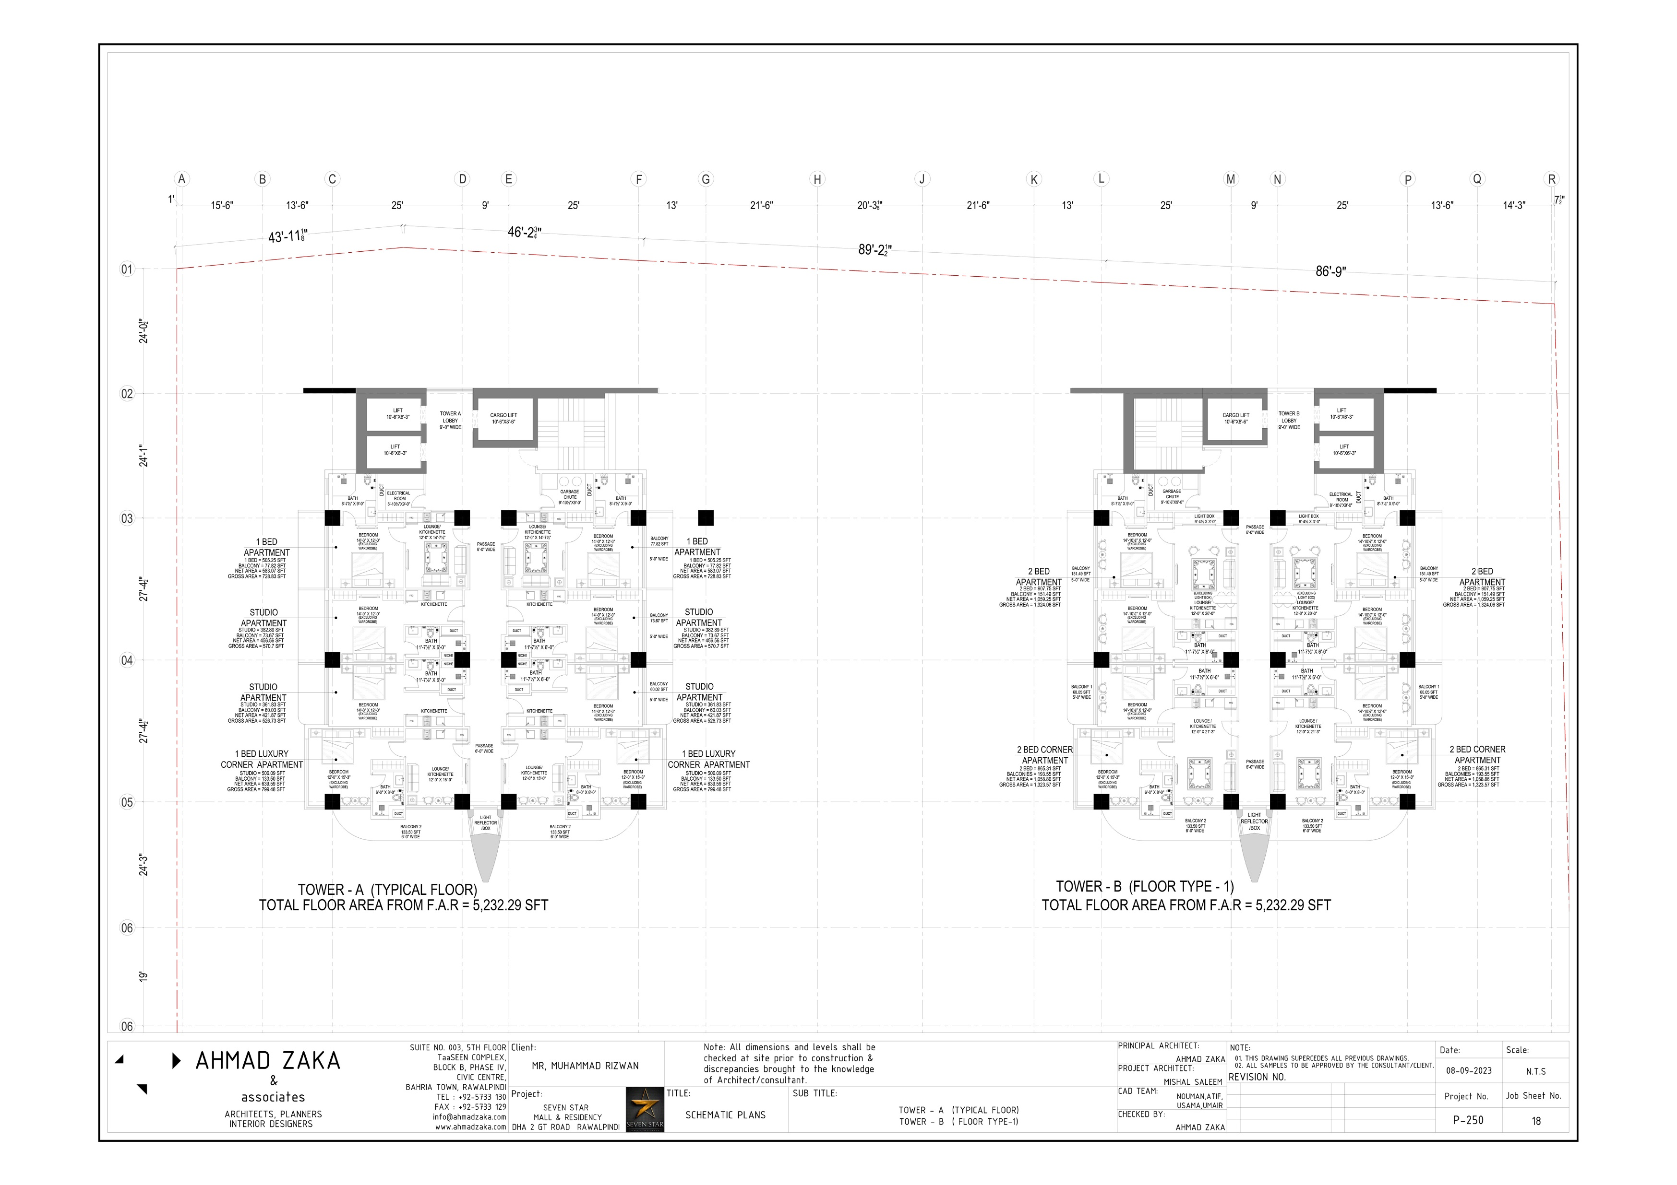
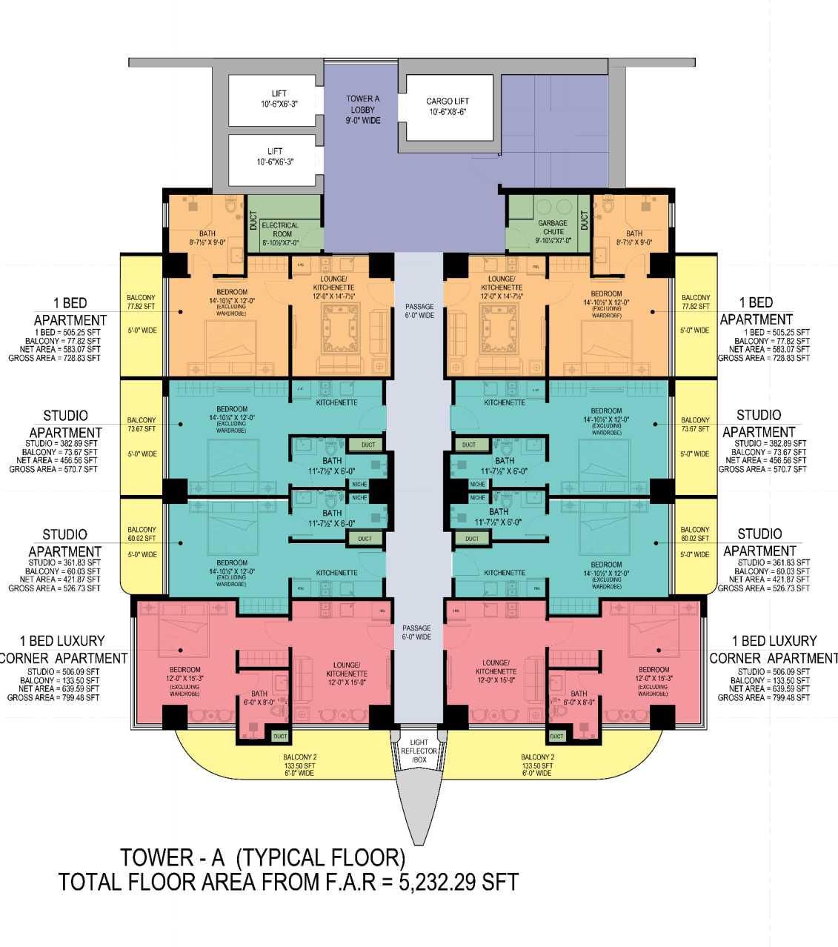
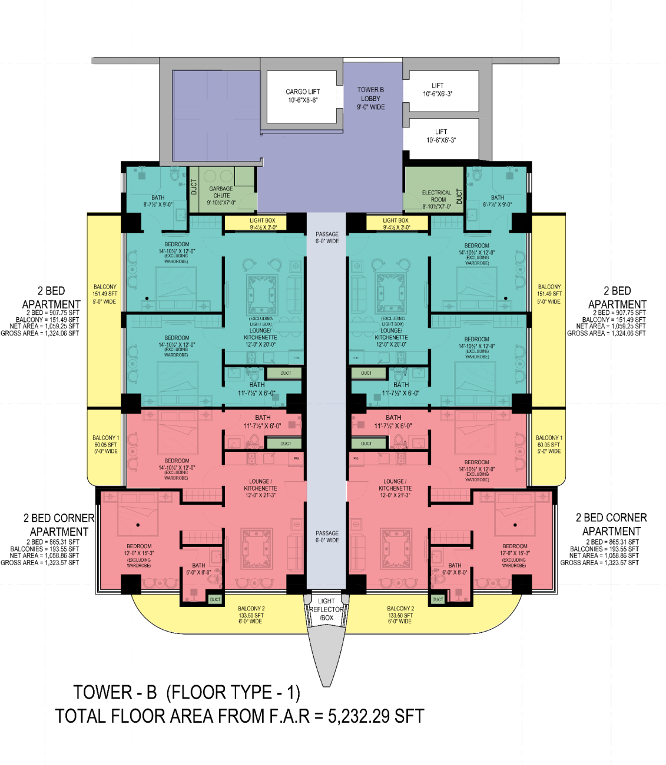
TOWER-A
TOWER-B
LIFT LOBBY
LIFT LOBBY
SERVICES
SERVICES
STUDIO APARTMENTS
TWO BED TYPICAL
ONE BED APARTMENT
TWO BED CORNER
ONE BED CORNER APARTMENT
PRIVATE GARDEN/
TERRACES
PRIVATE GARDEN/
TERRACES

Slide 20
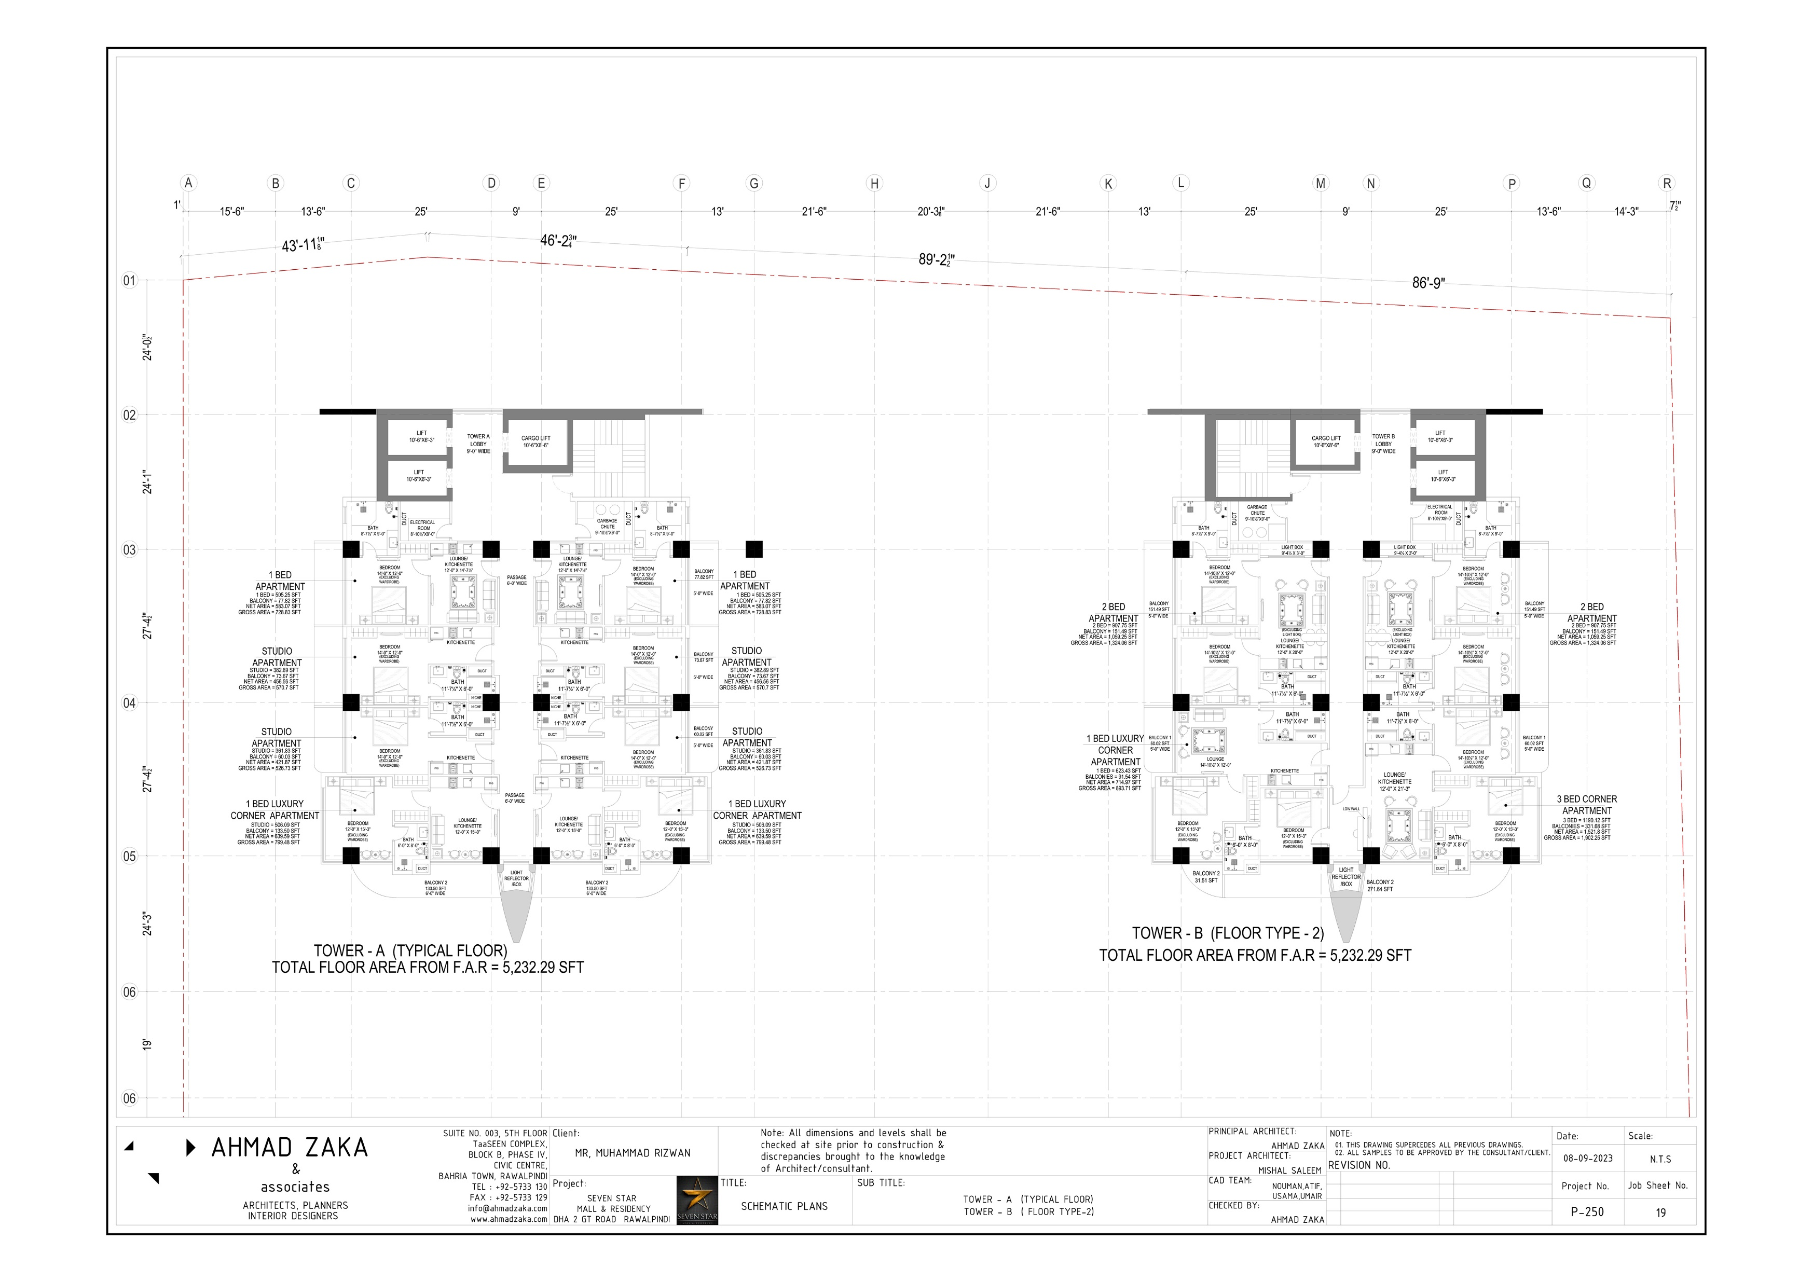
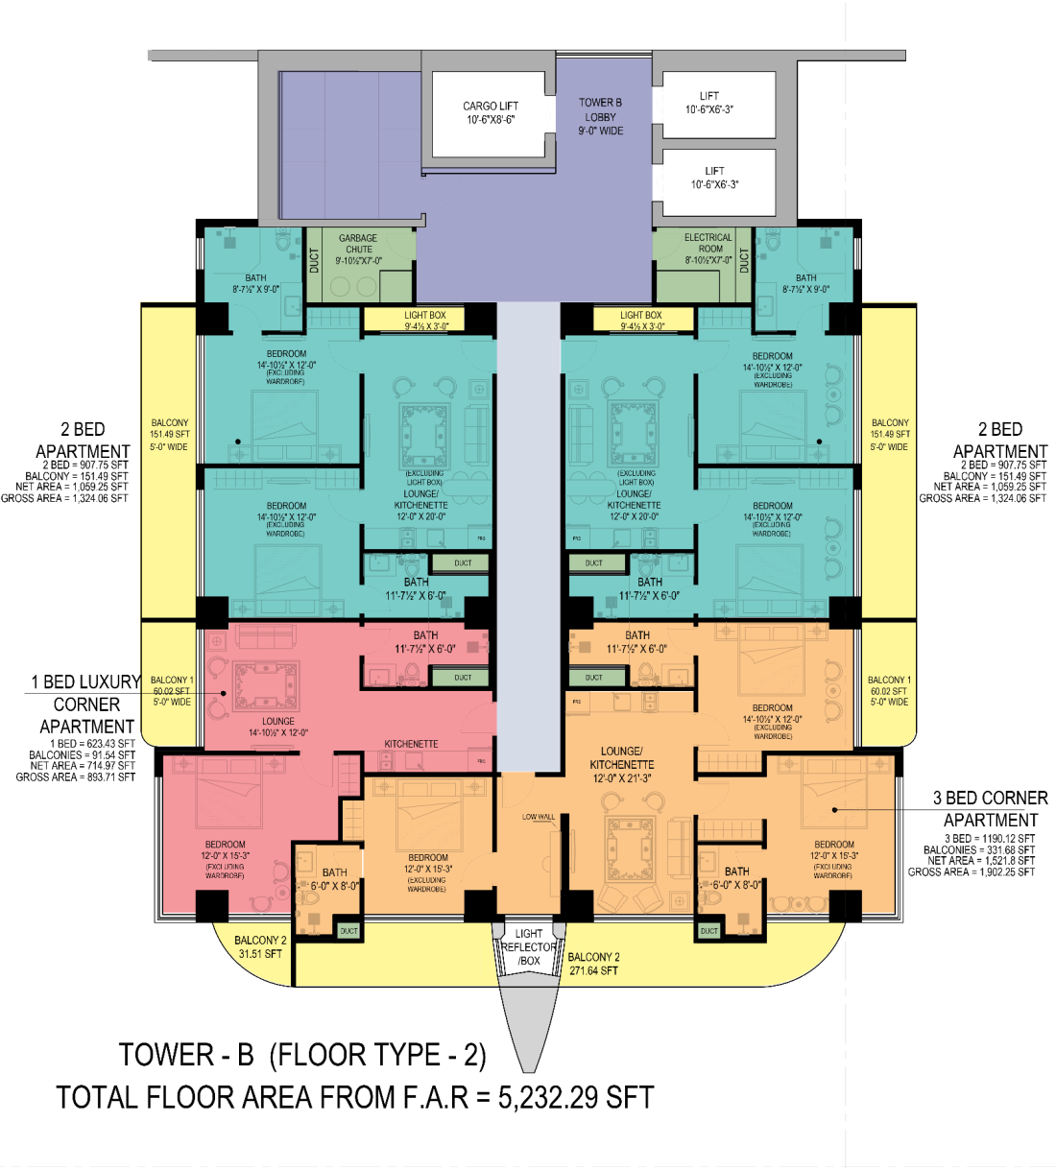
TOWER-A
TOWER-B
LIFT LOBBY
LIFT LOBBY
SERVICES
SERVICES
STUDIO APARTMENTS
TWO BED TYPICAL
ONE BED APARTMENT
ONE BED CORNER
ONE BED CORNER APARTMENT
THERR BED CORNER
PRIVATE GARDEN/
TERRACES
PRIVATE GARDEN/
TERRACES

Slide 21
TOWER A & B | APARTMENT TYPES & PLANS

Slide 22
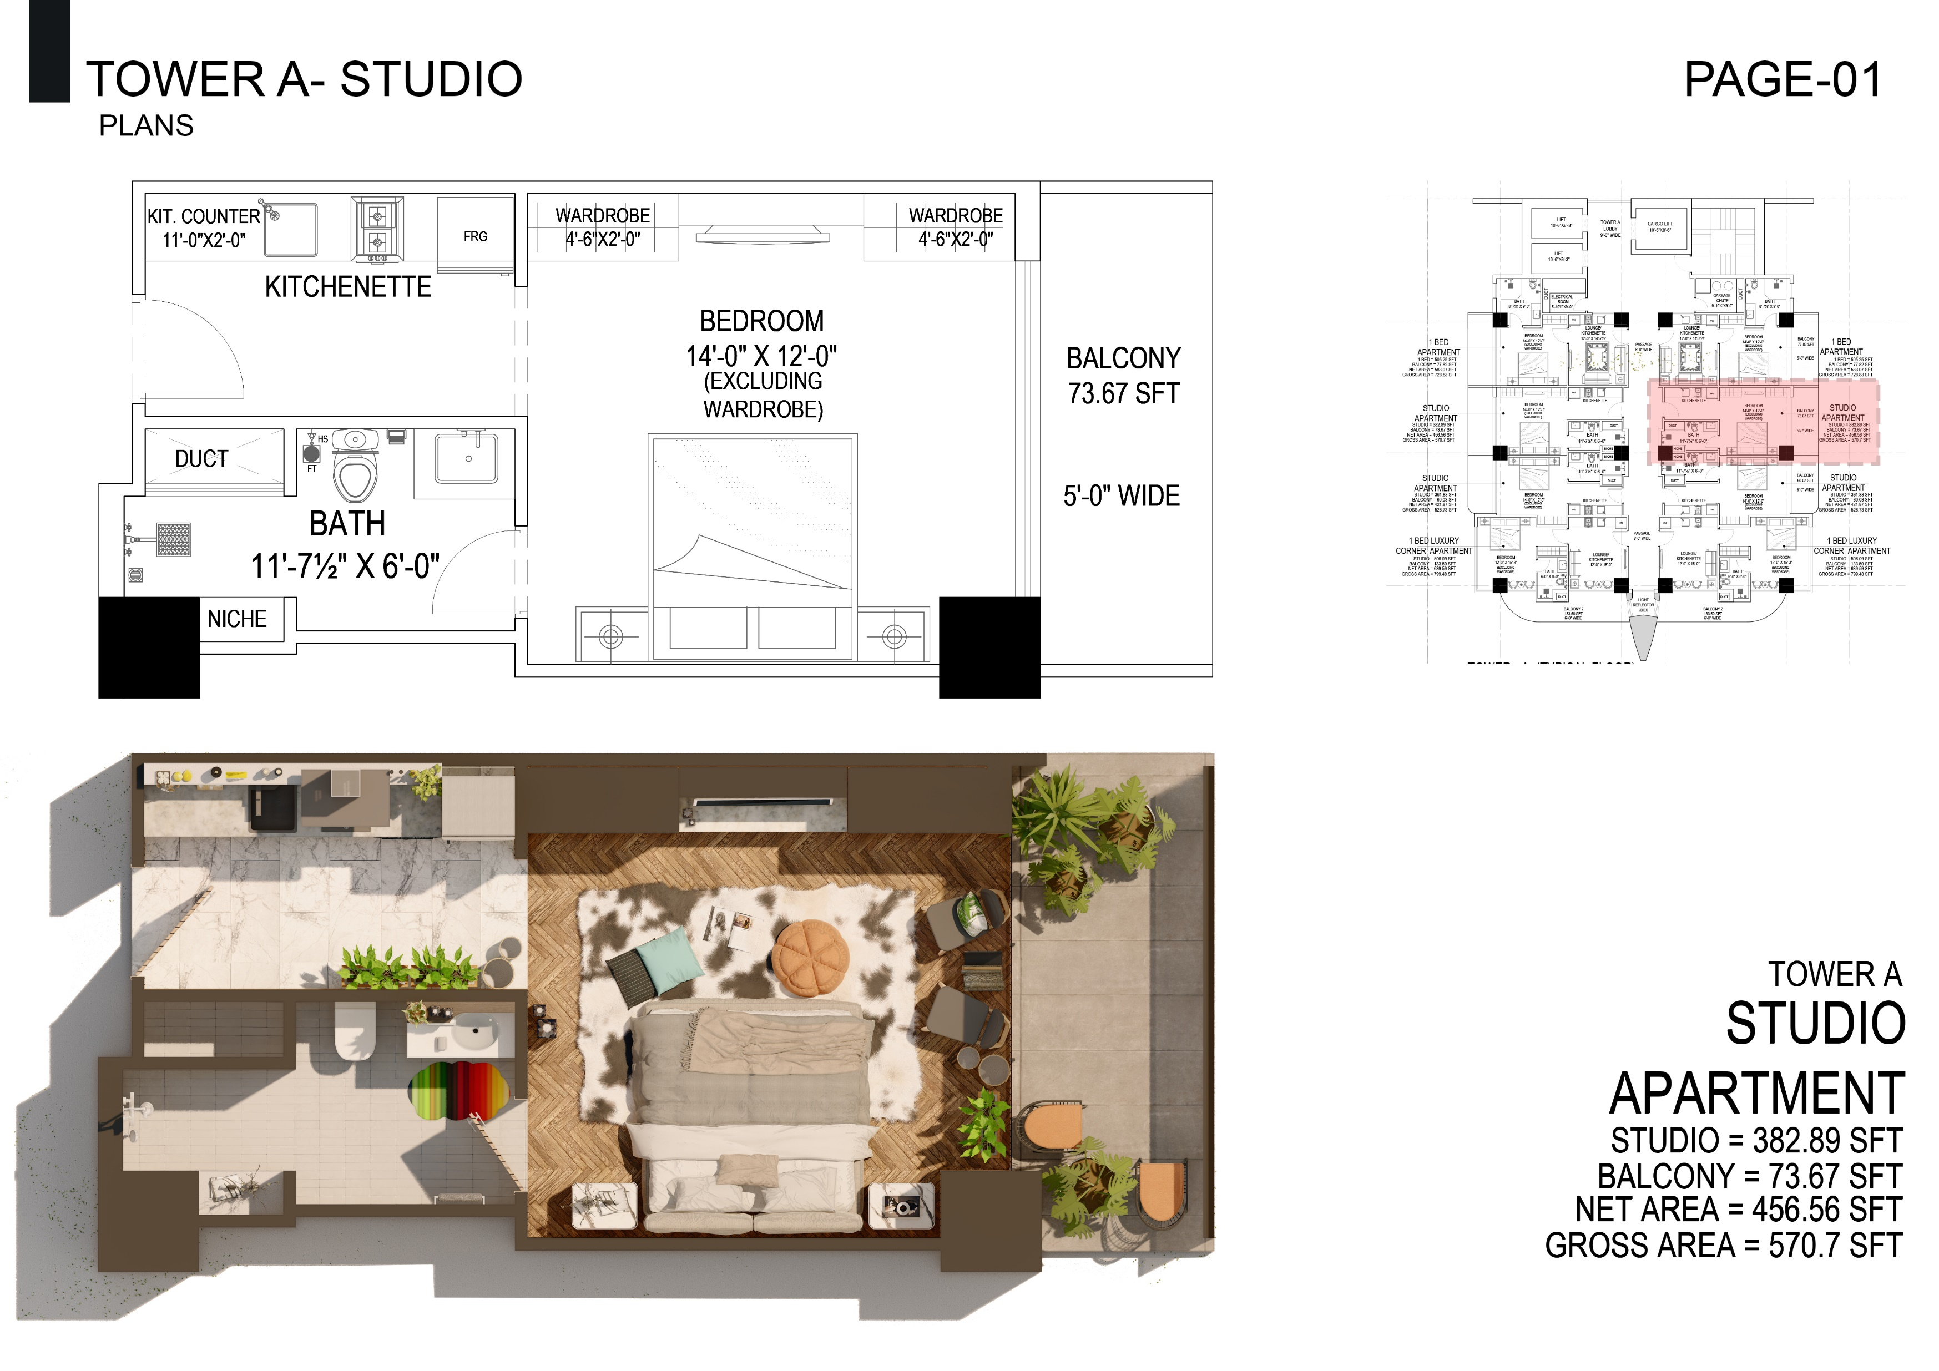

Slide 23
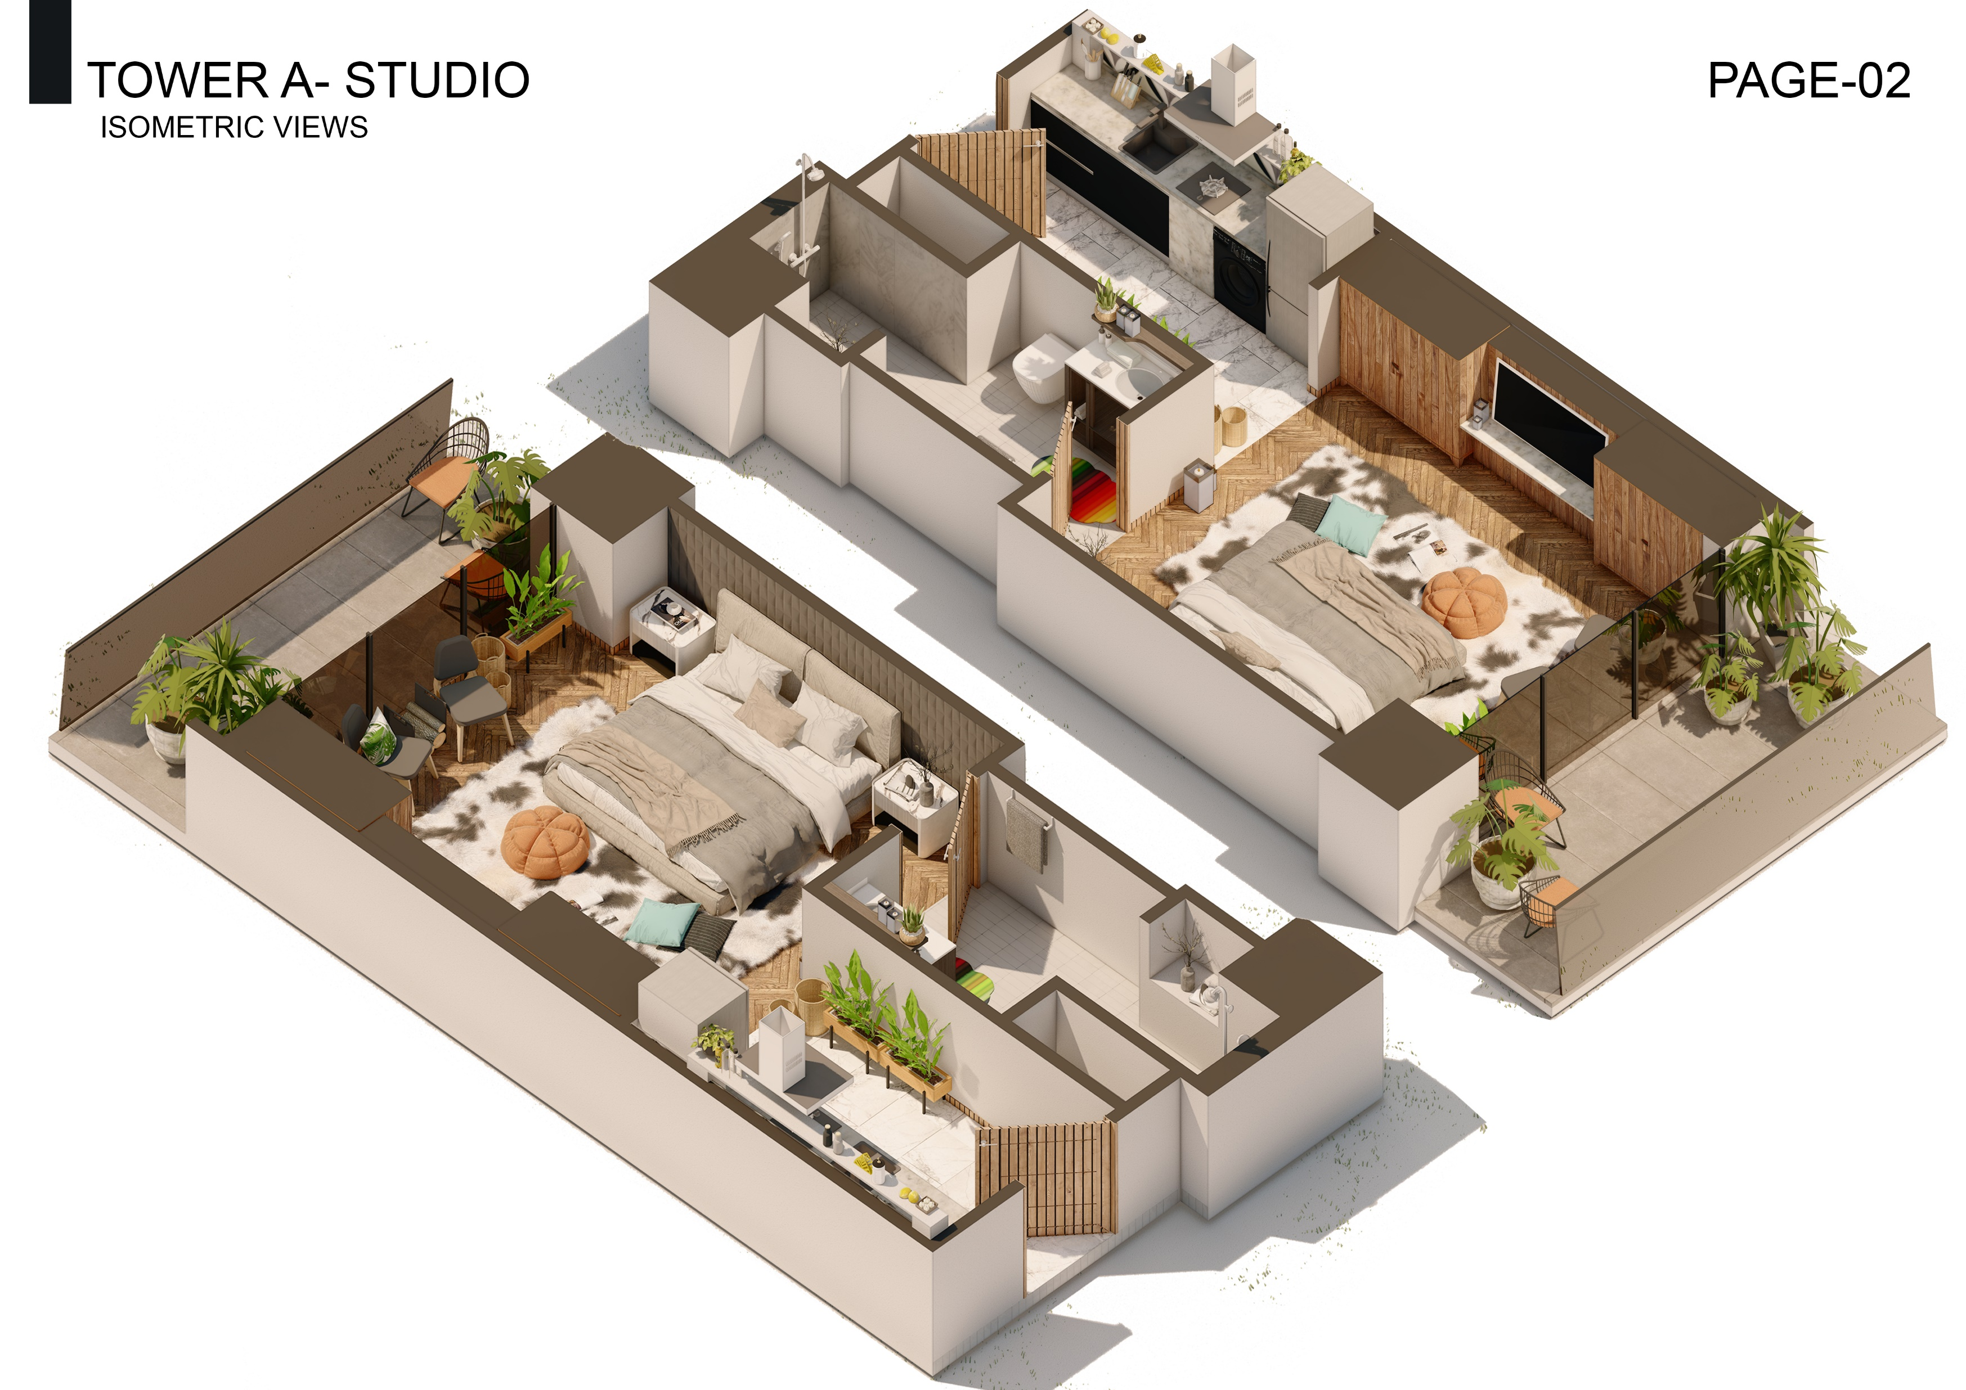

Slide 25
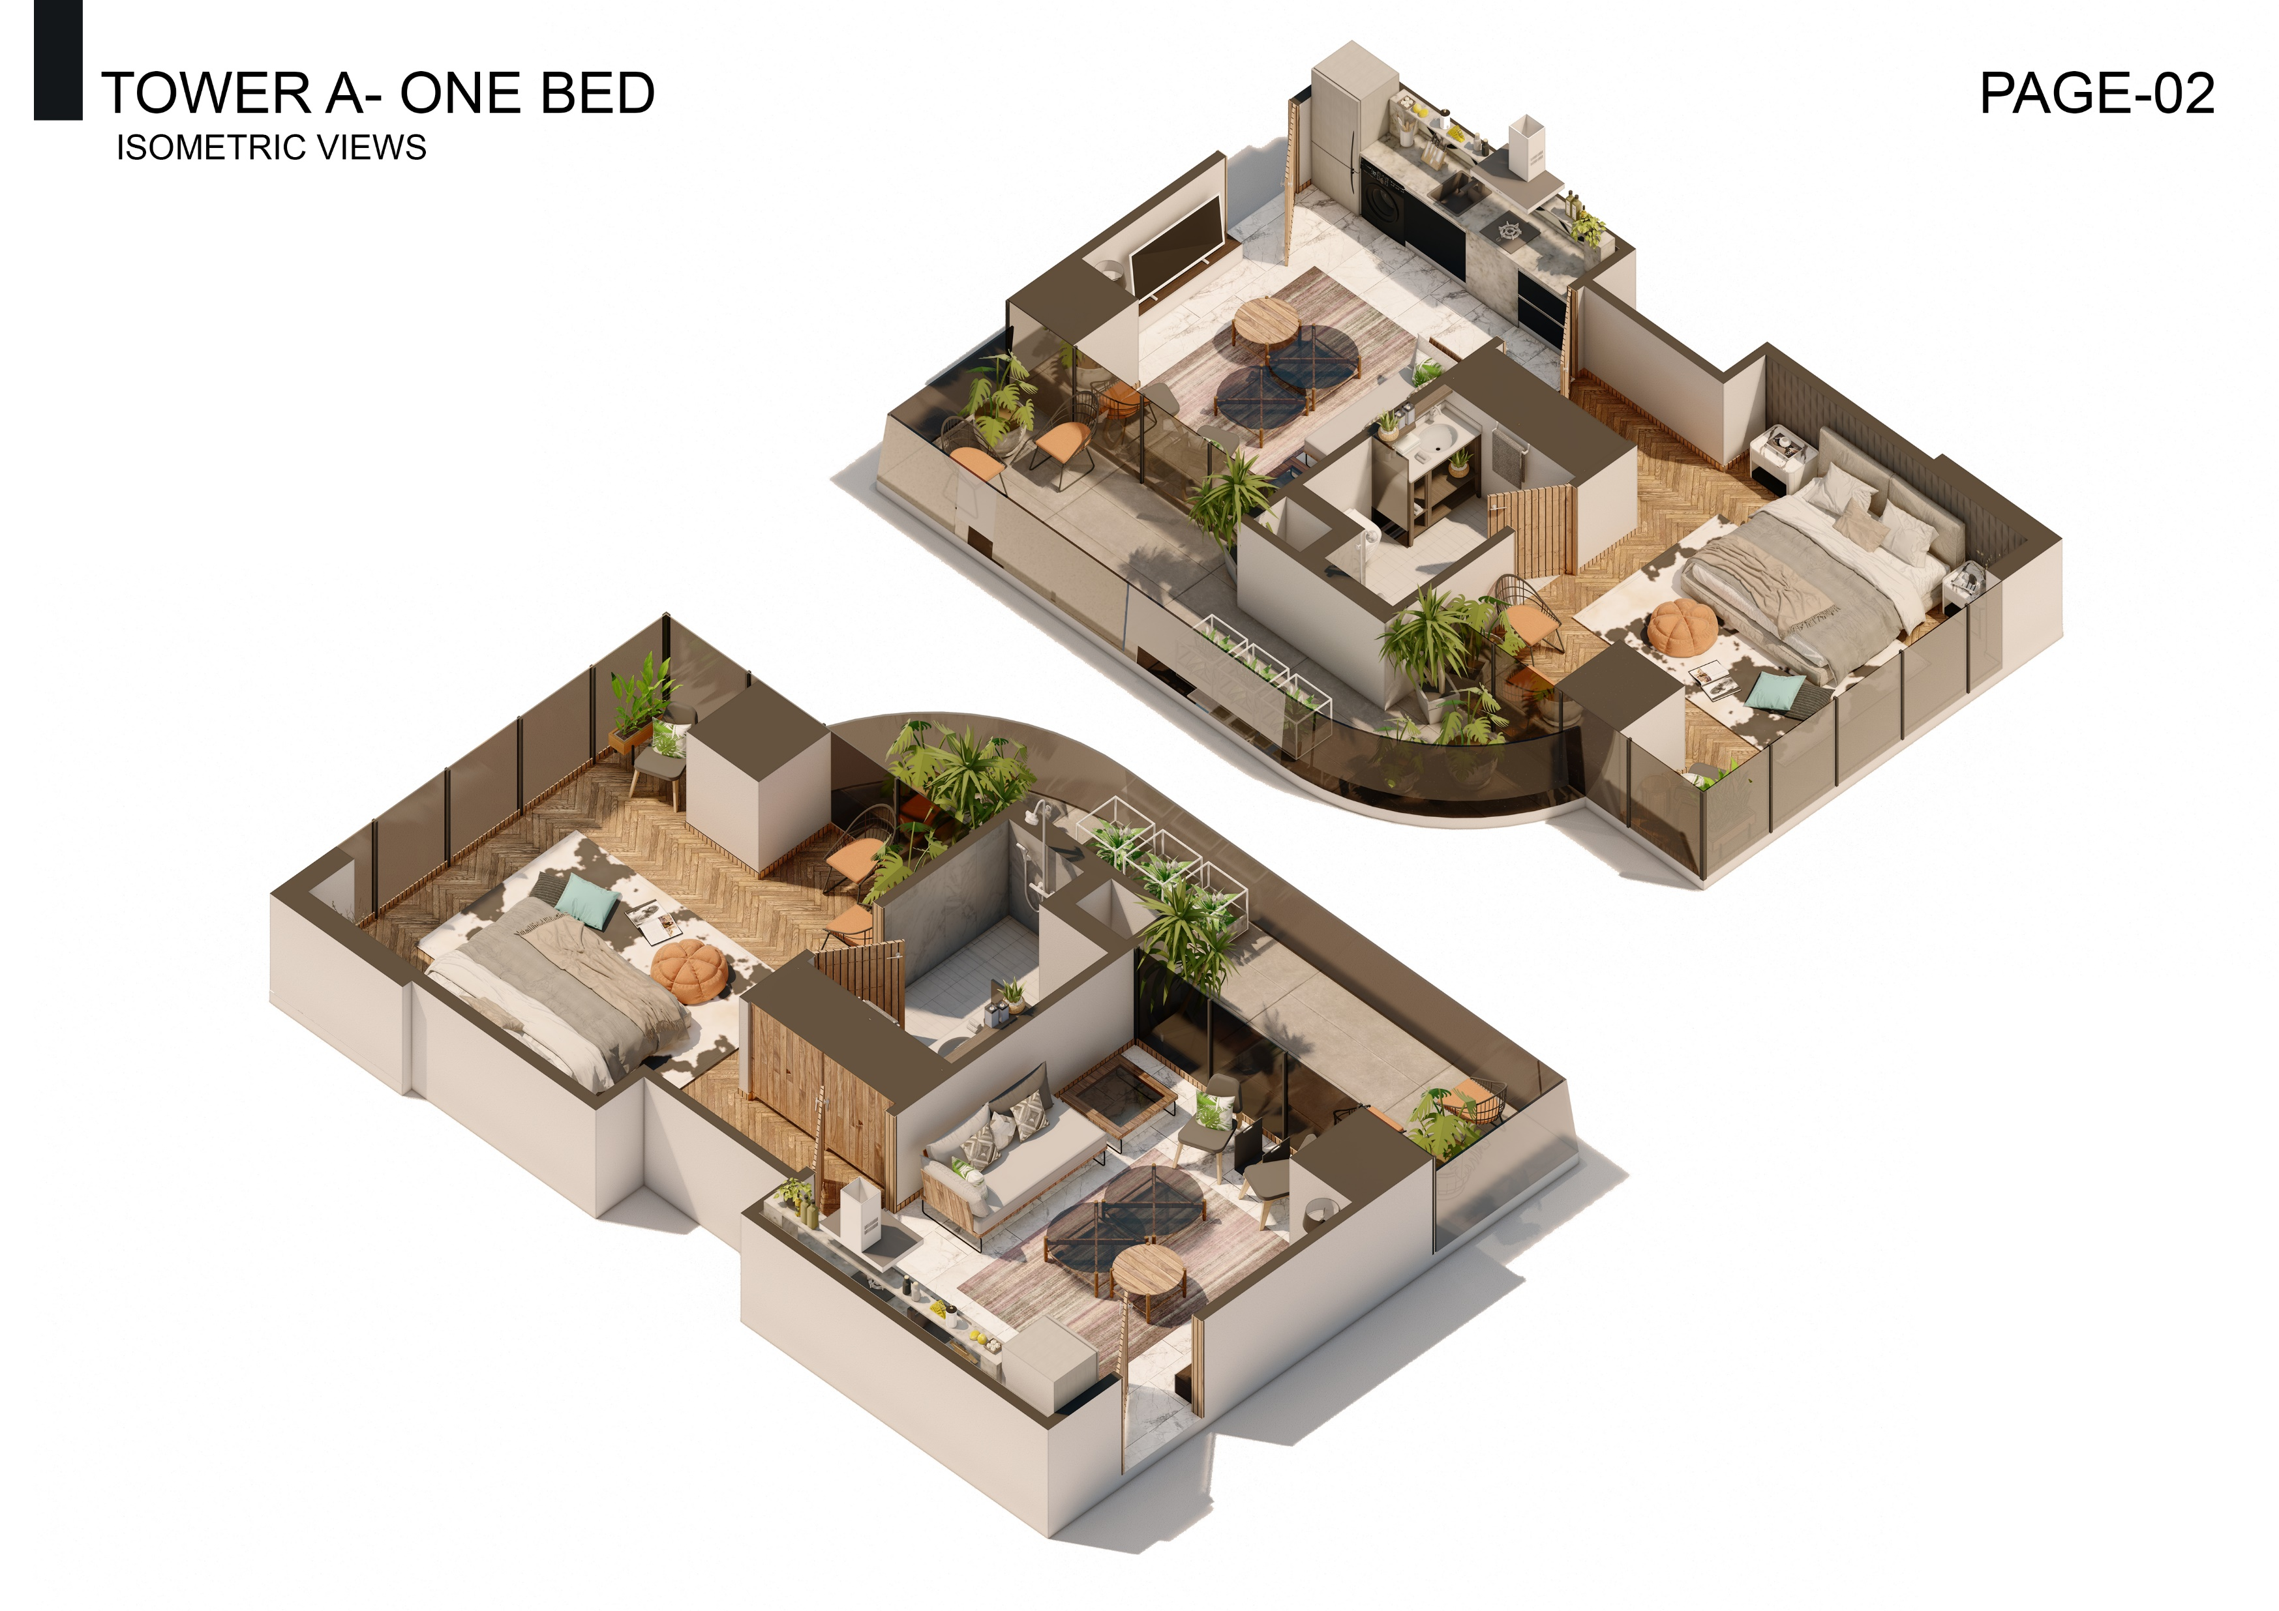

Slide 26
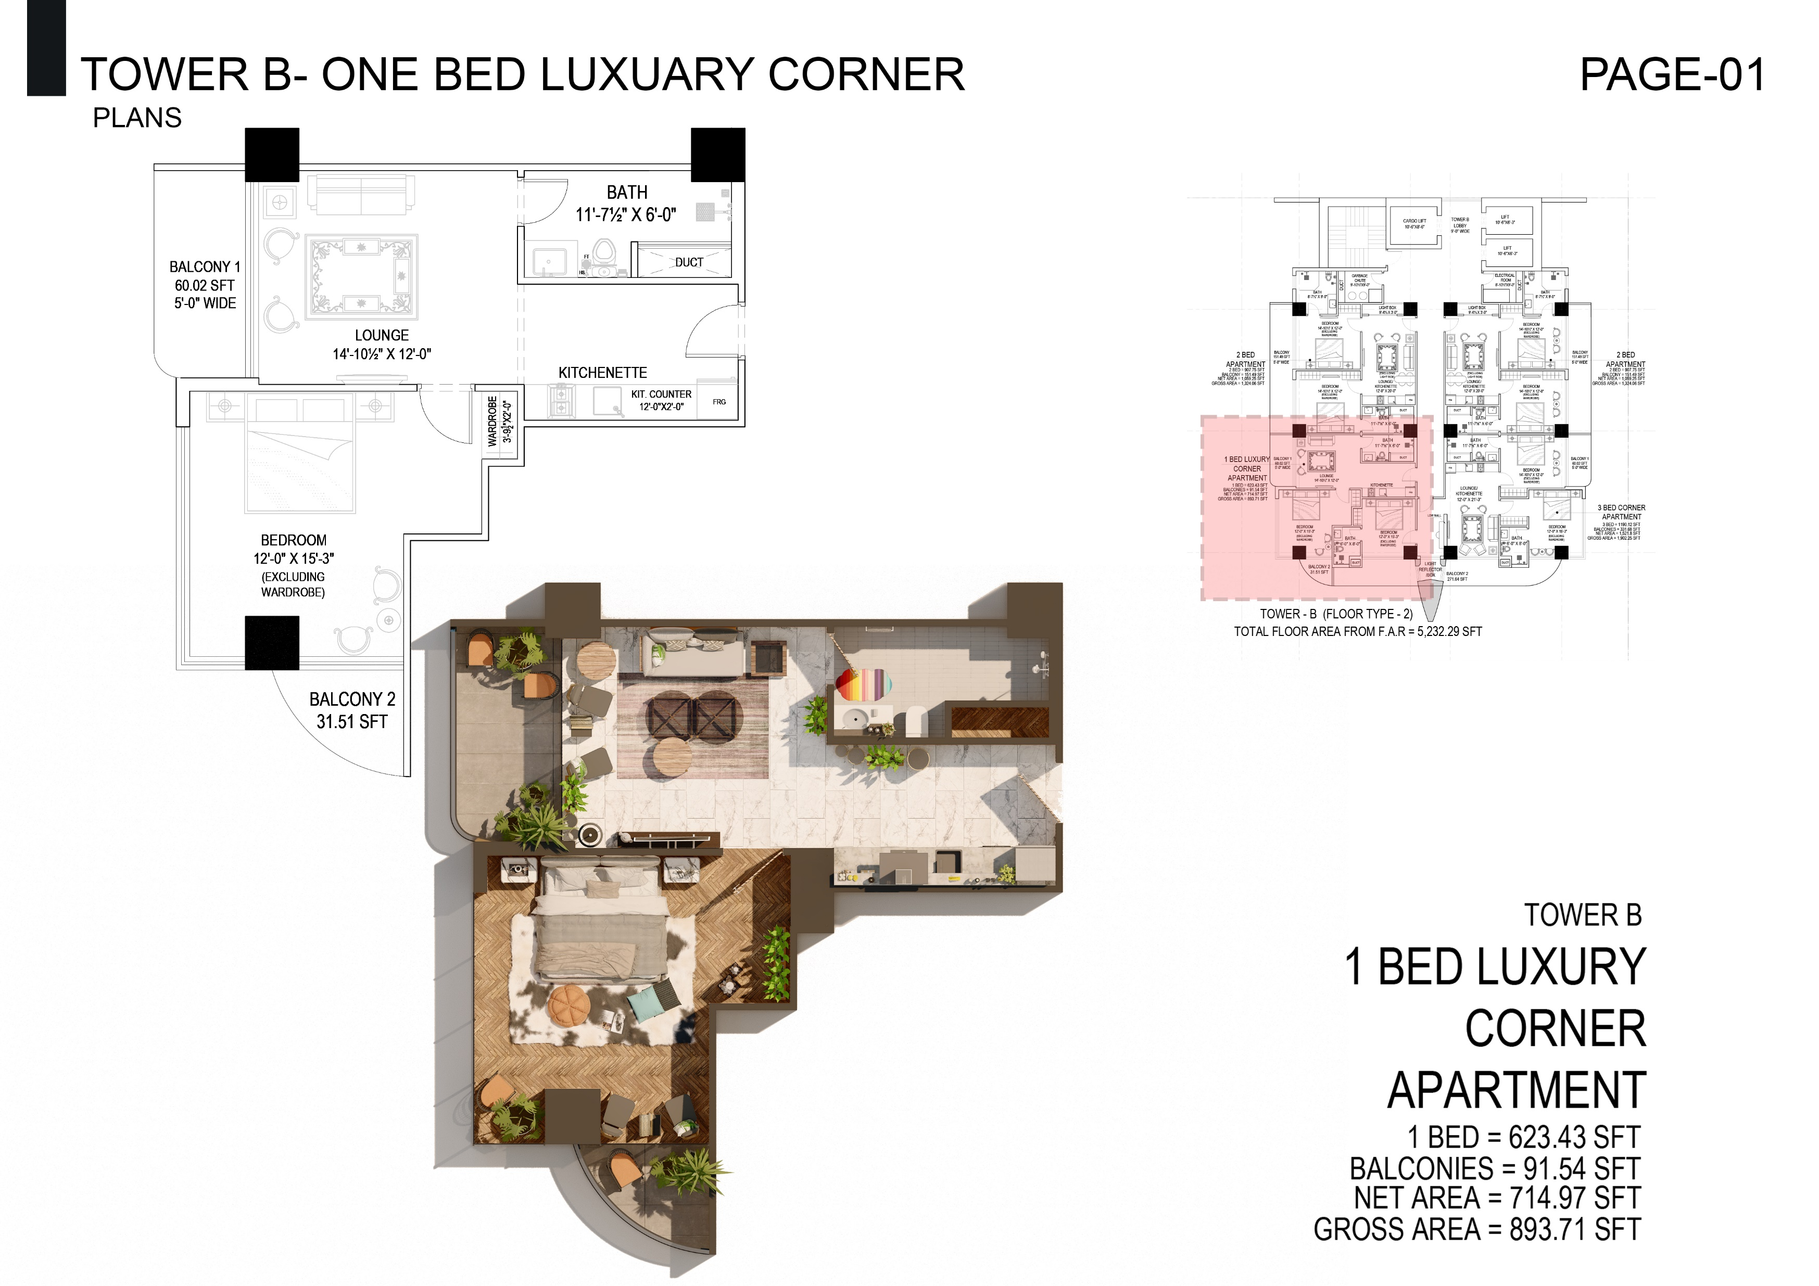

Slide 28
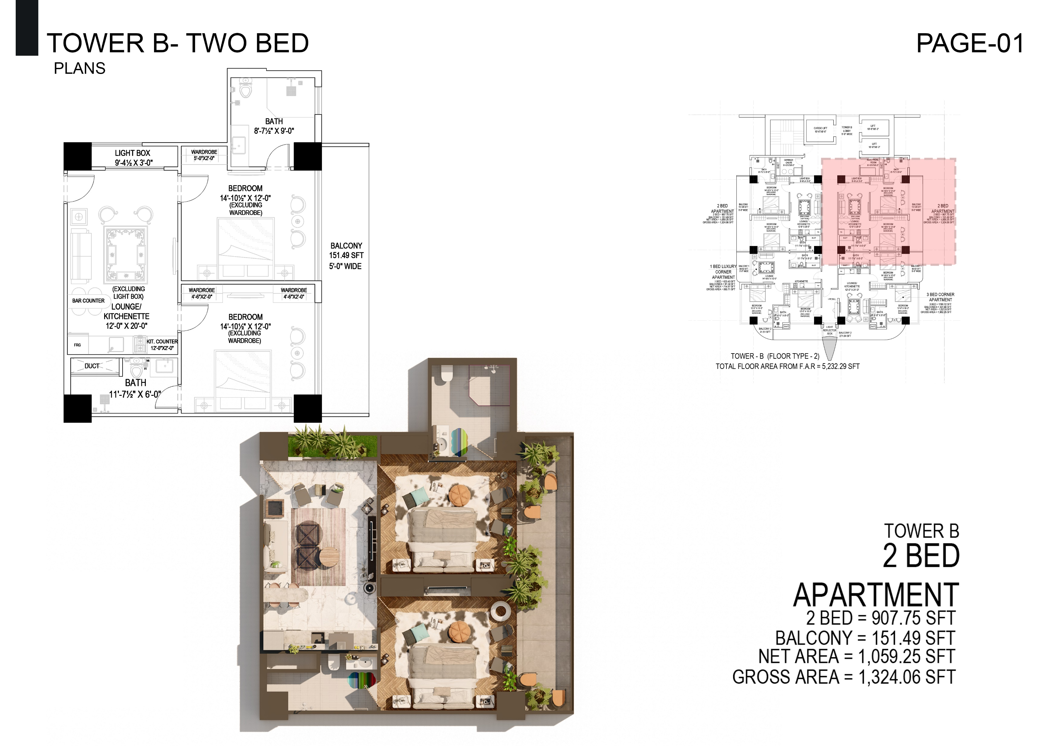

Slide 29
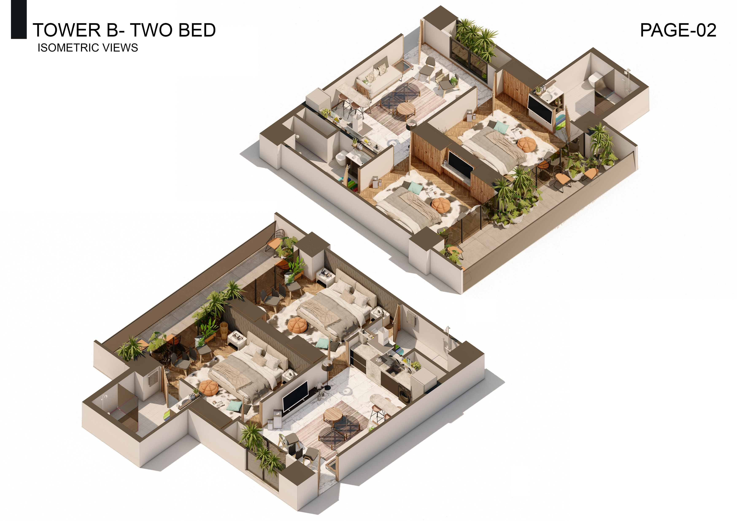

Slide 32
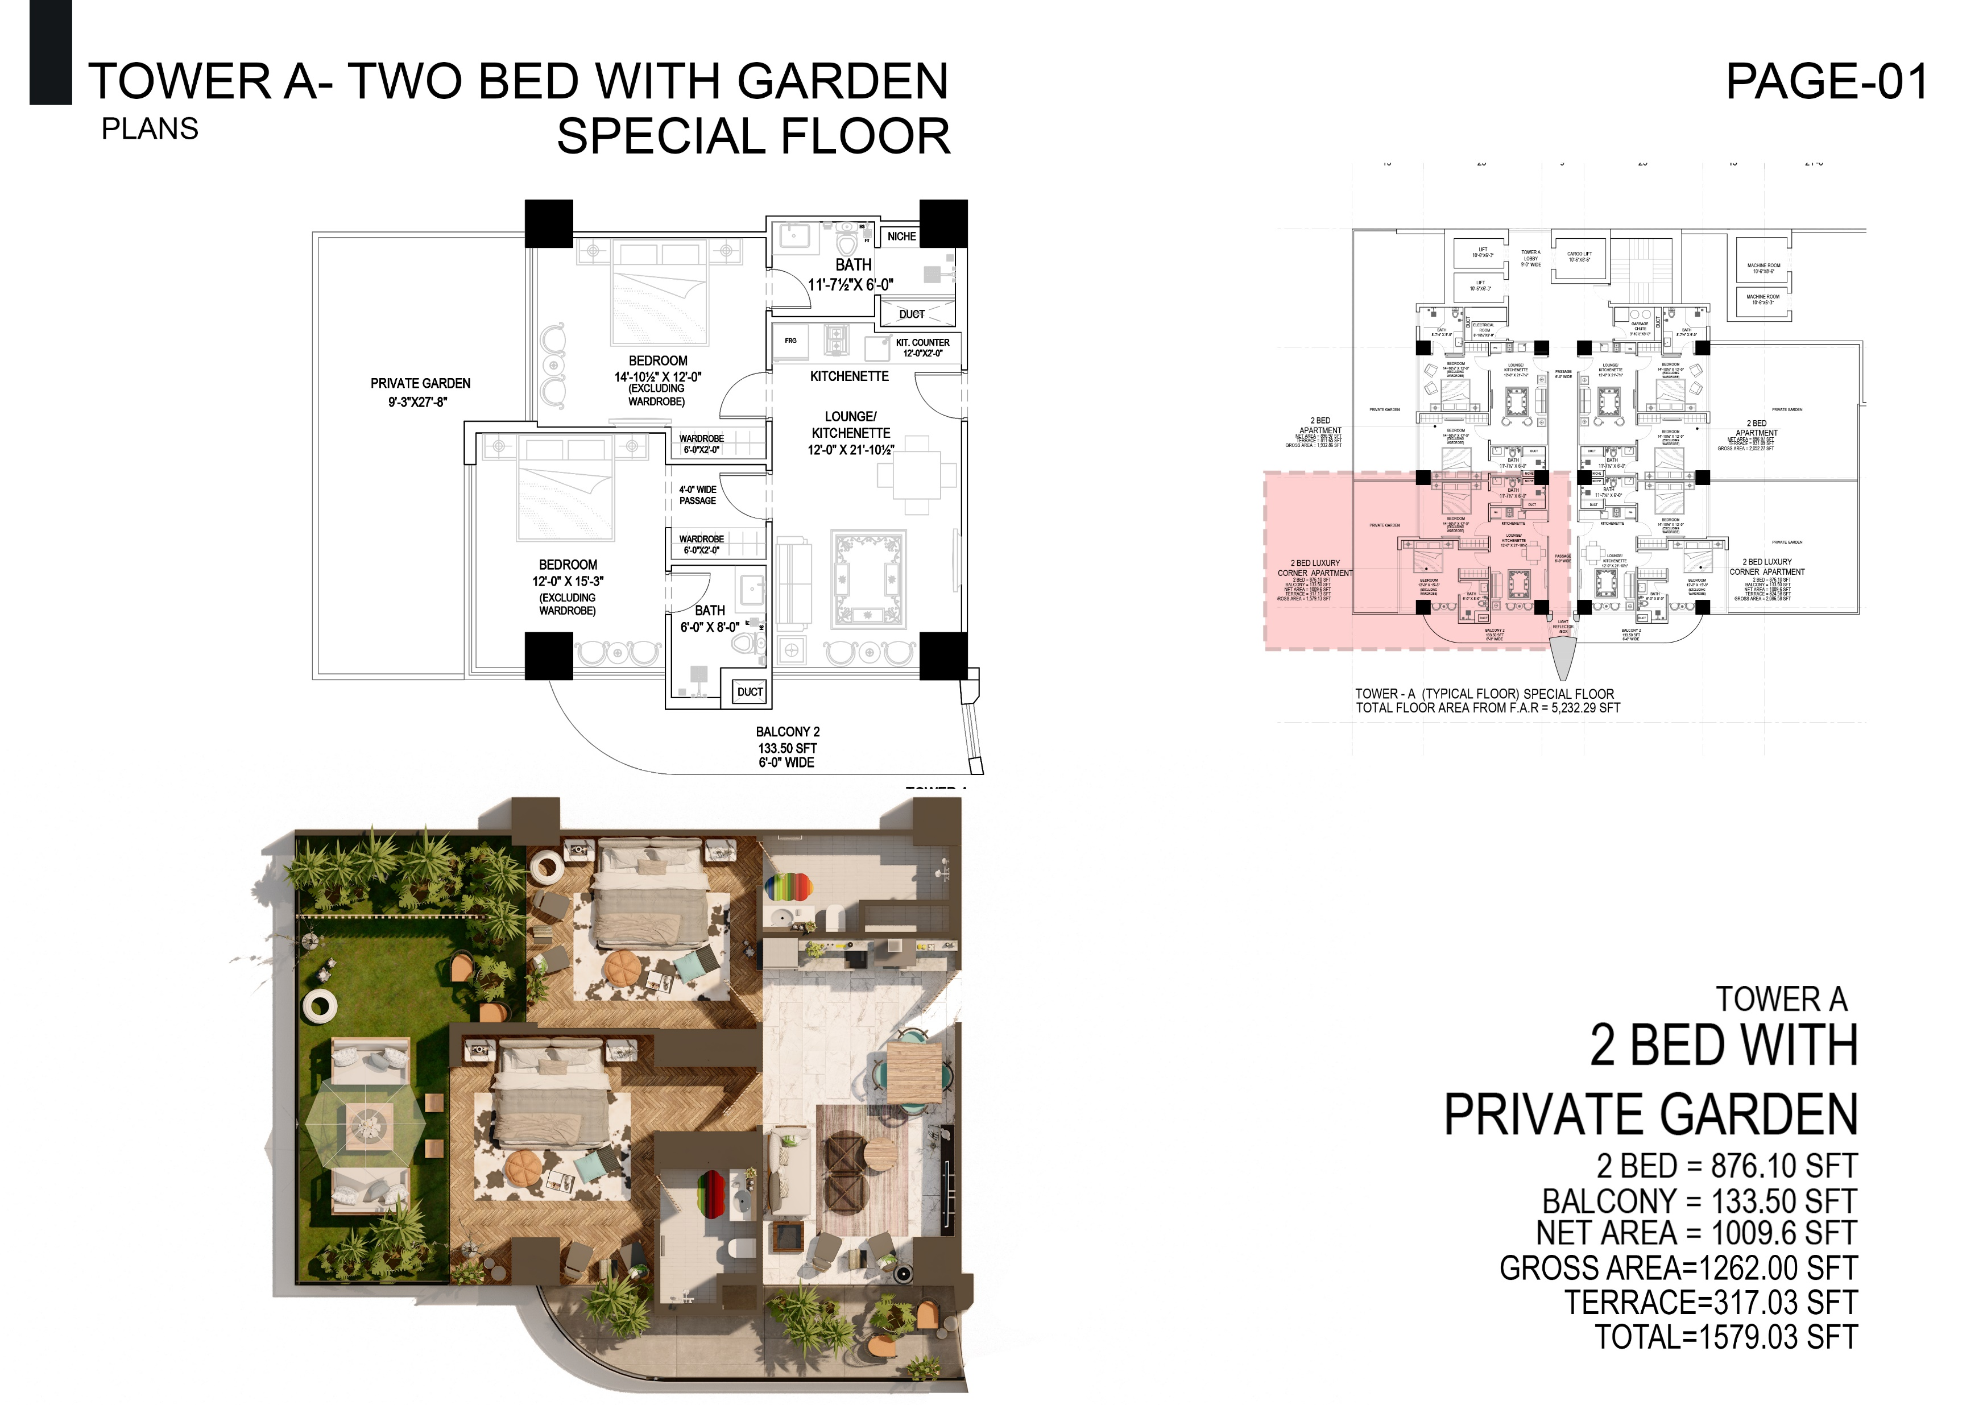

Slide 33
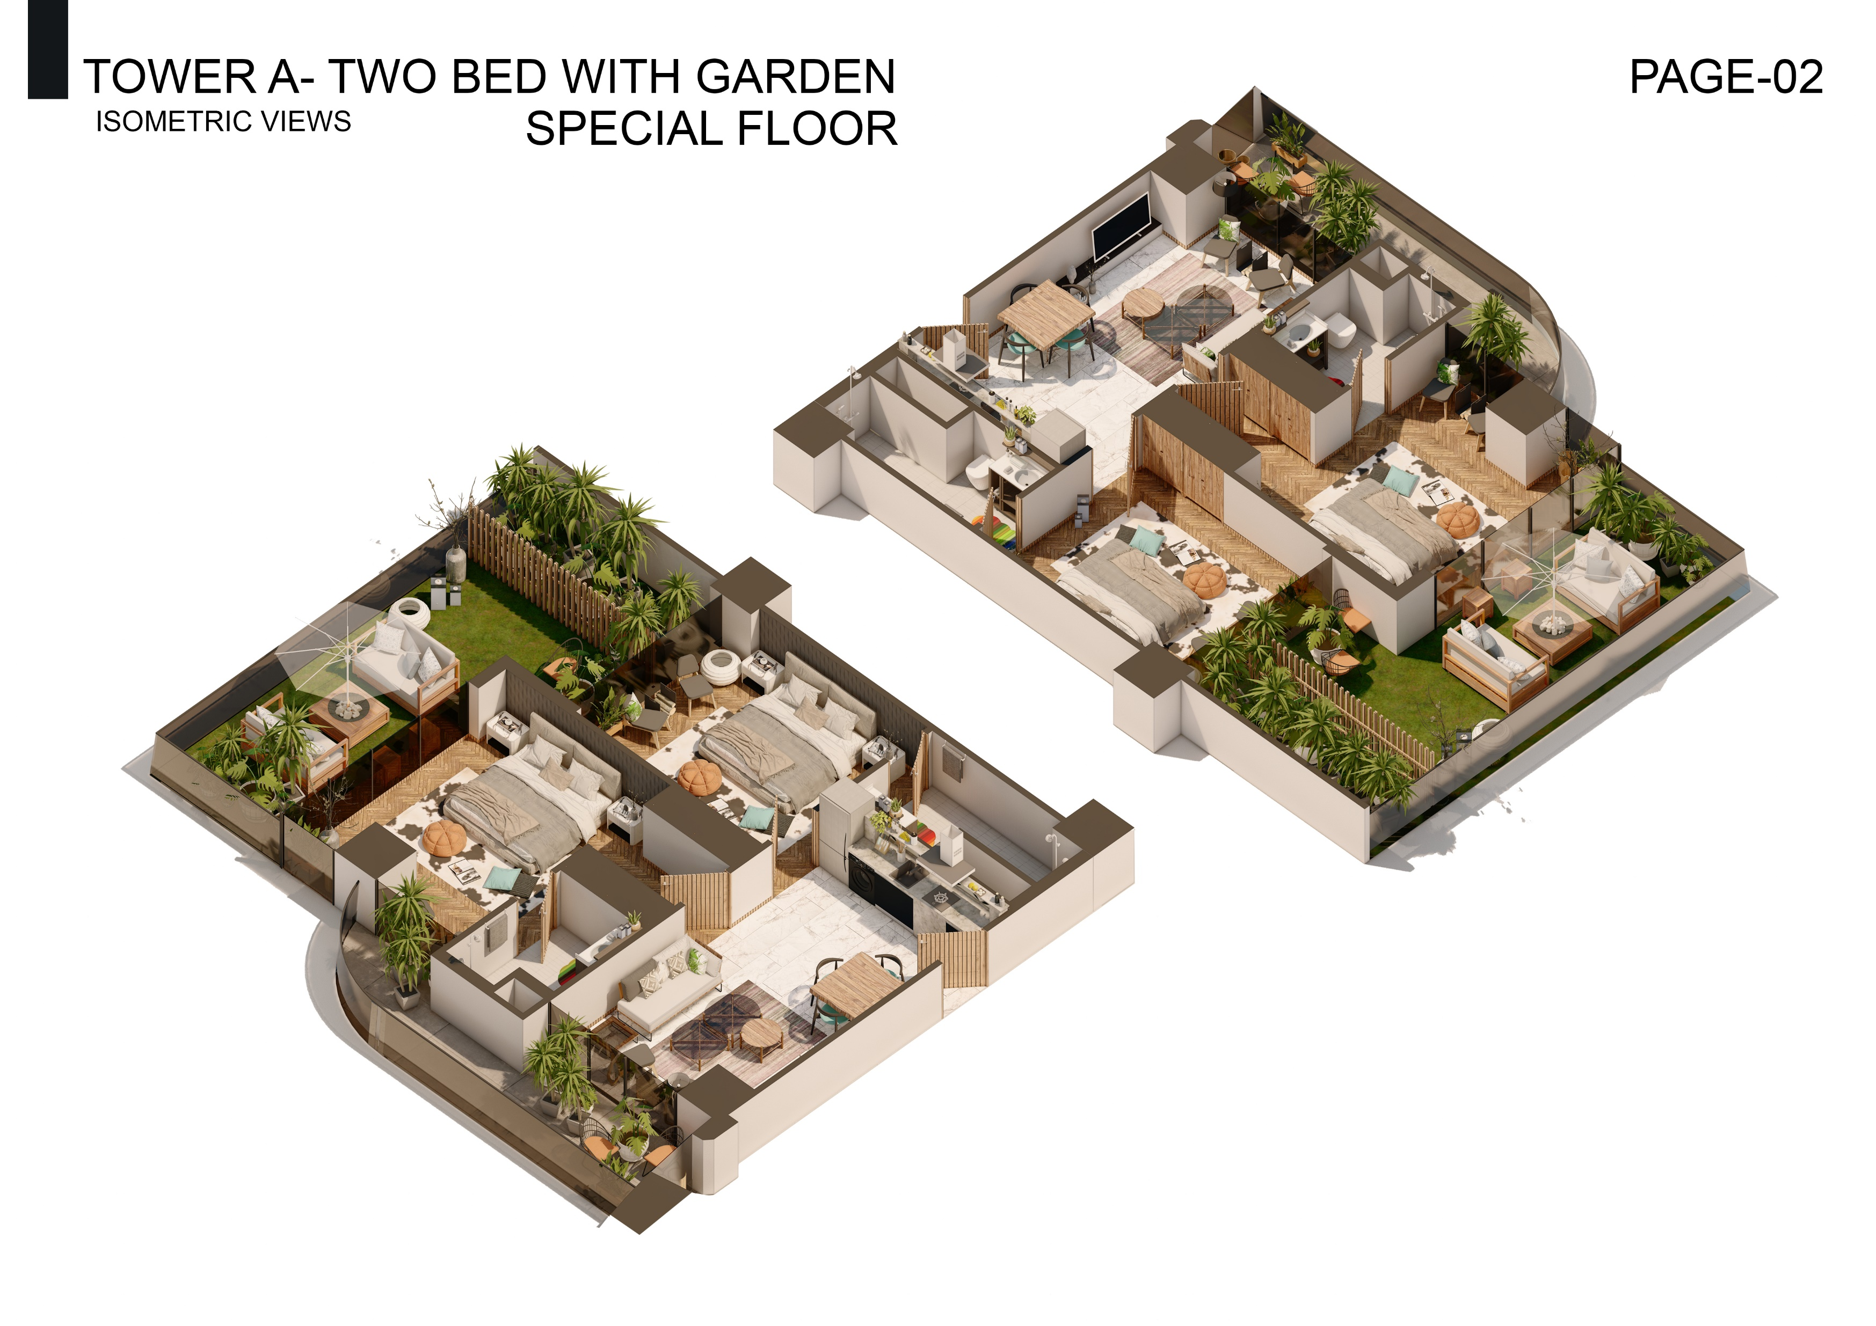

Slide 34
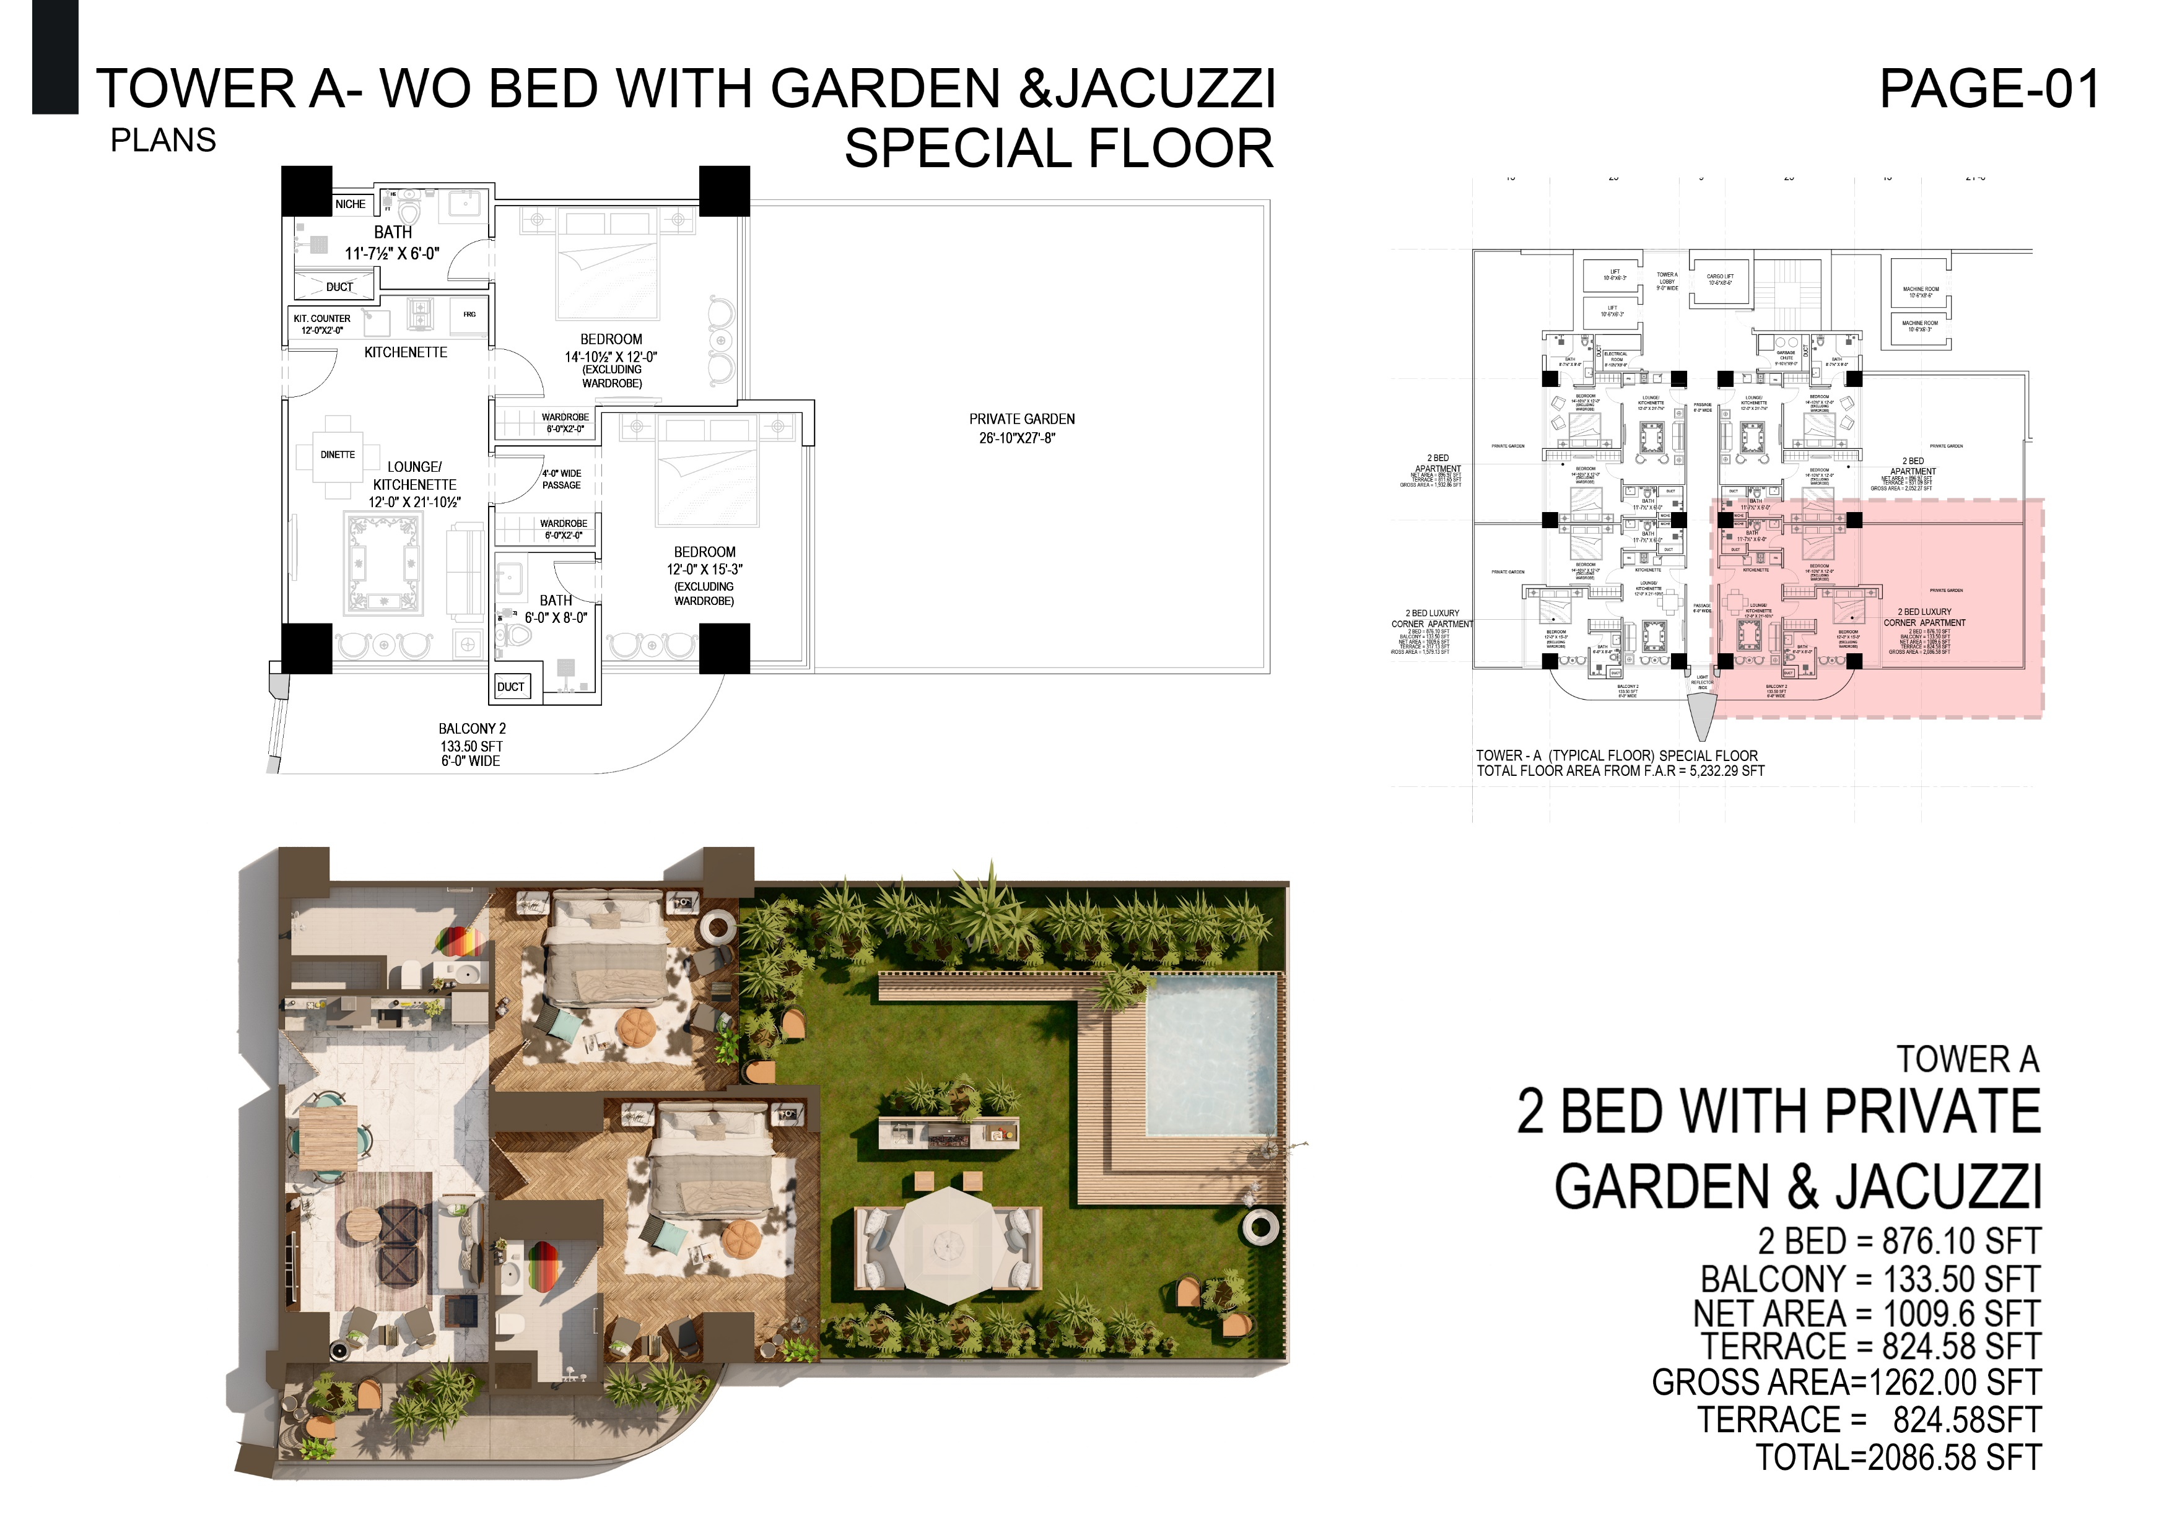

Slide 35
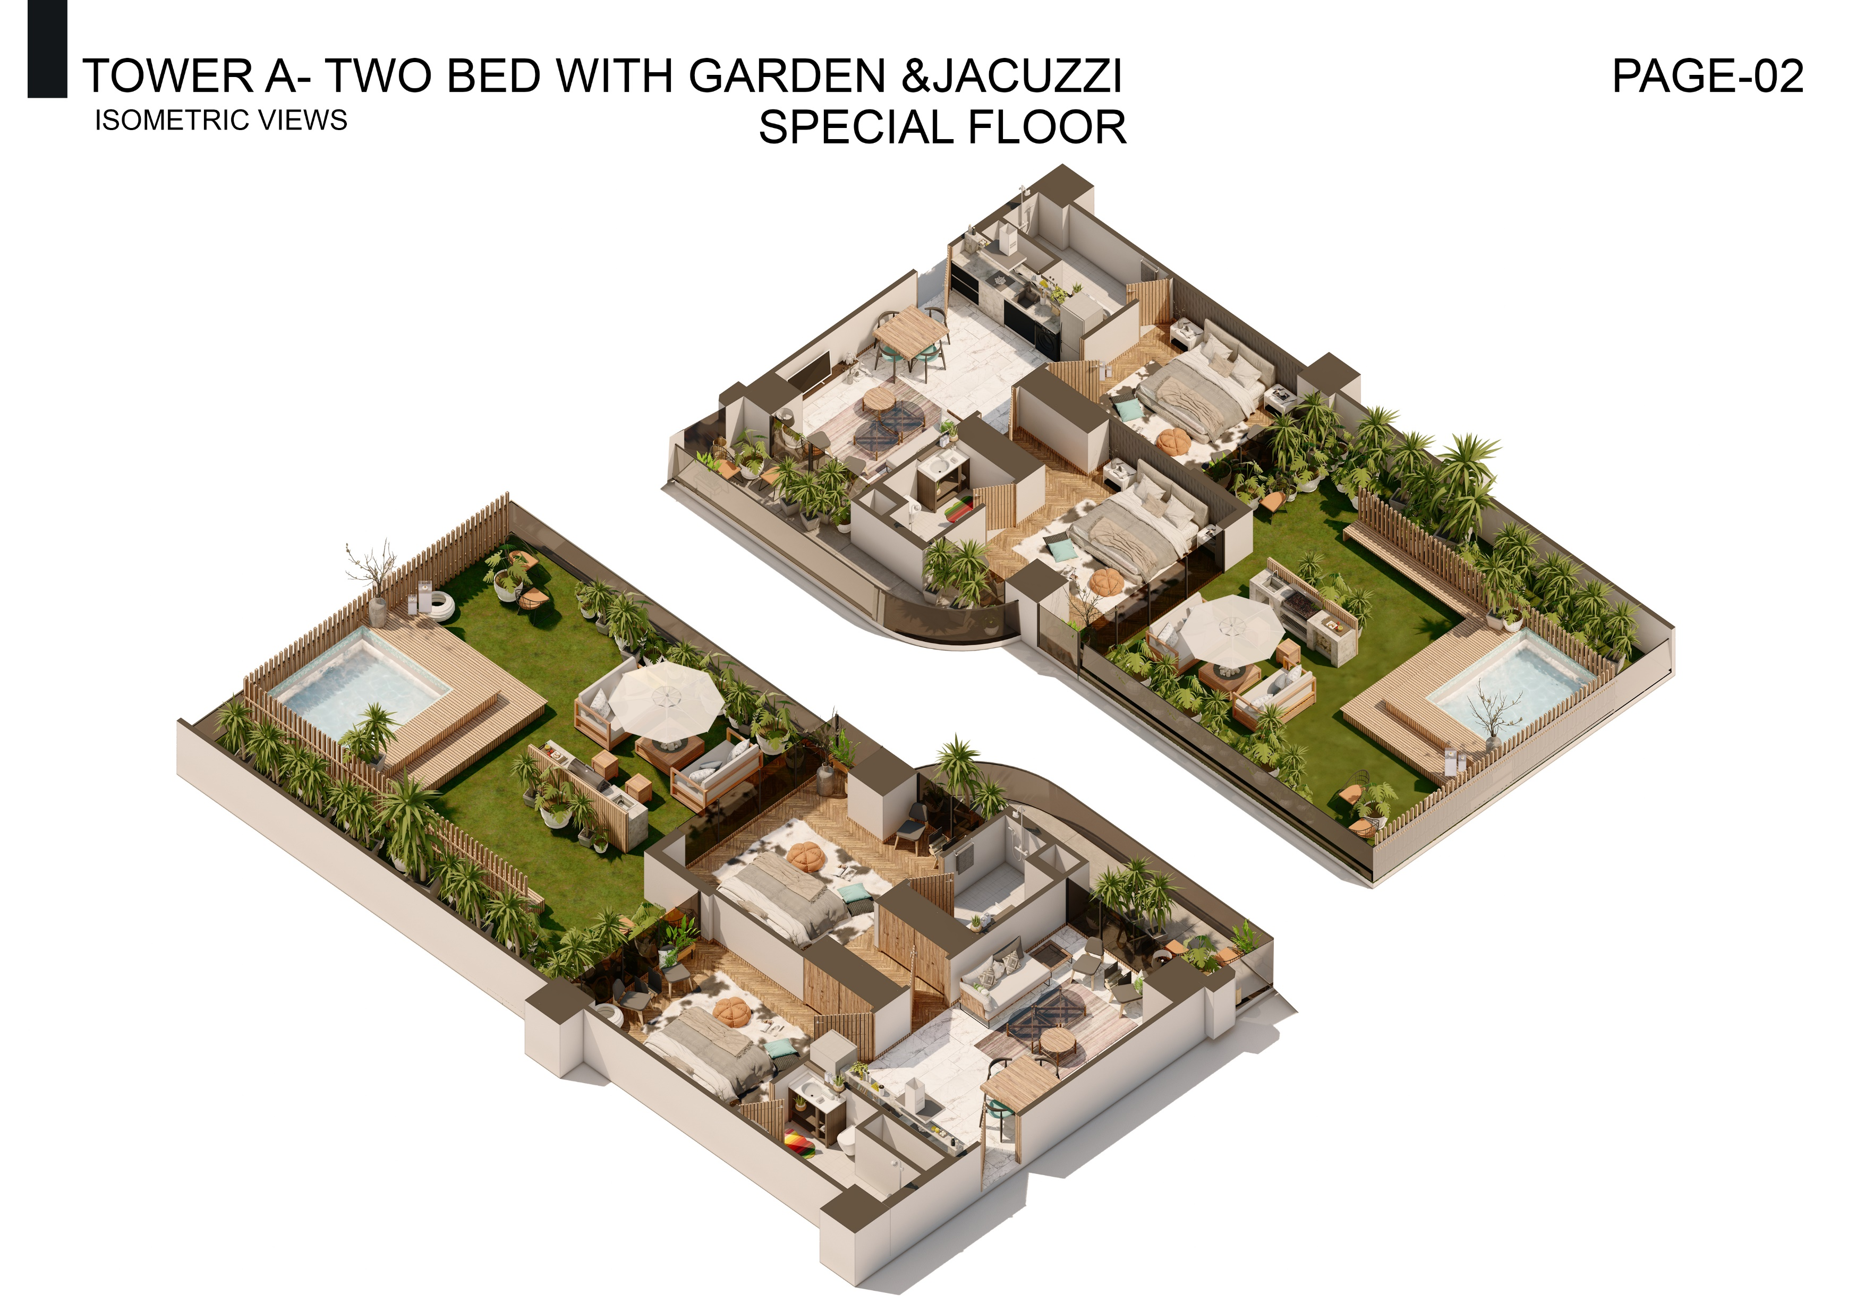

Slide 36
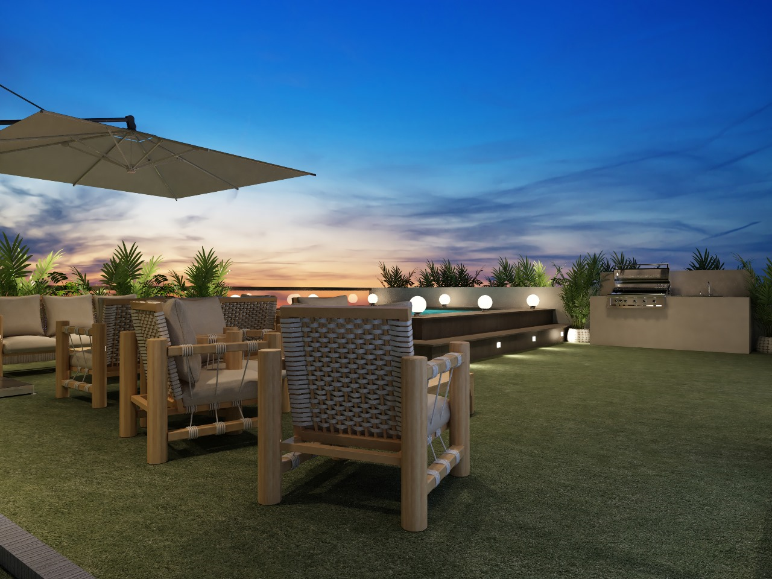

Slide 37
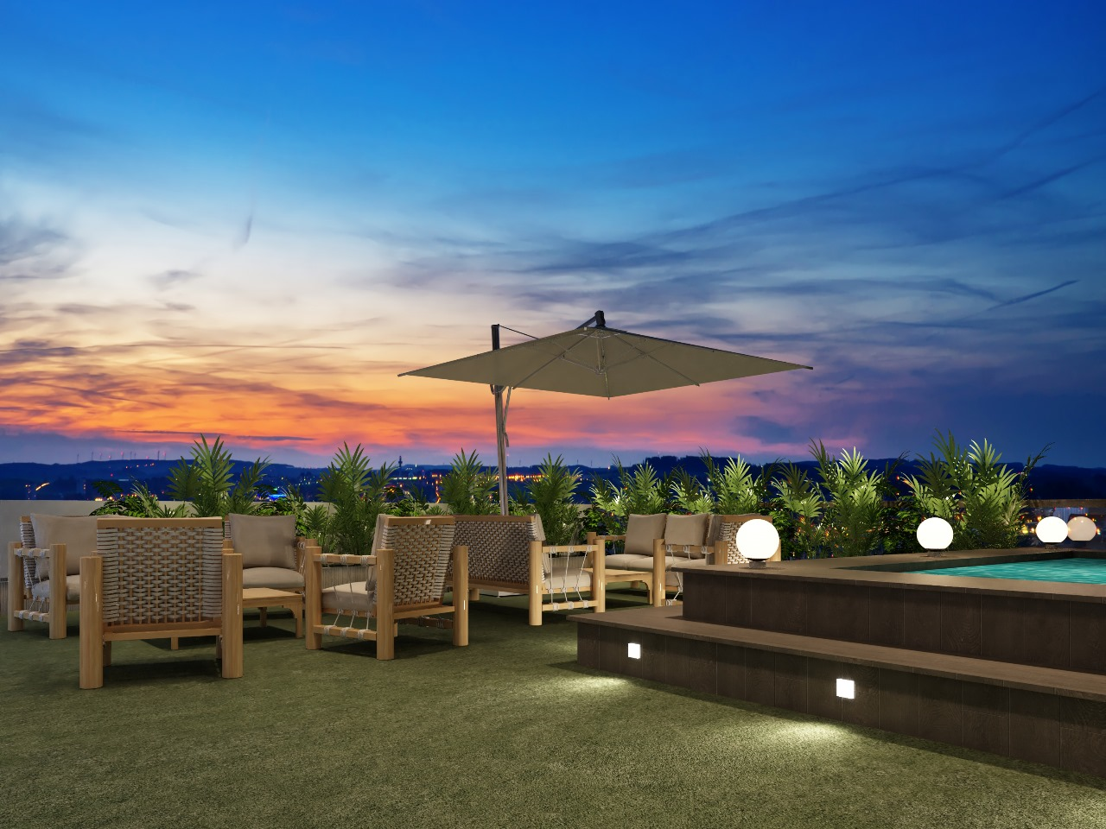

Slide 38
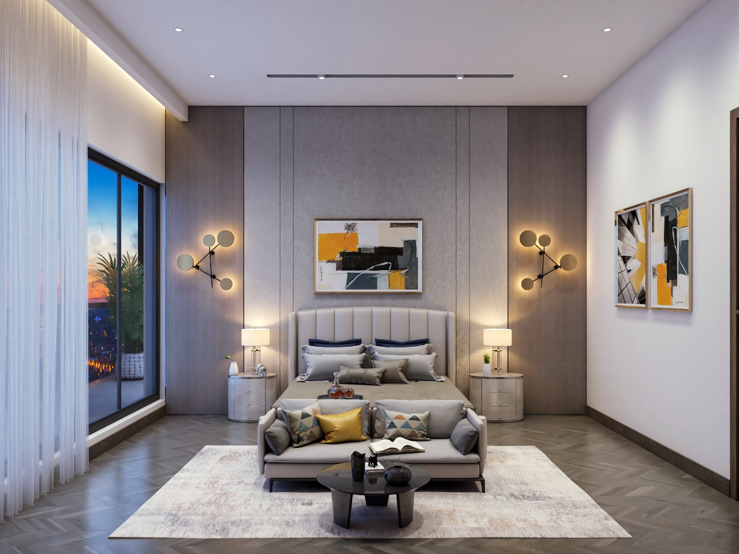

Slide 39
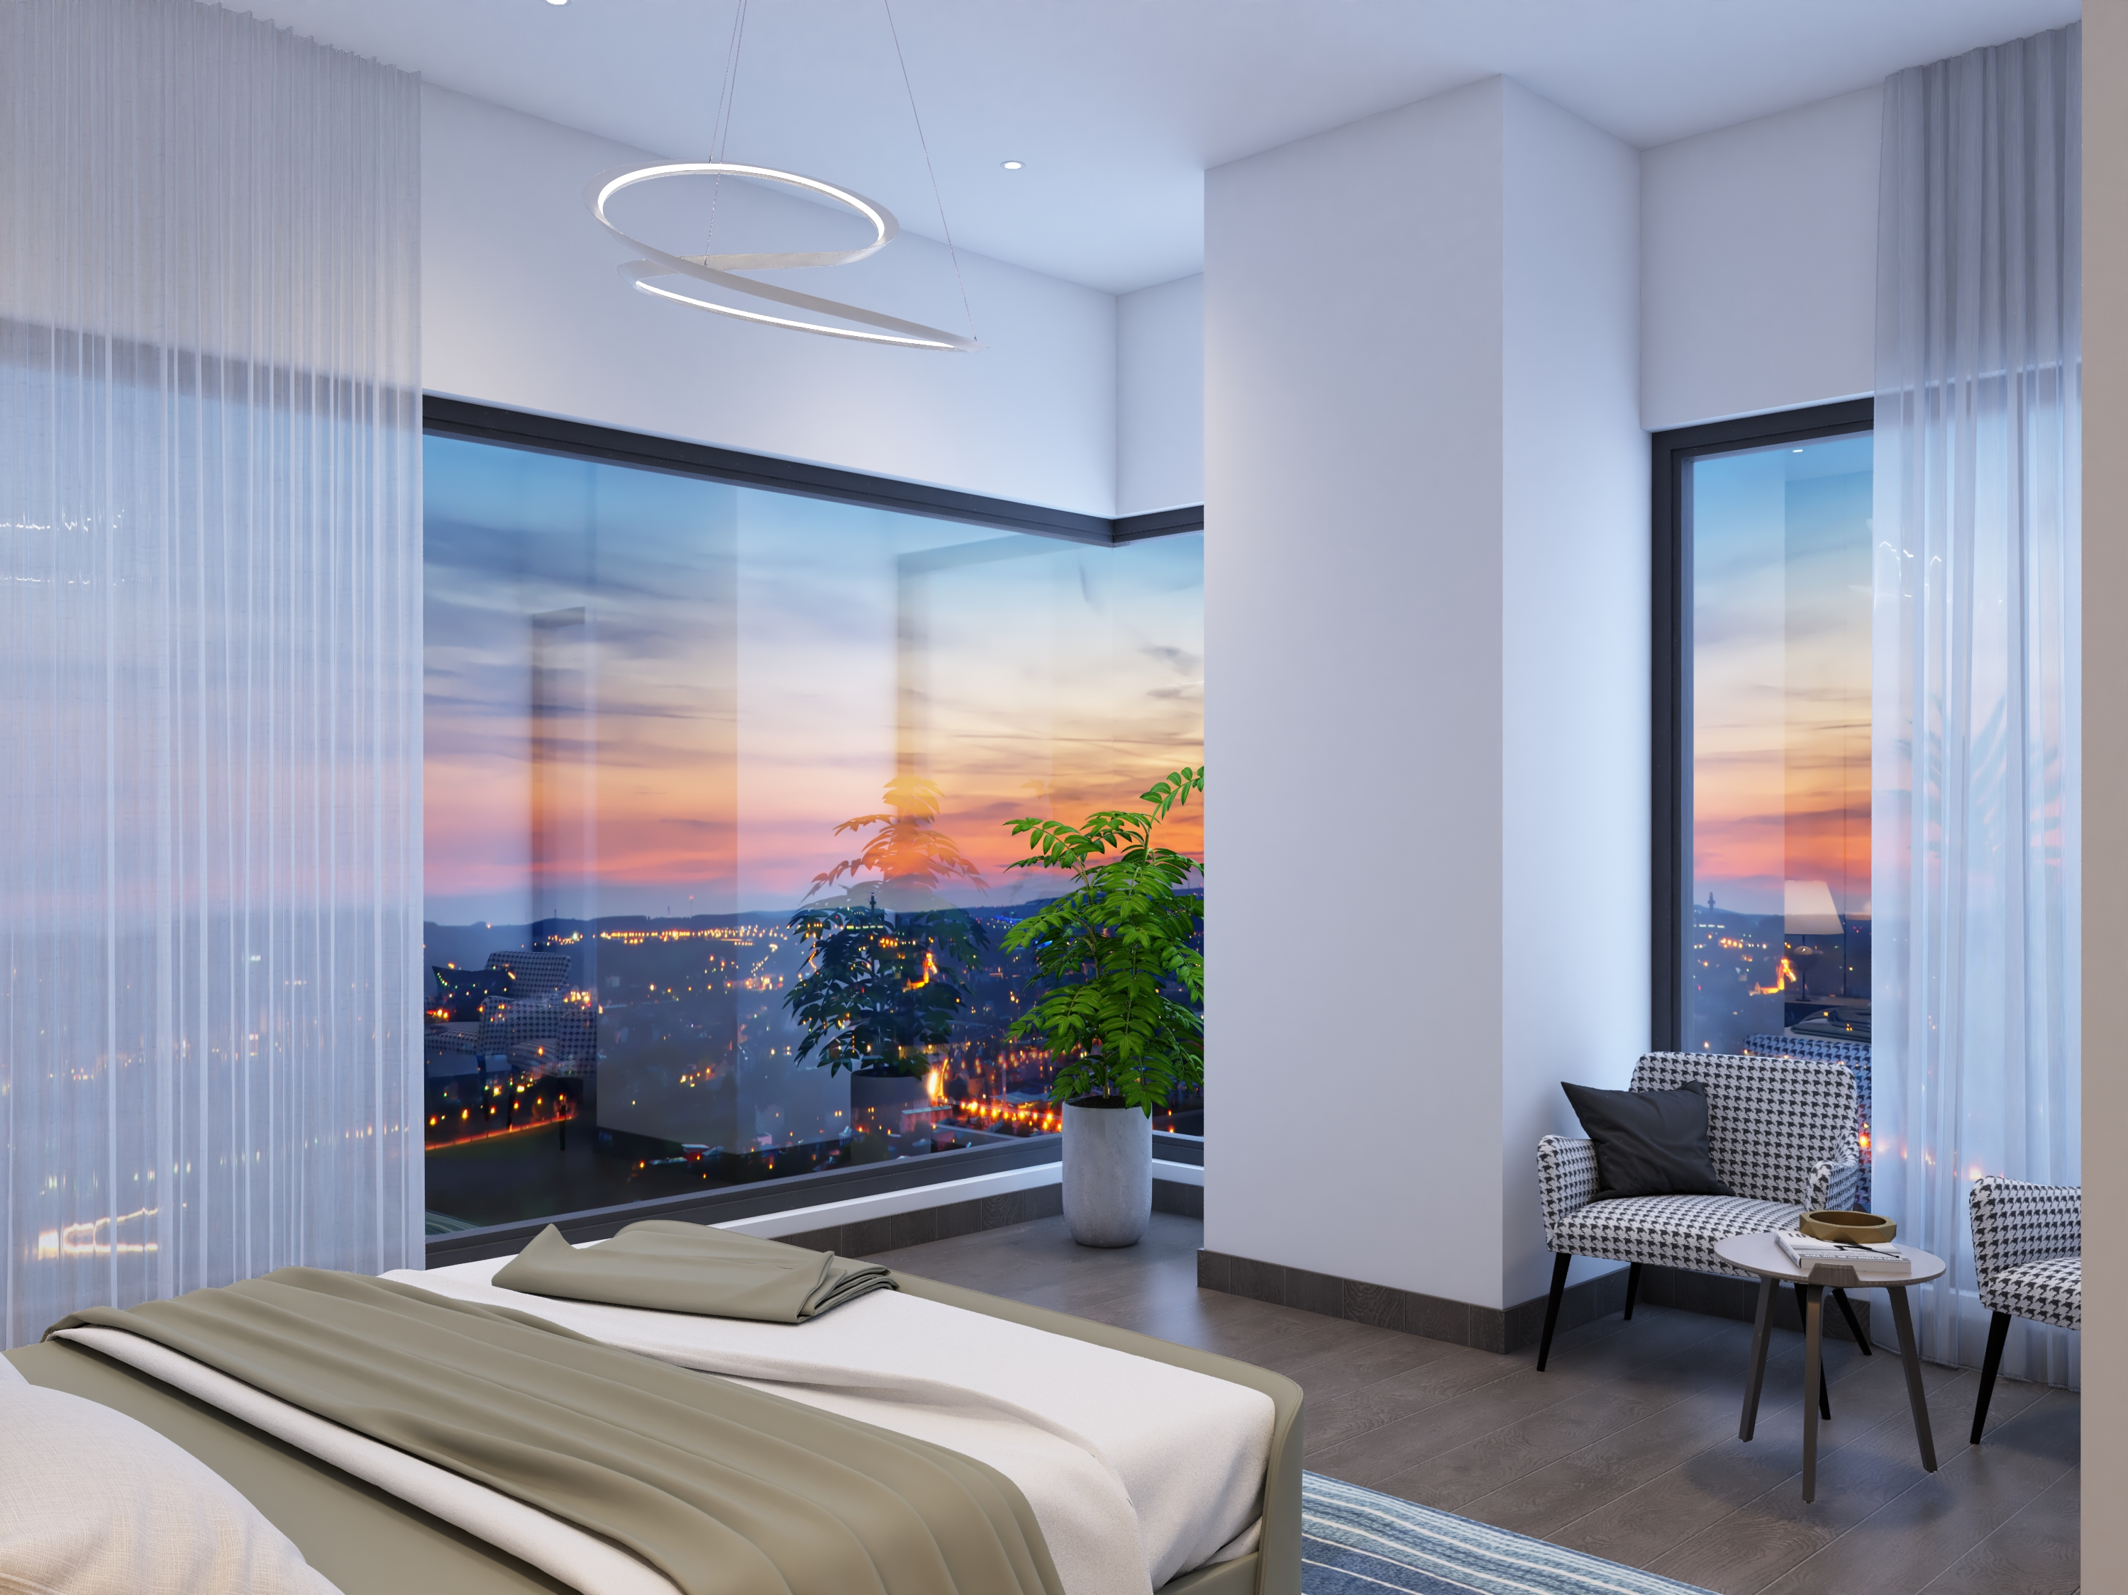

Slide 40
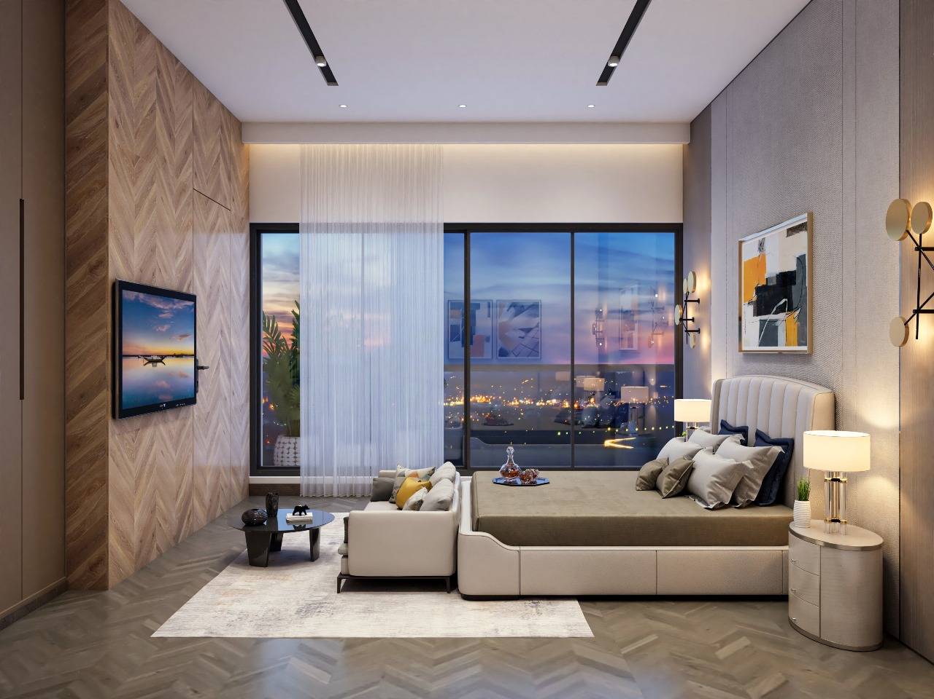

Slide 41
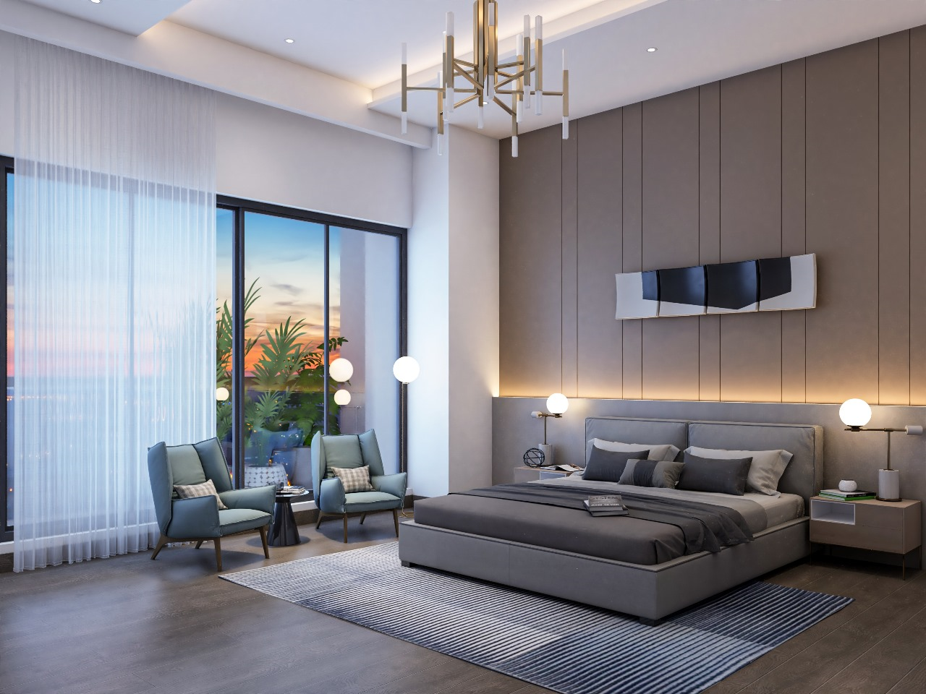

Slide 42
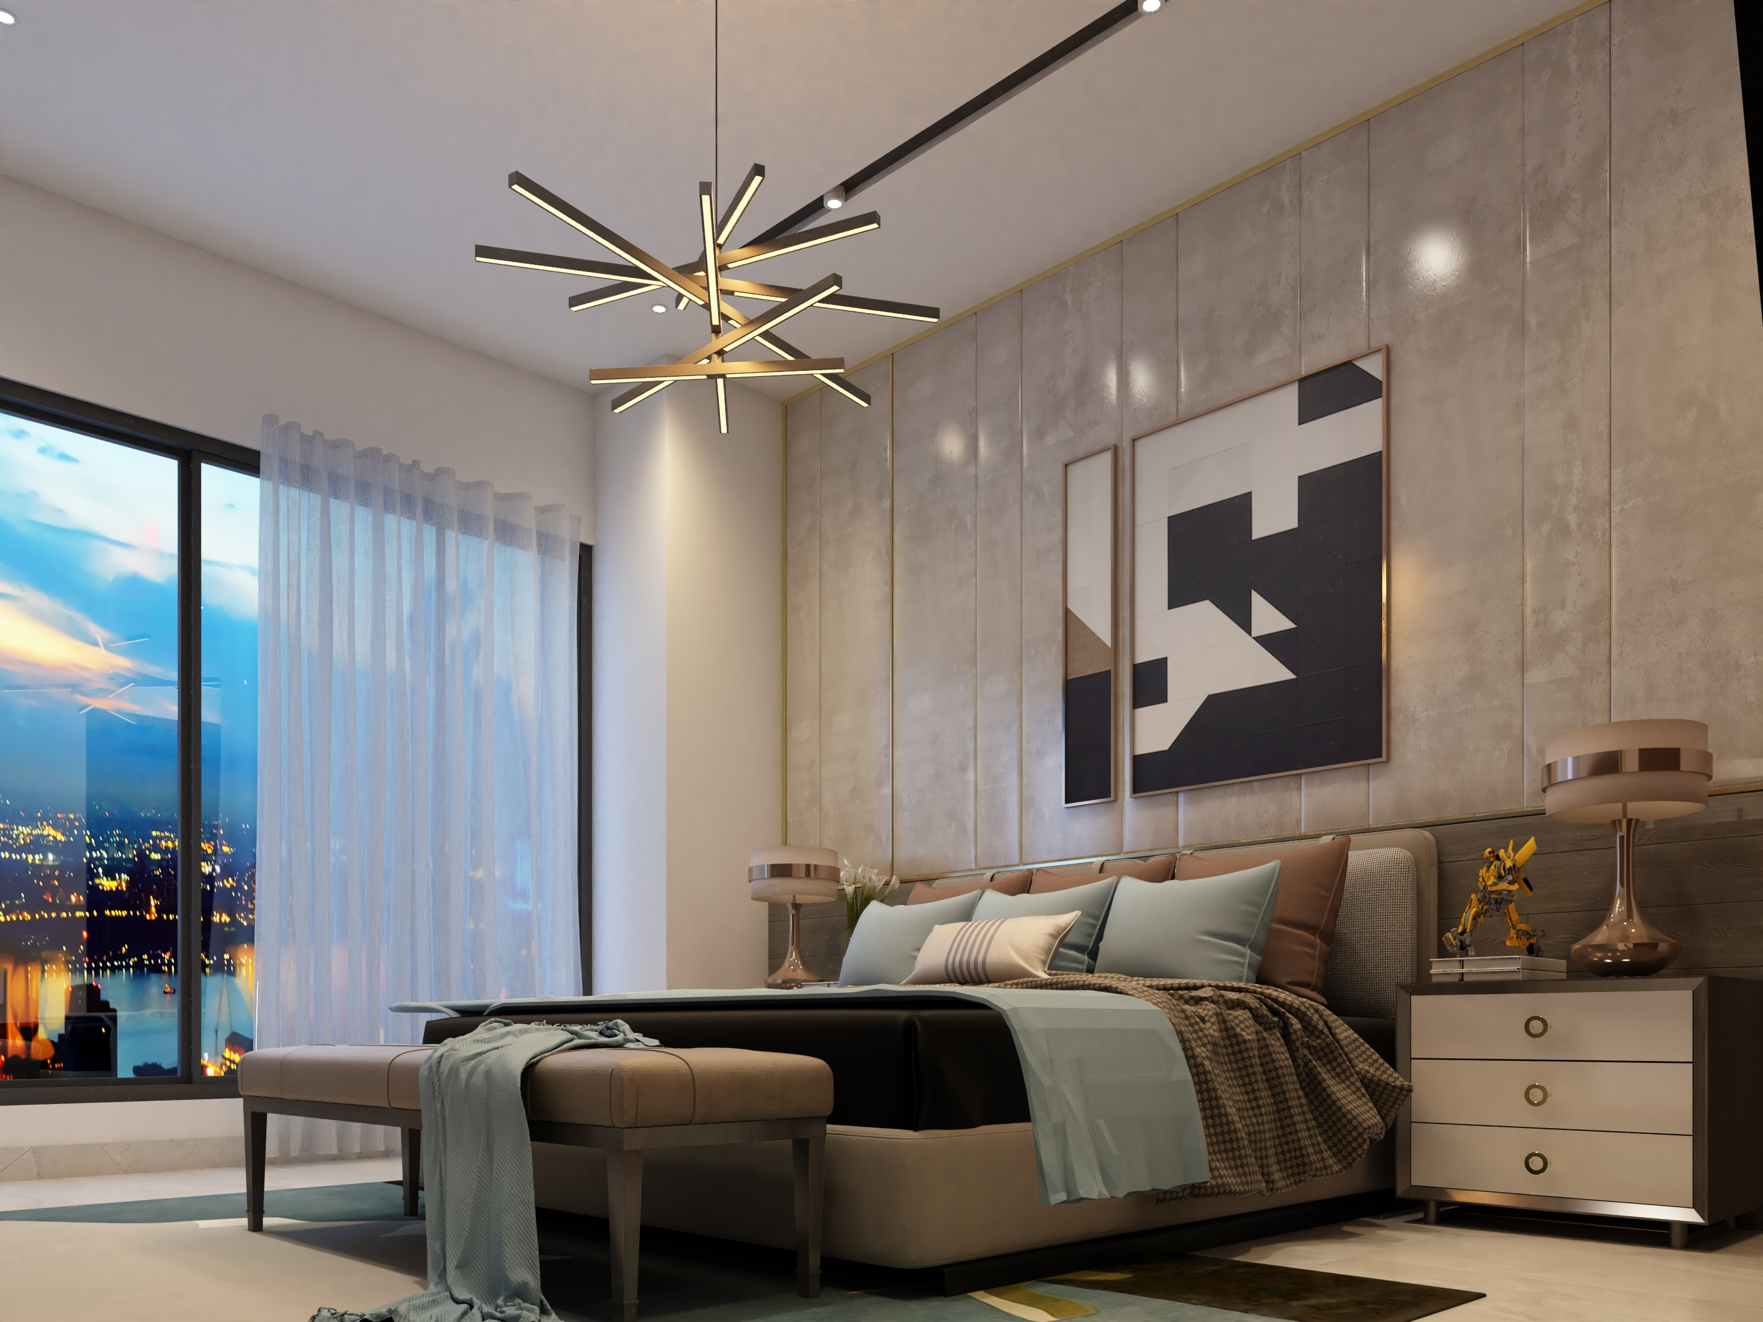

Slide 43
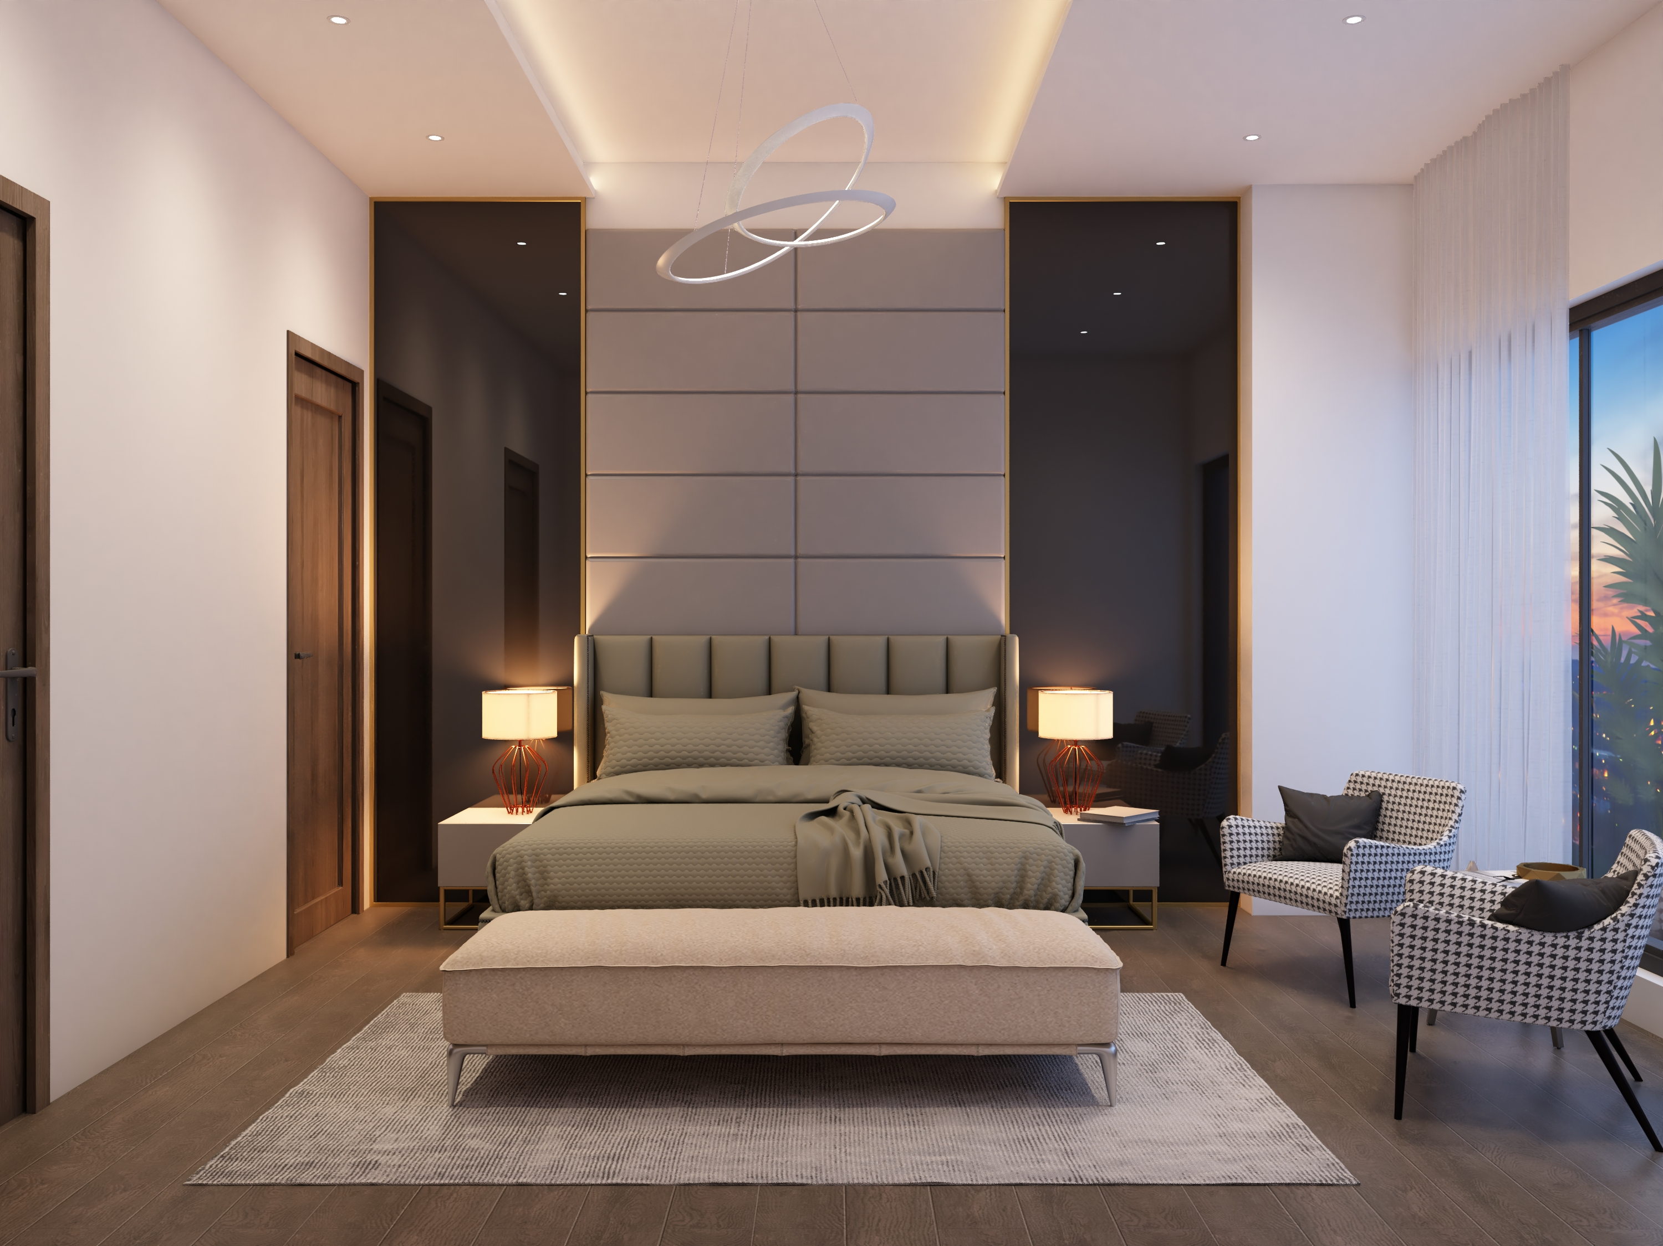

Slide 44
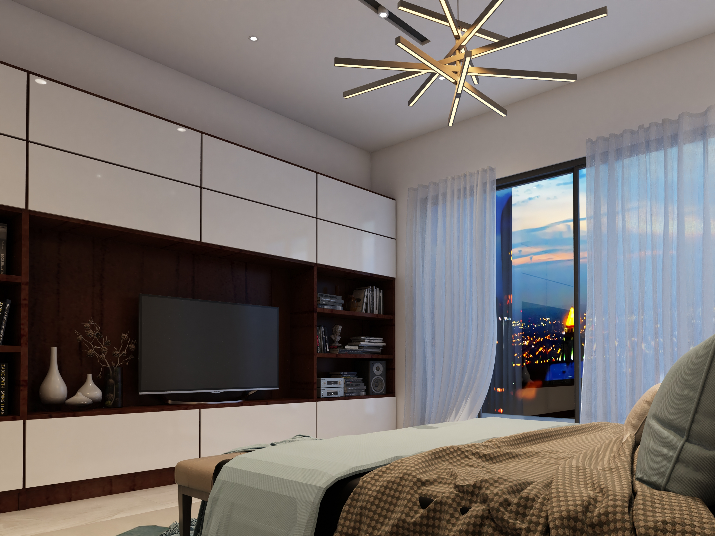

Slide 45
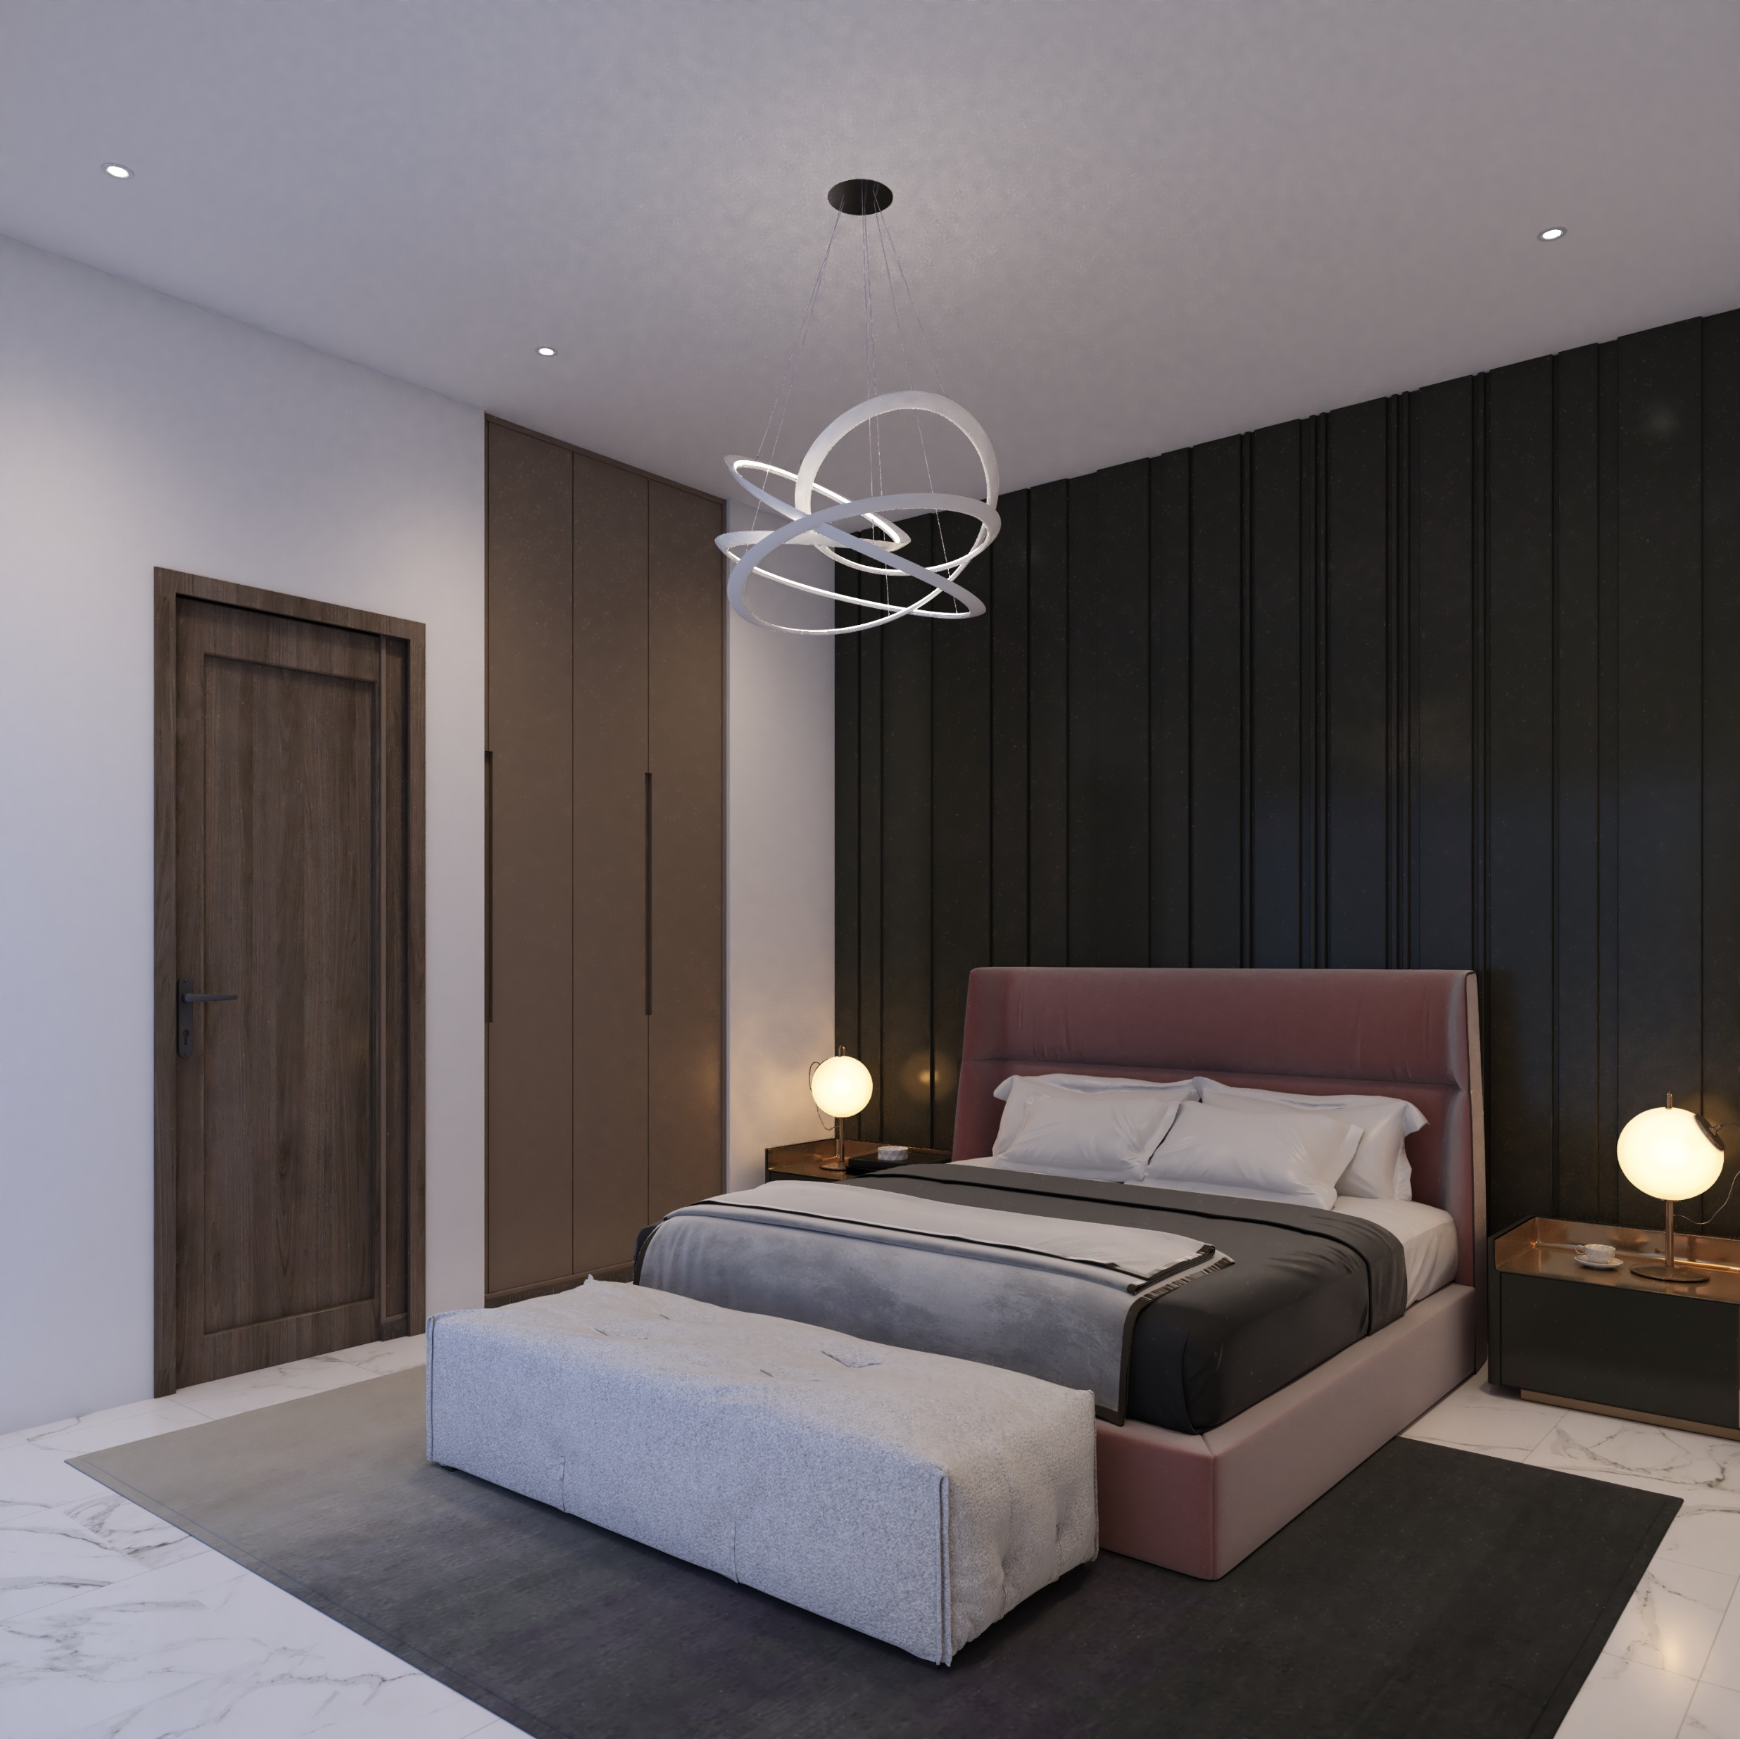

Slide 46
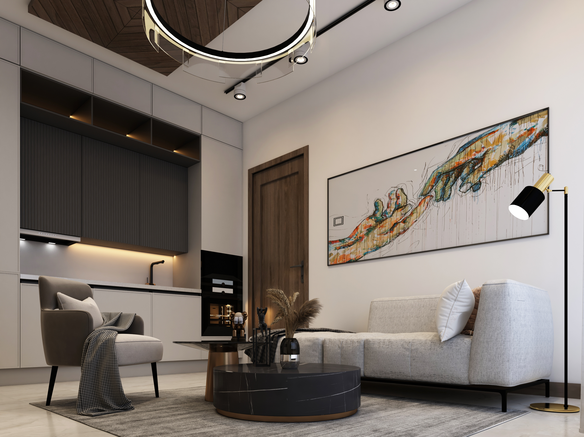

Slide 47
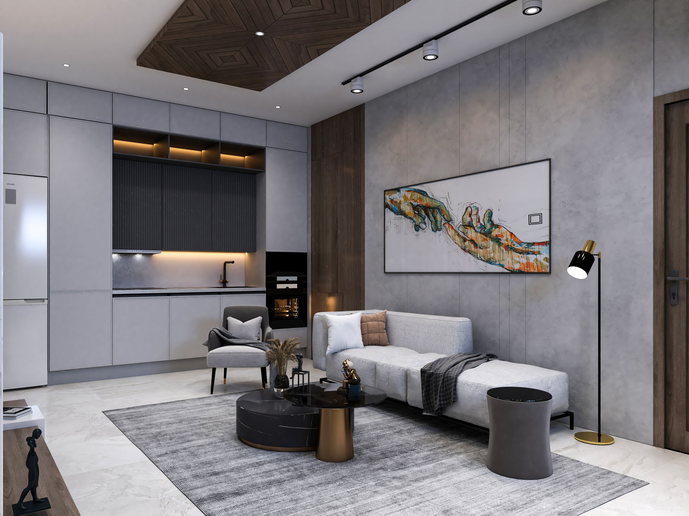

Slide 48
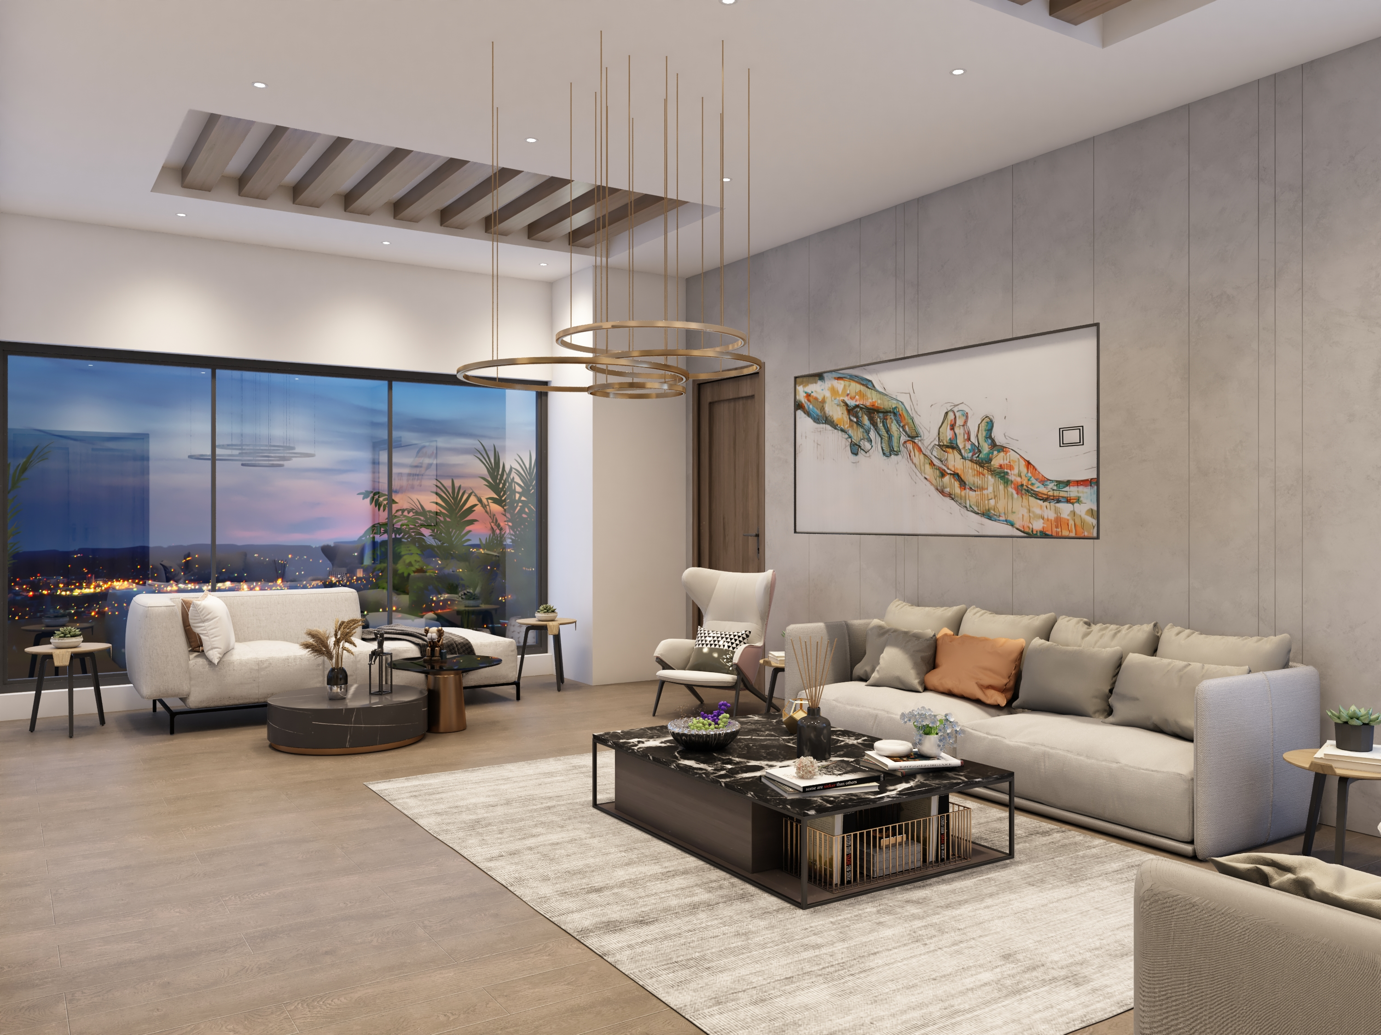

Slide 49
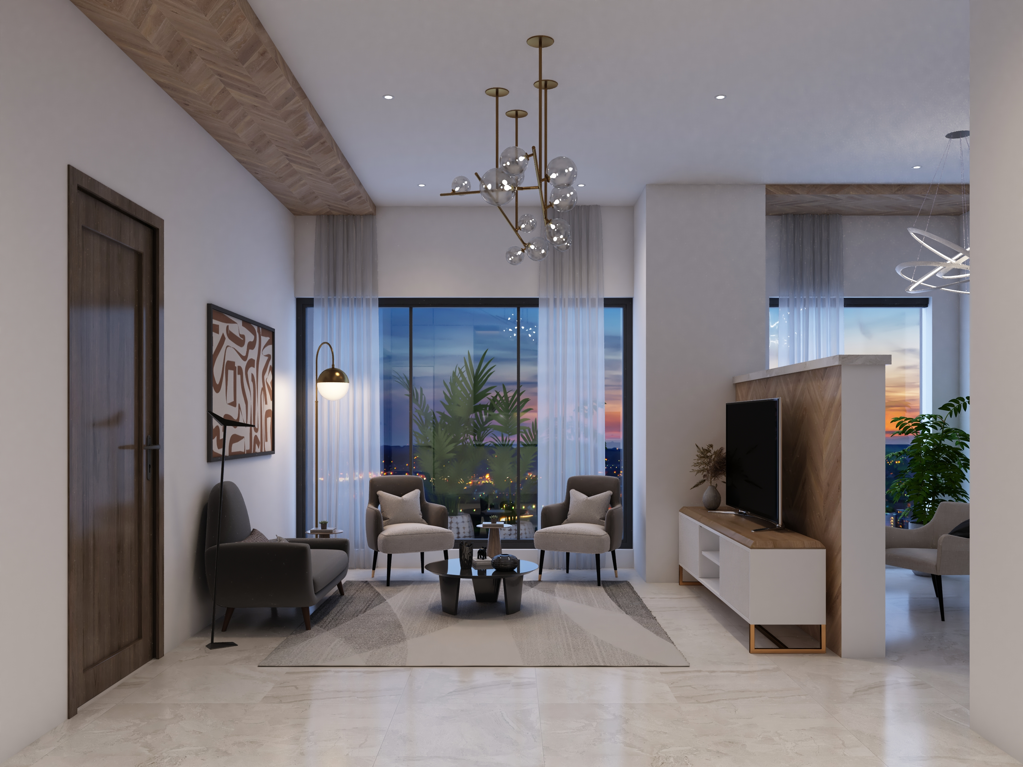

Slide 50
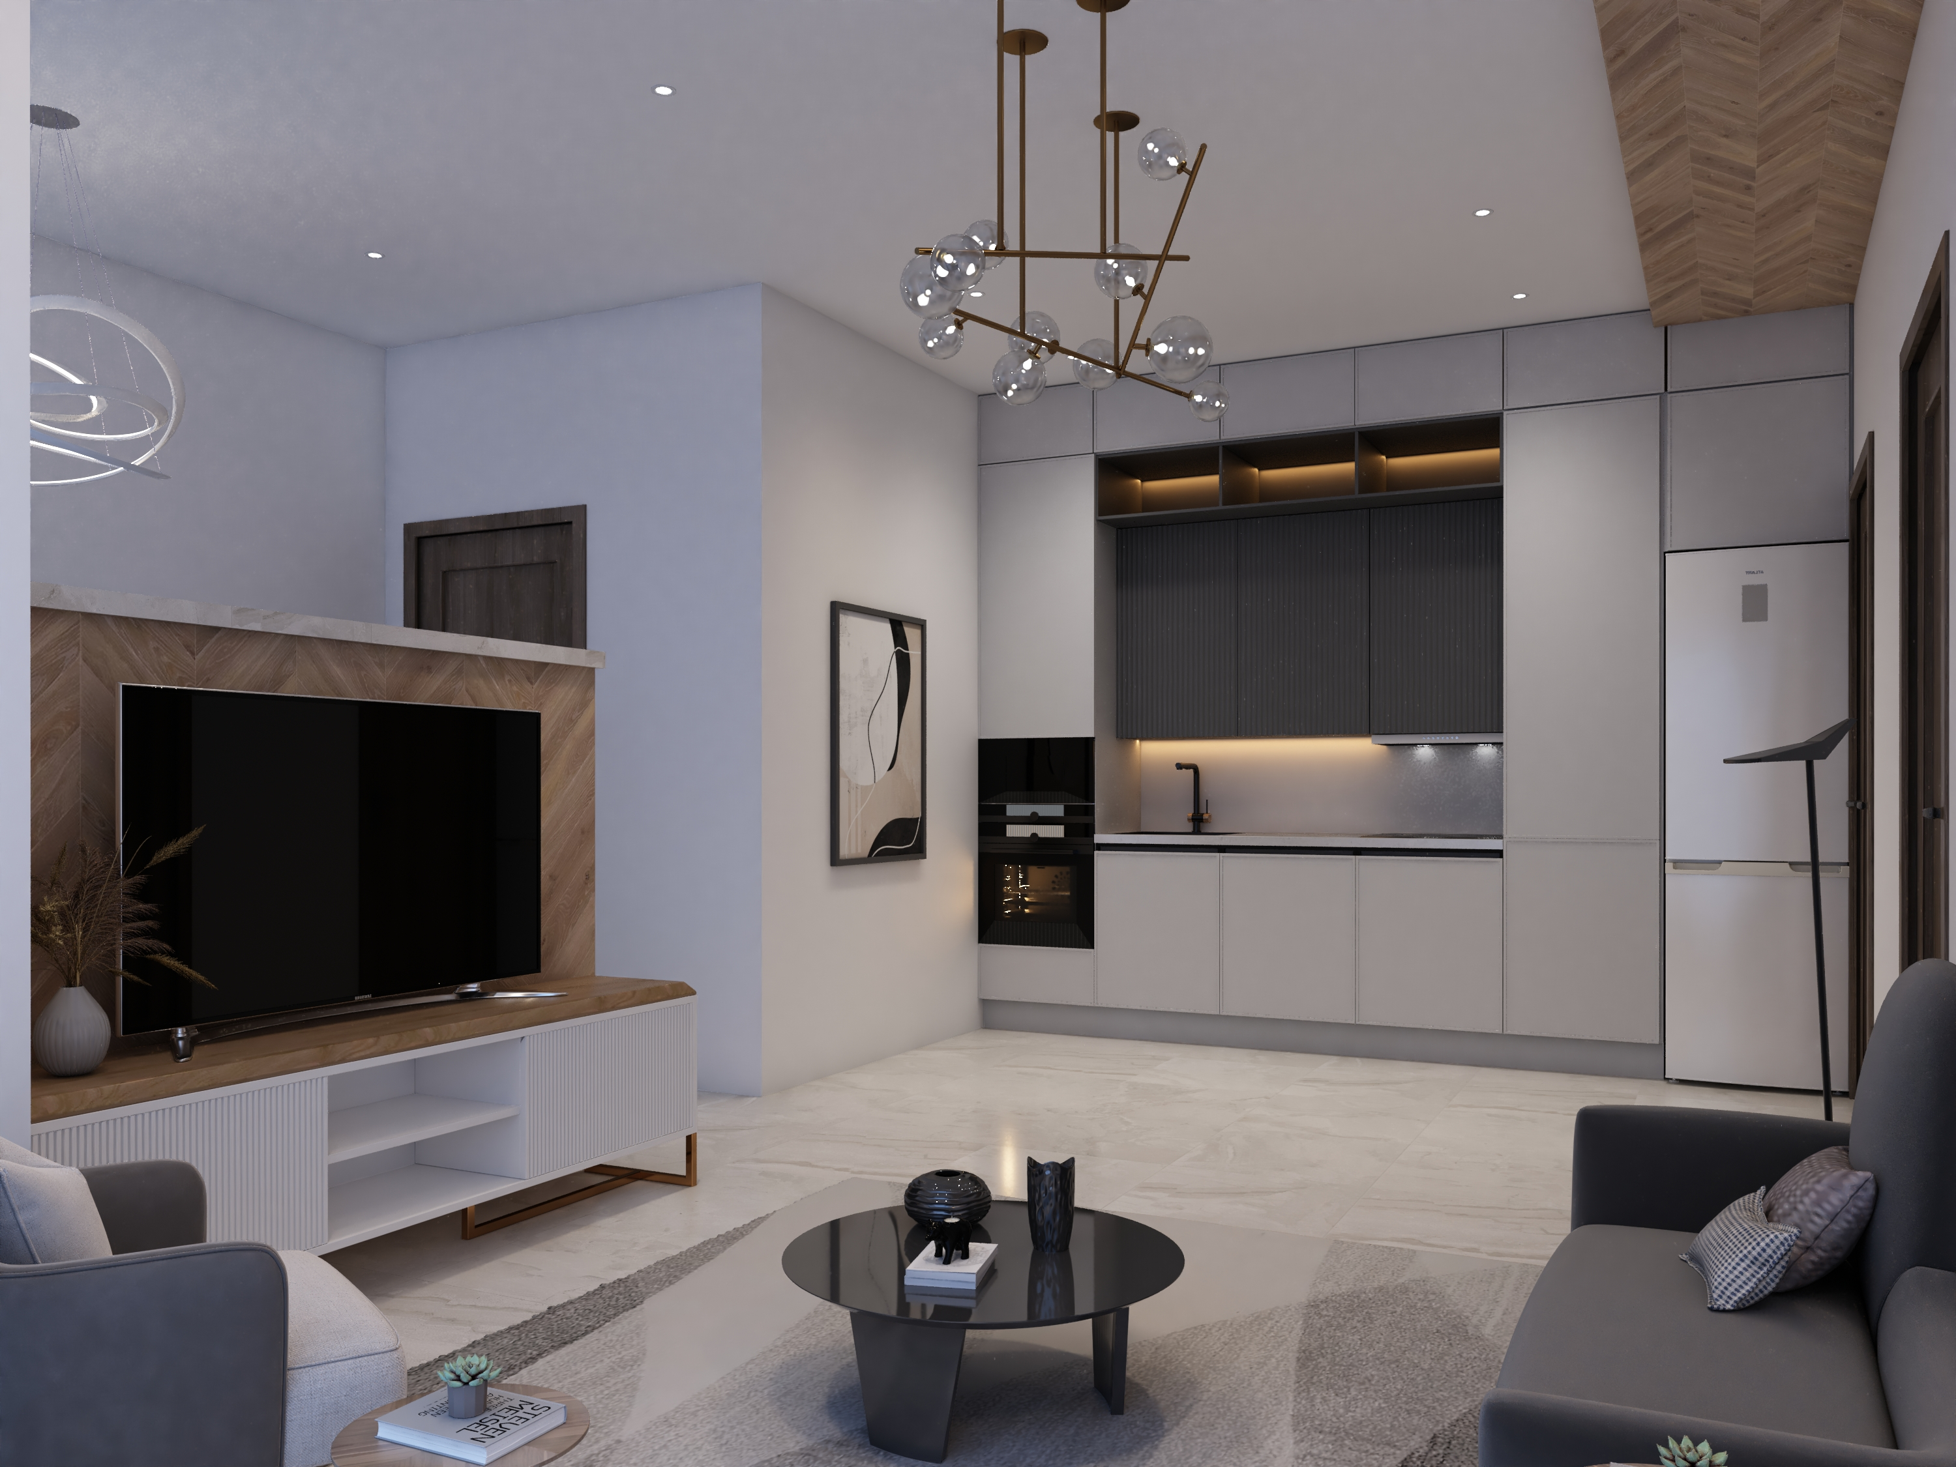

Slide 51
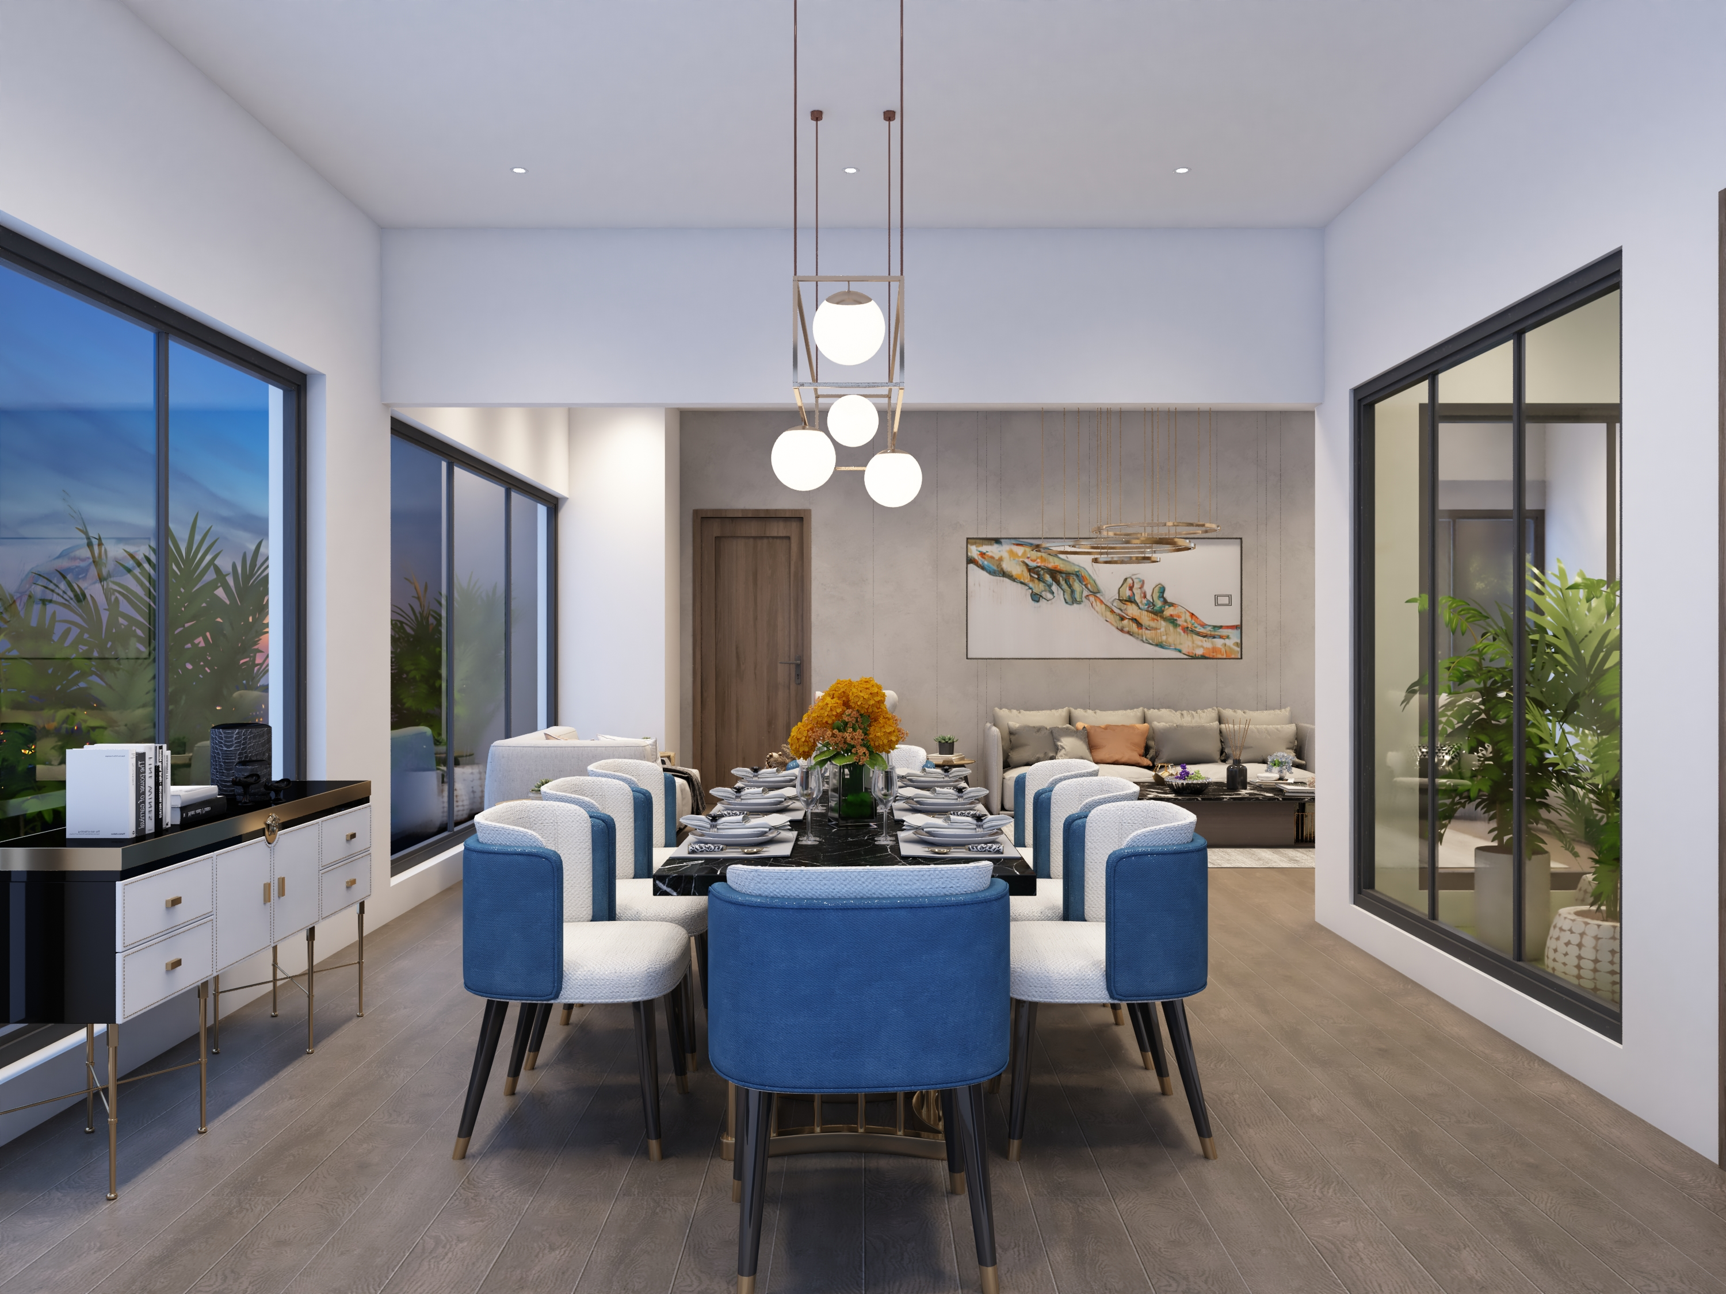

Slide 56
FLOOR
BOOKING START FROM
LOWER GROUND
36.37 Lac
GROUND
53.6 Lac
1ST FLOOR
38.28 Lac
2ND FLOOR
34.45 Lac
3RD FLOOR
14.37 Lac
4TH FLOOR
12.45 Lac
FOOD COURT
45.6 Lac
HOTEL APARTMENTS
46 Lac
RESIDENTIAL APARTMENTS
55 Lac
A PROJECT OF 7-STAR GROUP, MIRPUR AJK

Slide 57
BOOKING FROM 25%
4-YEARS INSTALLMENT PLAN
FOR BOOKINGS CALL: +92 58274 37268 | +92 300 2748007| +92 300 4376007
A PROJECT OF 7-STAR GROUP, MIRPUR AJK

